Slide 1

Bedfordshire, Luton and
Milton Keynes
Diabetic Eye Screening Programme
www.blmkdiabeticeyescreening.nhs.net

Slide 2
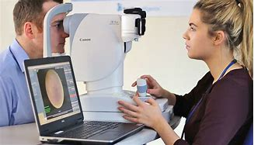
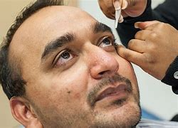
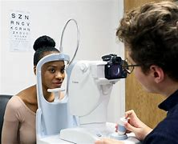
Diabetes Eye Screening
www.blmkdiabeticeyescreening.nhs.net

Slide 3
Who we are and what we do
We are the only provider of NHS specialist diabetic eye screening in Bedfordshire, Luton and Milton Keynes (BLMK).
Eye screening is a key part of diabetes care, and all diabetic patients aged 12 years or older, should have a specialist diabetic eye screening test every year due to the risk of developing diabetic retinopathy which can severely affect their sight.
Screening can detect the condition early and before any changes to the vision are noted by the patient and where needed the patient can be referred into hospital eye services for treatment. Early treatment can prevent severe sight loss.
We provide annual eye screening service to our patients in over 20 locations.
We currently support 80,000 patients with their Diabetes eye screening.
More information can be found on our website: www.blmkdiabeticeyescreening.nhs.uk

Slide 4
Diabetes
There are two main types of diabetes: type 1 and type 2.
When you’ve got type 1 diabetes, you can’t make any insulin at all. If you’ve got type 2 diabetes, which is the most common, it’s a bit different. The insulin you make either can’t work effectively, or you can’t produce enough of it. They’re different conditions, but they’re both serious.
In all types of diabetes, glucose can’t get into your cells properly, so it begins to build up in your blood. And too much glucose in your blood causes a lot of different problems. To begin with, it may lead to diabetes symptoms.

Slide 5
Diabetes - Symptoms
The symptoms can depend on the type of diabetes you have. But the common symptoms of diabetes include:
Going to the toilet a lot, especially at night
Being really thirsty
Feeling more tired than usual
Losing weight without trying to
Genital itching or thrush
Cuts and wounds take longer to heal
Blurred vision
5.6 million people are estimated at living with a diagnosis of diabetes in the UK

Slide 6
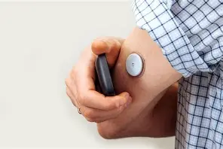
Diabetes - Treatment
Treatment is about trying to keep blood sugars within a target range. Being as active as possible, eating healthy and going for regular health checks will help you do this. Some people will also need to take insulin or other medication and check their blood sugars regularly.
Lots of things can affect blood sugars, so it can be tricky to balance. But it’s possible to lead a full life. It's about being in tune with your body and learning what works for you.

Slide 7

What happens at your eye test
Plan how you'll get to and from the test – do not drive, as your sight may be blurry for a few hours afterwards
Bring all the glasses and contact lenses you wear, along with contact lens solution
bring sunglasses – everything can look very bright for a few hours after the test
eat and drink as normal
You might want to bring someone with you, or ask someone to collect you after the test.

Slide 8
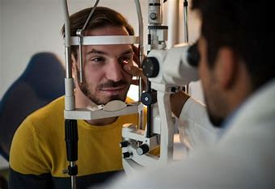

What happens at your eye test
You'll be asked to read some letters on a chart first.
Pictures are taken of the back of your eyes. There will be a bright flash when a picture is taken.
Your appointment will usually last about 30 minutes.
Drops are put in your eyes. These may sting for a few seconds.
The drops make your sight blurry after about 15 mins.
When they start working we will take an image of your eye.

Slide 9
After the test
You can go home when the test is finished.
Your sight may be blurry for up to 6 hours after the test – do not drive until it goes back to normal
everything can look very bright – wearing sunglasses can help
You will not get your test result on the day.
You'll get a letter about your result within 6 weeks.

Slide 10
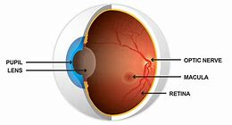
What do we check for?
Diabetic eye screening checks for signs of diabetic retinopathy and other eye problems caused by diabetes and monitor the health of your eyes if you are pregnant and have type 1 or type 2 diabetes. Gestational diabetes can be treated through changes in diet and usually goes away once the baby is born. You will not be offered diabetic eye screening if you develop gestational diabetes.
www.blmkdiabeticeyescreening.nhs.net
Notes:
Plain slide with subhead and bullets

Slide 11
Why do we offer regular Eye Screening check ups?
People with Diabetes are at a greater risk of Diabetic Retinopathy if you:
Have had diabetes for a long time
Have poorly controlled diabetes
Have high blood pressure
Are pregnant
Are of Asian or Afro-Caribbean ethnic background
www.blmkdiabeticeyescreening.nhs.net

Slide 12
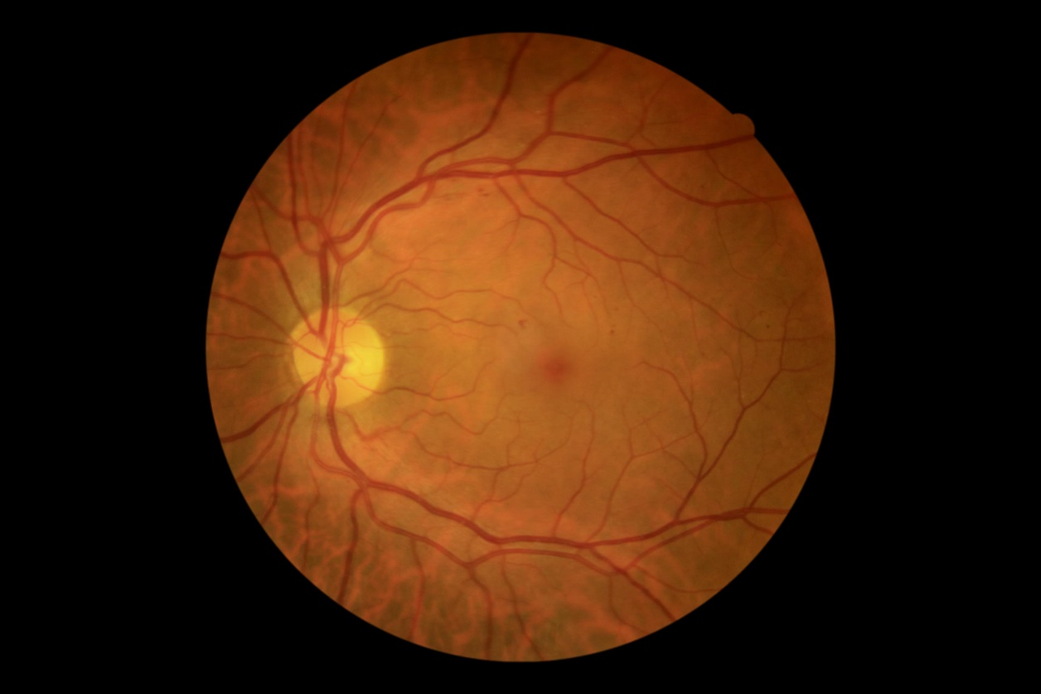
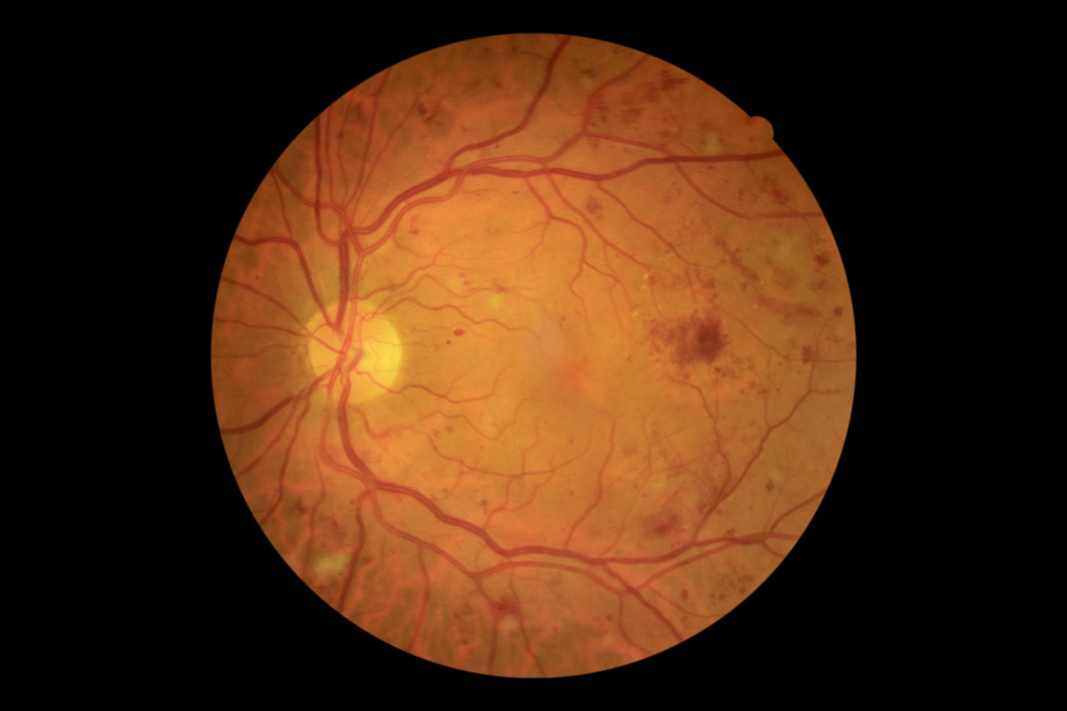
Diabetic Retinopathy
Left Eye with no Retinopathy
Left Eye with Retinopathy grade 3
www.blmkdiabeticeyescreening.nhs.net

Slide 13
What is Retinopathy?
Background Retinopathy This means that tiny bulges (microaneurysms) have appeared in the blood vessels in the back of your eyes (retina), which may leak small amounts of blood. This is very common in people with diabetes.
At this stage your sight is not affected, although you're at a higher risk of developing vision problems in the future
you do not need treatment, but you'll need to take care to prevent the problem getting worse. The chances of your sight getting worse are higher if both of your eyes are affected
Pre-proliferative Retinopathy
This means that more severe and widespread changes are seen in the retina, including bleeding into the retina.
There's a high risk that your vision could eventually be affected you'll usually be advised to have more frequent screening appointments every 3, 6, 9 or 12 months to monitor your eyes
Proliferative Retinopathy
This means that new blood vessels and scar tissue have formed on your retina, which can cause significant bleeding and lead to retinal detachment, where the retina pulls away from the back of the eye. There's a very high risk you could lose your vision, treatment will be offered to stabilise your vision as much as possible, although it will not be possible to restore any vision you've lost.
www.blmkdiabeticeyescreening.nhs.net

Slide 14
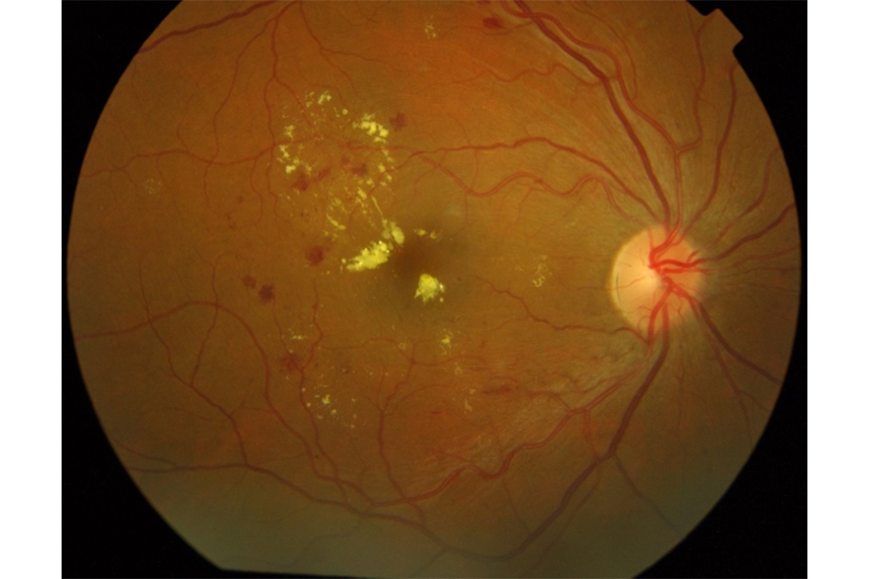
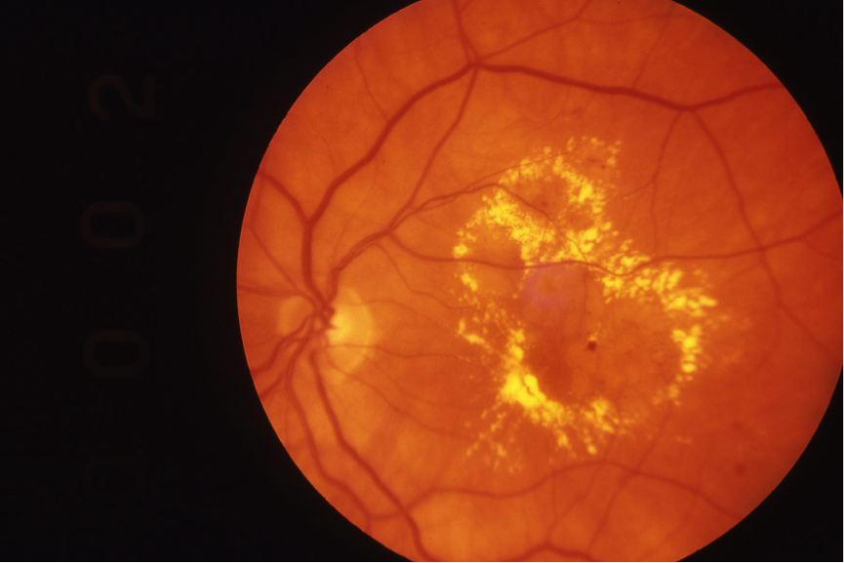
Maculopathy
www.blmkdiabeticeyescreening.nhs.net

Slide 15
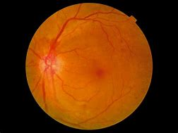
What is Maculopathy?
In some cases, the blood vessels in the part of the eye called the macula (the central area of the retina) can also become leaky or blocked. This is known as diabetic maculopathy. If this is detected there's a high risk that your vision could eventually be affected you may be advised to have more frequent specialised testing to monitor your eyes you may be referred to a hospital specialist to discuss treatments that can help stop the problem getting worse.
The macula is the small central part of the retina that you use to see things clearly. It is the most used area of the retina and is the part you are using now to read this. If you have this you will need to be seen more regularly and offered treatment to reduce your risk of sight loss.
Optic Nerve
Macula
www.blmkdiabeticeyescreening.nhs.net

Slide 16
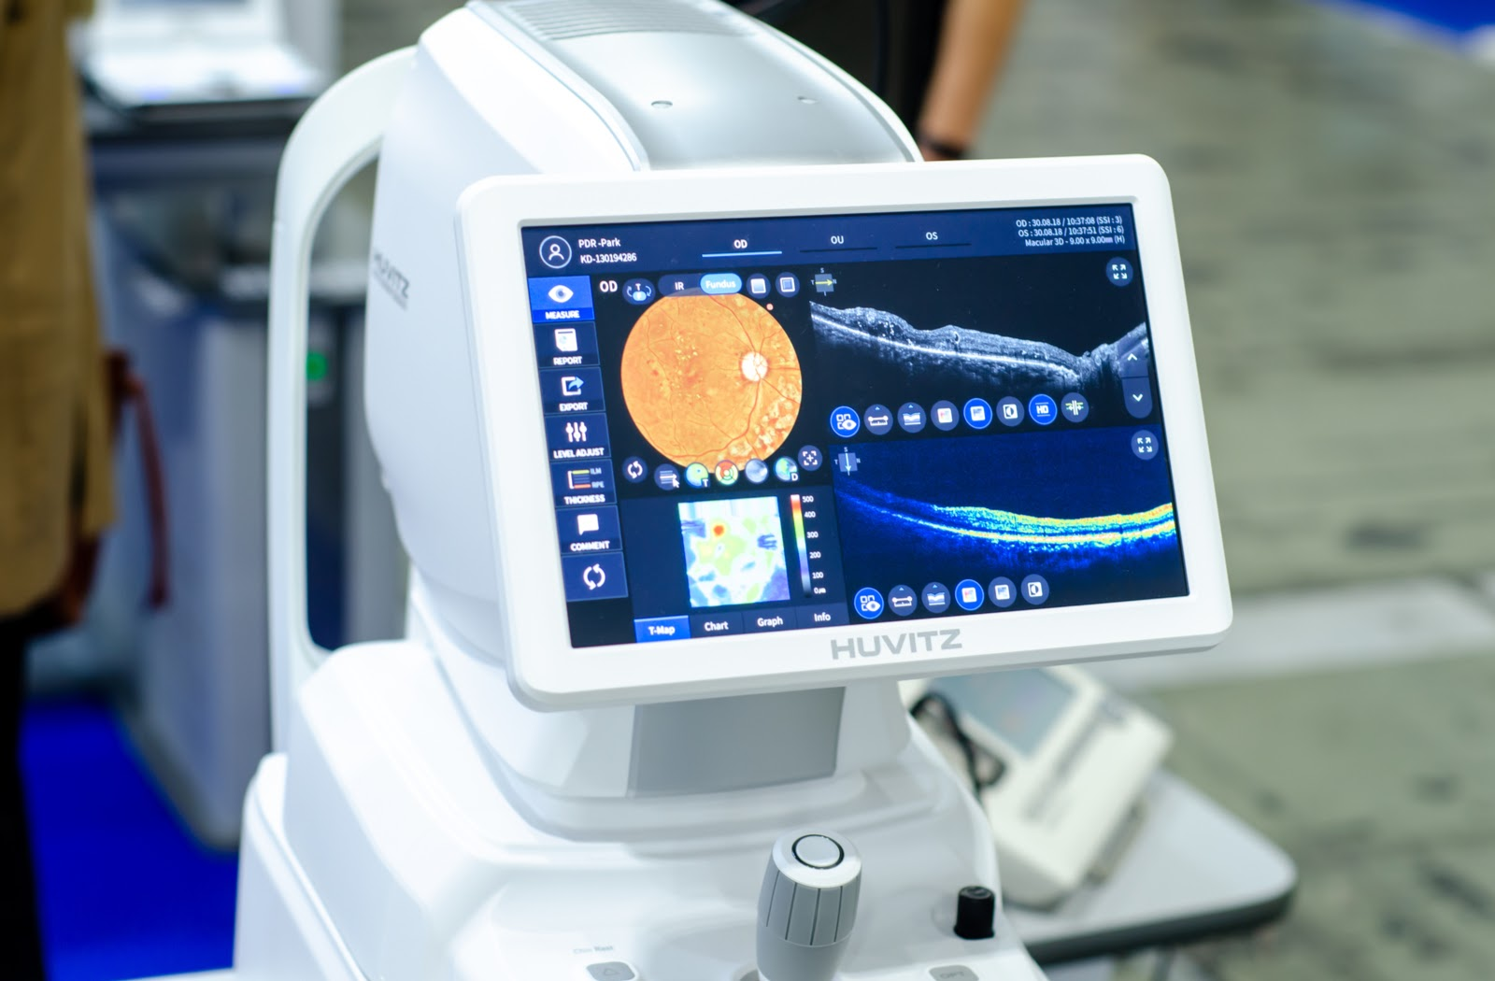
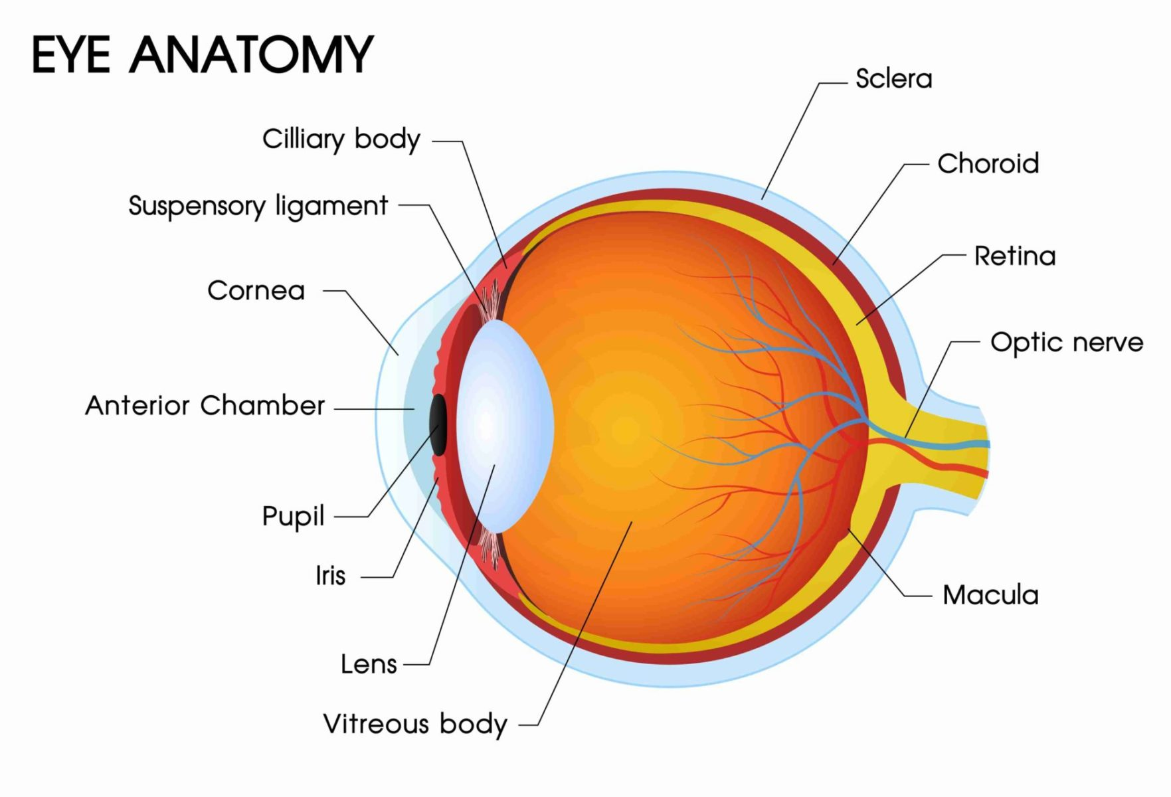
What is Optical Coherance Tomography (OCT)?
Optical Coherance Tomography (OCT) is a non-invasive imaging test, widely used in the field of Ophthalmology. An OCT scan provides a high resolution, cross sectional image of the ocular tissues at the back of the eye. The scanning uses light waves to achieve high resolution pictures.
Optic Nerve
Macula
The most regular scans performed by the OCT scanner are a macular OCT (a small area in the retina that deals with fine, detailed vision) and an optic disc OCT (the head of the optic nerve)
www.blmkdiabeticeyescreening.nhs.net

Slide 17

How to contact us:
Our main office contact number is 01234 795861
www.blmkdiabeticeyescreening.nhs.uk
Optic Nerve
Macula
www.blmkdiabeticeyescreening.nhs.net

