Slide 1




BLMK ICS Digitising Social Care (DiSC) Programme
MiiCare self-help guide
Email the team: blmkicb.digital.socialcare@nhs.net
Visit our DiSC webpages: https://blmkhealthandcarepartnership.org/our-priorities/
data-and-digital/digitising-social-care-disc-programme/

Slide 2
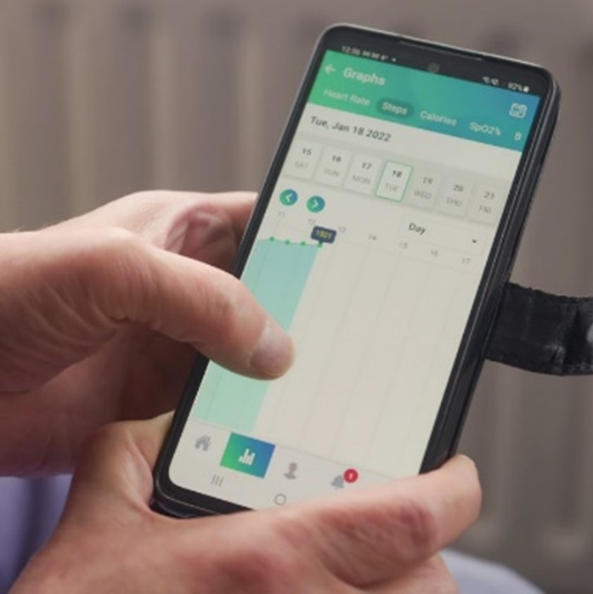

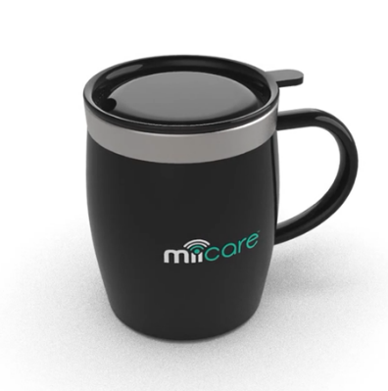
MiiCare
25% reduction in routine site contacts
An assistive technology platform supporting vulnerable adults to live independently at home. A ‘virtual assistant’ called Monica checks on wellbeing and daily routines to help users to stay safe and well at home.
MiiCare is suitable for people who are at risk of falls or urinary tract infections, or who have recently left stroke or neurological units.
39 residents supported through 39 installations
Helps people stay in their own home, safely and for longer​
A central MiiCare hub is connected to a set of devices and sensors around the home – such as door sensors, mugs and watches
Helps reduce hospital admissions​
Prompts actions important for wellbeing​ – such as
reminders to take medication and have a drink
Gives reassurance to family members and alerts them
in case of emergency.​
“Thanks to the MiiCare app I have assurance at my fingertips! This little box has taken away some of the worry, without removing my mother’s sense of self or independence.”
‘Karen’ (not her real name),
whose mother uses MiiCare

Slide 3
Getting set up
What will MiiCare cost?
BLMK ICS have fully funded the project including installation for the next two years.
This project is dependent on future funding to cover ongoing costs.
Do I need WiFi?
No. A dongle can be provided if you do not have the internet.
How do I refer a potential resident?
Email blmkicb.digital.socialcare@nhs.net for information about the criteria and a referral form.
We will email you to let you know if your referral has been successful or unsuccessful.
We will contact you to arrange an online meeting (on Microsoft Teams) to discuss MiiCare and answer any questions you have. We will arrange an installation date, and explain about the necessary consent forms.

Slide 4
Installation
Who installs the MiiCare kit?
We will call the individual or their next of kin to arrange an installation date that is suitable for them, and a member of the BLMK team will install the kit.
The installation can take between 1-2 hours. There is no cost to install the kit.
How simple is the installation?
MiiCare is simple and hassle-free, with no need to pair devices.
Does MiiCare need to be monitored?
Yes. Alerts will come via the dashboard/app, so someone in your team needs to monitor this. This can be accessed via an app on a phone or computer. SOS alerts can be set up to three different numbers for when the individual calls out for assistance.

Slide 5
About Monica
How does Monica work?
Monica can gently remind the person to take their medicine, drink water and stay active.
She can congratulate them on their step goals, and can also remind them when appointments are due.
These personalised interactions proactively engage with older users to encourage an acceptance of technology, and also provide companionship.
Monica is ready for emergencies – just shout “I need help!” to raise her, or press the SOS button to send an alert and message to caregivers.
Does Monica communicate in other languages?
Yes, Monica can communicate in a number of other languages including French, Arabic and German (other languages are in development). Please specify your language requirement on the referral form.

Slide 6
Further questions
How do I report an issue with the MiiCare kit (such as not connecting or the app not working)?
Please contact the team at blmkicb.digital.socialcare@nhs.net
Or contact MiiCare: support@miicare.co.uk
What if I no longer want my MiiCare kit?
Please contact the team at blmkicb.digital.socialcare@nhs.net who will reply to arrange collection of the MiiCare kit.
How do I restart using my MiiCare kit?
Support including videos of troubleshooting can be found on MiiCare’s website: www.miicare.co.uk

Slide 7
Find out more
Visit MiiCare’s website: www.miicare.co.uk
Read a local case study: www.blmkhealthandcarepartnership.org/new-technology-helping-people-to-stay-safely-in-their-own-homes

