Slide 1
A new approach to health and care
Dr Rima Makarem
Chair, Bedfordshire, Luton and Milton Keynes Integrated Care Board

Slide 2

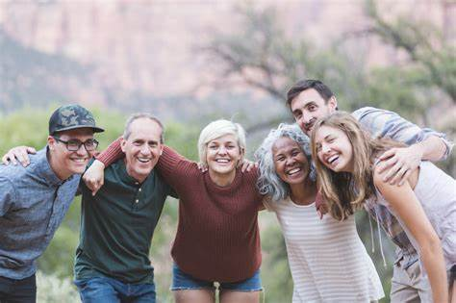
A better future
1
Our aim is simple. We want everyone in our towns, villages and communities to live a
longer, healthier life.
By working together with local people, the Integrated Care System achieve this by:
improving the health of the population
reducing inequalities between different groups
improving the productivity of our services
contributing towards social economic development.

Slide 3
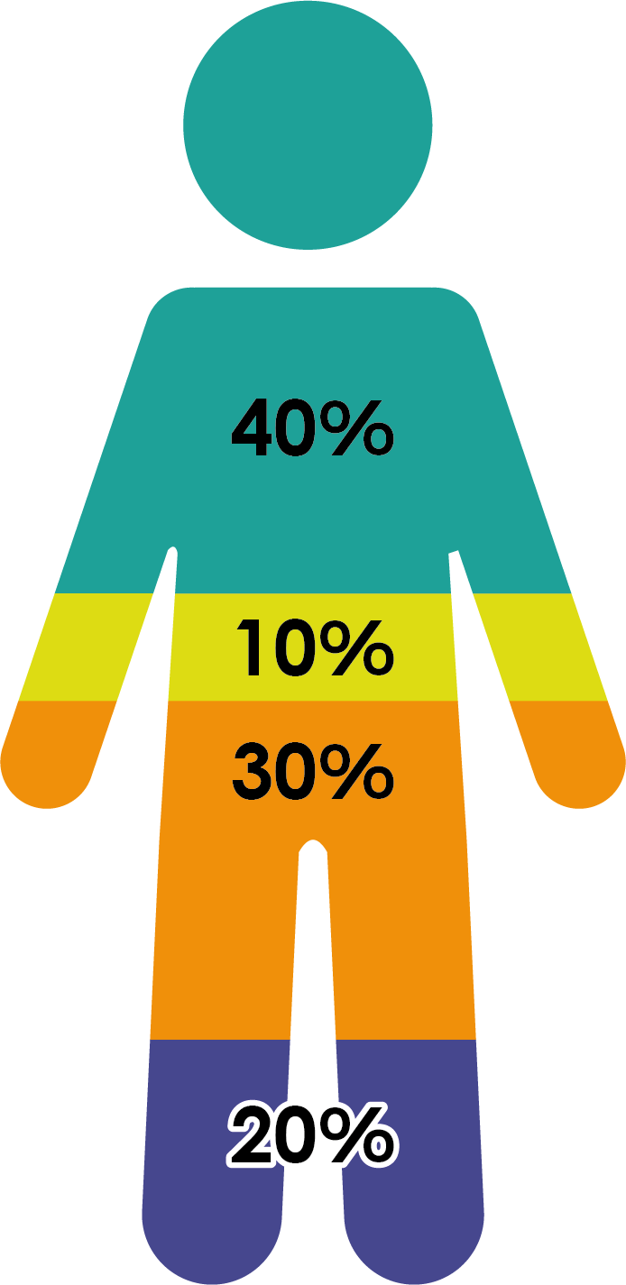
What contributes to a person’s health?
2
Socioeconomic factors
Physical environment
Health behaviours
Healthcare

Slide 4

We’re already making changes
3
Margaret’s story…
Margaret collapsed while taking her dog for a walk near her home and was rushed to Milton Keynes Hospital
Once she had her CT scan, doctors were able to view the scans instantly on their smartphone using the AI-powered software. They also used the software to analyse and identify any areas of the brain that may be damaged. Doctors were able to share the images with their colleagues at Oxford University Hospitals for expert advice using the mobile app. Margaret was then was quickly diagnosed with a stroke and transferred to John Radcliffe Hospital for a thrombectomy.
The rapid diagnosis, transfer and treatment of Margaret which was aided by the AI-powered software, allowed Margaret to return home after a few days in hospital and recover from this serious illness.
You can watch a video on Margaret’s story here – https://vimeo.com/595431160.

Slide 5
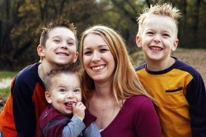
We’re already making changes
4
Helen’s story…
Helen was referred to the Integrated Community Services team (ICST) for social, financial and isolation reasons.
She was experiencing physical, mental and sexual assault from her partner, while living with her 3 children in a 2 bed flat and also suffered with depression, self-harm and low self-esteem.
The team worked together with the local council, school and Children and Family Practice to get the family rehoused and to provide ongoing support including finances which enabled her to break the cycle.
She was supported to look for work and re-train, all while accessing talking therapies.
The young woman and her children are now happy and settled in their new home and the children are still attending their old school.

Slide 6
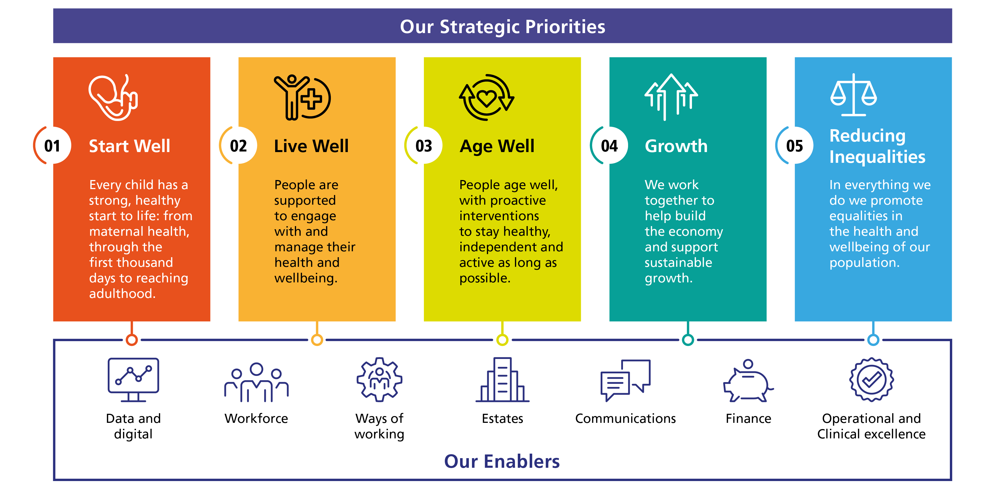
So how will we make the change we want to see?
5

Slide 7
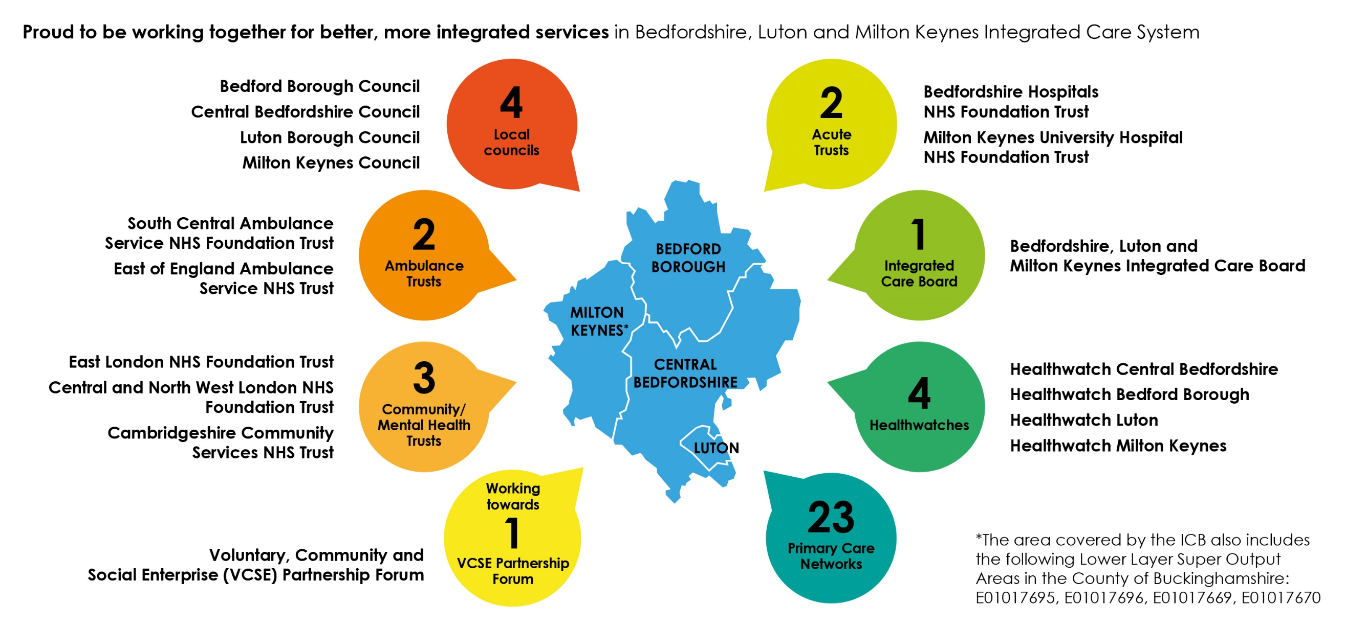
Who is involved in our system?
6
Organisations who provide health and care services in Bedfordshire, Luton and Milton Keynes.

Slide 8
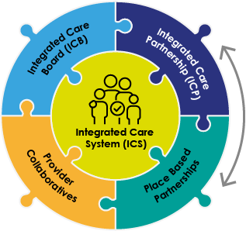
So, how does the system work?
7
Called the BLMK Health and Care Partnership. All partners, including Healthwatch and the voluntary sector, working together to set the integrated health and care strategy for the population. Deep dive workshops on specific topics.
BLMK ICB - accountable organisation reporting to NHS England. Delivering the joint forward plan for BLMK health and care and responsible for system quality, finance and operational performance.
Strategy development
Groups of partners working together to deliver specific services across a wider geography than place. E.g. East of England Children & Young People Provider Collaborative.
The MK Health and Care Partnership is the place based partnership in Milton Keynes. It includes local authority, NHS, Primary Care Networks and Healthwatch partners. It will set the strategy and is developing the ‘MK Deal’ which will be the priorities for its work.

Slide 9
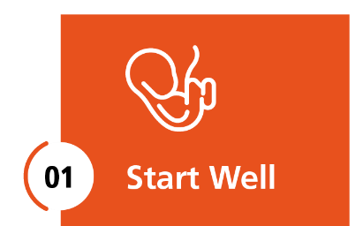
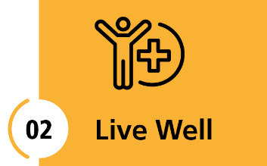

MK Deal - priorities for improvement in MK
8
Children’s mental health: building a consistent, effective, MK-wide approach to prevention and early help, alongside interventions for young people and their families, with a focus on those in at-risk groups and with complex needs.
Tackling obesity: to support the high numbers of adults and children with excess weight, and those at higher risk due for socio-economic or physical/mental health reasons; improving access to healthy food and opportunities to be active, with focused support for families, and changes to the MK built environment to make it easier for people to maintain a healthy weight.
Support for people with complex needs: developing a well resourced, integrated, proactive, all-age local model of planning, assessment and case management, with simplified processes and procedures, and eliminating the need for out of area provision specialist/ crisis provision for people with the most complex needs.
Reducing unnecessary hospital stays: with a focus on improving discharge for people medically able to go home, especially those placed out of area; redoubling efforts to avoid admission for people with frailty markers; reducing long term care home placements, and the number of people who are discharged into bed based services without rehabilitation, ensuring that community services are focused on helping people to regain their independence and stay in their own homes.
Each priority will focus on addressing inequalities and keeping people healthy to support growth and sustainability.
Notes:
in the first year of operation.

Slide 10
Working with the VCSE
Strategic partnership
13
Critical friends
Start with people from the grassroots up
Co-production
Trusted people
Learning and adapting
Community focus
Engagement structures to support community voice
MOU in action
Equity and parity of power in decision making
Governance integrated at every level
Planning, design and delivery of services and projects

Slide 11
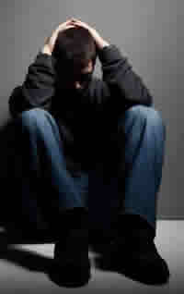
So why does our relationship matter?
5
Here’s why…B’s story…
After receiving gang related injuries, B attended Milton Keynes Hospital, where a team of volunteers helped him turn his life around…
Milton Keynes Hospital is working with Thames Valley Police and the YMCA MK Hospital Navigator Volunteers, who work in the Emergency Department. They are actively helping young people that have been affected by assault, serious violence, substance abuse, mental health issues and self harm.
After B was injured in a fight, he went to Milton Keynes Hospital, where the team supported B. He was given a key worker, mentoring, guidance and emotional support to help him make positive changes to his life.
#Momentsthatmatter

Slide 12
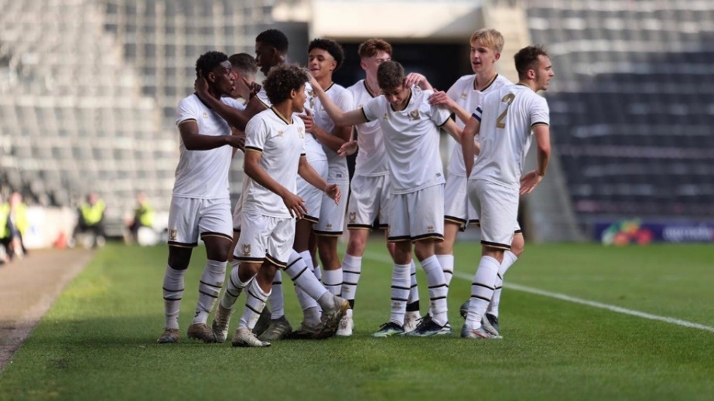
Moments that matter
6
M’s story…
When social isolation and anxiety started to affect his life, the MK Dons helped him to tackle it head on.
M had suffered with anxiety for a long time and this was beginning to get worse, with him becoming socially isolated because of anxiety.
Thanks to an innovative scheme with the MK Dons, M joined a programme which helped to improve the mental health and wellbeing by taking part in football sessions for young men from hard to reach backgrounds.
The sessions provided M with exercise, a sense of purpose and encouraged him to mix with other young people who were experiencing similar issues.
Run by experienced coaches, the social inclusion programme gave M the confidence to overcome his anxiety, make new friends and improve his life experience.
Notes:
we’re already hearing about lives transformed.

Slide 13
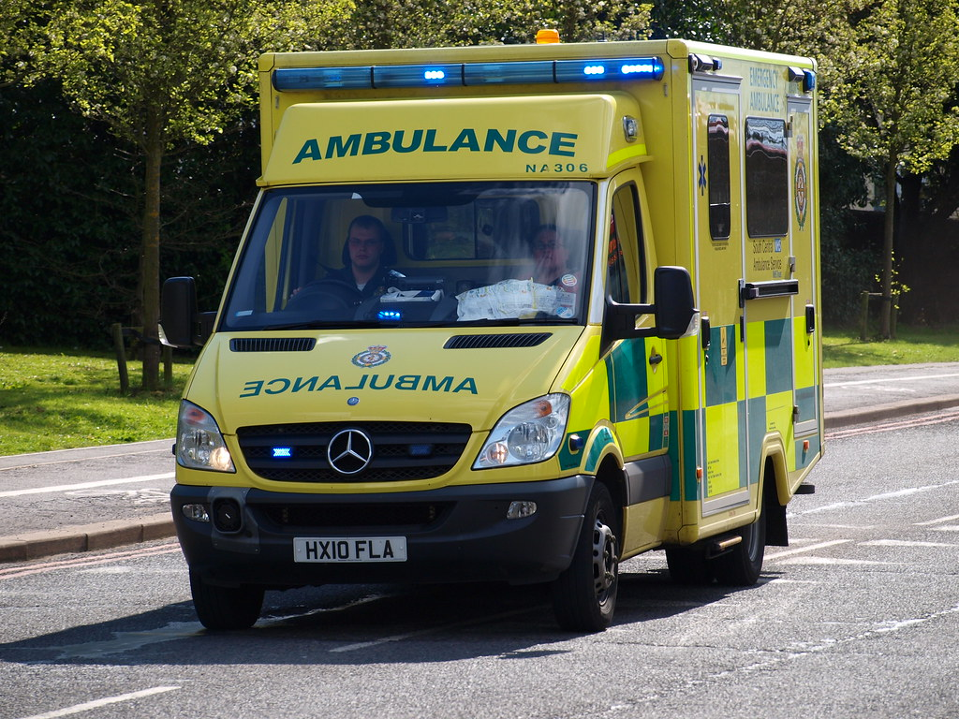
Moments that matter
7
South Central Ambulance’s story..
Providing valuable support to the community
At a time of significant pressure in the NHS, the voluntary sector is supporting with the discharge of residents from Milton Keynes Hospital through the South Central Ambulance Charity.
Milton Keynes Hospital has supported with the training for enhanced community first responders, out of hospital cardiac arrest and the community care home project across Milton Keynes.
Community First Responders (CFRs) have been trained and provided with the necessary equipment for CFRs.
The service will be operational in Milton Keynes this winter – providing valuable support to residents.

Slide 14
How we’re working with the VCSE
8
A strategic partnership
Joint posts between ICB/VCSE
Established an MOU – to agree principles and cement our relationship
Projects are already underway that are making a difference
VCSE making a significant contribution to planning, design and delivery
Opportunities for more grant funding
Co-production with local people and lived experience front and centre
Trusted relationships to support bottom up approach to service design
More joined up and better care for local people

Slide 15
More information
15
For more information, visit
https://blmkhealthandcarepartnership.org/

