Slide 1
Improving care…
transforming lives
Dr Rima Makarem, Chair
Felicity Cox, Chief Executive Officer

Slide 2



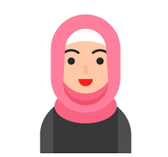






Meet Nam
Screening is carried out in good time, further tests undertaken and cancer diagnosed early
Nam travels to Mount Vernon for her radiotherapy treatment
The treatment course is complete and Nam’s cancer is in remission
What should happen
Nam is referred for radiotherapy
Nam lives in Luton.
She was invited for routine cervical screening last year
What did happen
Nam delayed going for screening because she did not want to see her male GP.
As Nam cannot drive, and her husband cannot get time off work to take her to appointments, she is not able to travel to Mount Vernon for treatment
Not being able to access treatment, Nam is put onto a palliative care pathway
Nam does manage to make an appointment to see a female nurse at her practice, but her cancer is already advanced

Slide 3
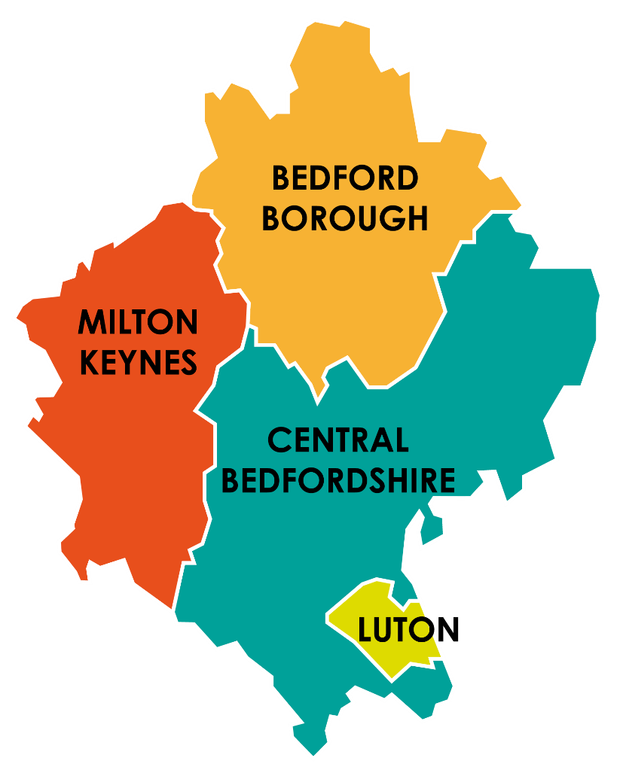
A quick health check
Life expectancy between the most and least deprived neighbourhoods in Bedford is 8.9 years for men and 7.8 years for women.
Referrals to mental health providers increased by 20% in 2021/22 and 26% for those aged 18 to 64 years. 25% of patients with a long-term condition also have a recorded mental health need.
Luton has the highest levels of deprivation (24% of neighbourhoods) and is in the 20% most deprived neighbourhoods in England.
Luton (7.7%) and Milton Keynes (1.4%)
has a higher number of low birth-weight babies compared to England increasing risk of childhood mortality, asthma, acute respiratory infections and diseases in adulthood.
Females in our most deprived areas spend 34% of their life in ill health and males 30%
Childhood vaccine uptake in England has been declining since 2012-13 and made worse by Covid. In BLMK 28,000 children under 5 years have an indicated health need.
Luton (17%) has the highest smoking rate compared with England (14%).
Black patients have a higher occurrence
of Obesity (13.27%), Hypertension (14.45%) and Diabetes (10.55%).
Luton has the highest children obesity rates. Rates are 2X higher in most deprived 10% of children compared to least deprived.
Breast cancer is the 2nd most common cause of death among women. Breast screening is low in Bedford (58%) compared to England (64%).
New HIV diagnoses in people aged 15+ is significantly higher in Luton (15.9%) and Milton Keynes (22.8%) compared to England.

Slide 4
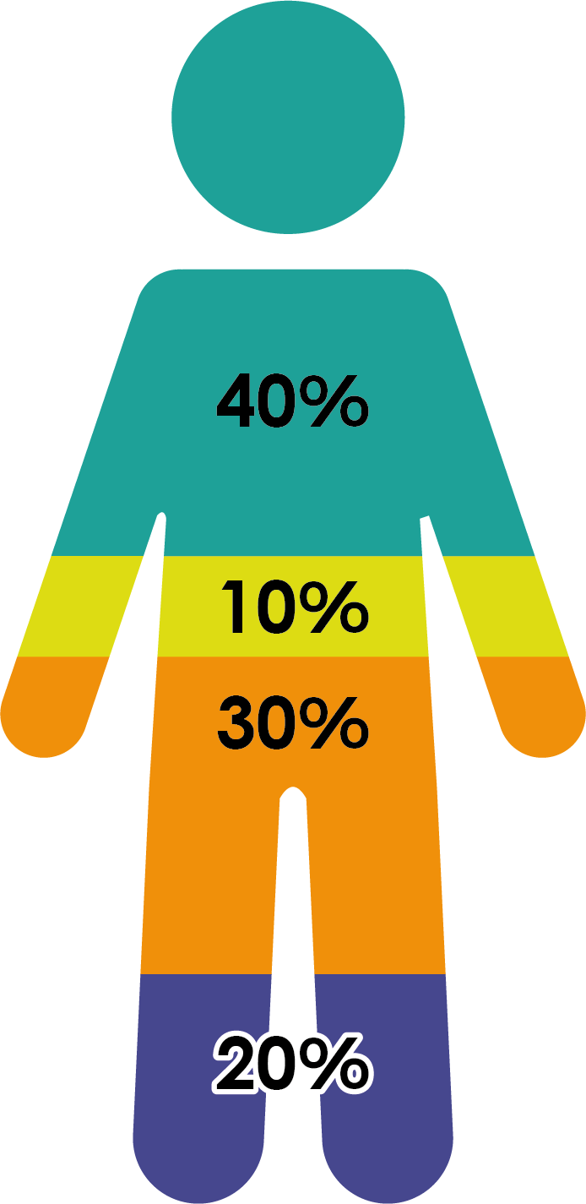
What contributes to your health?
Socioeconomic factors
Physical environment
Health behaviours
Healthcare

Slide 5
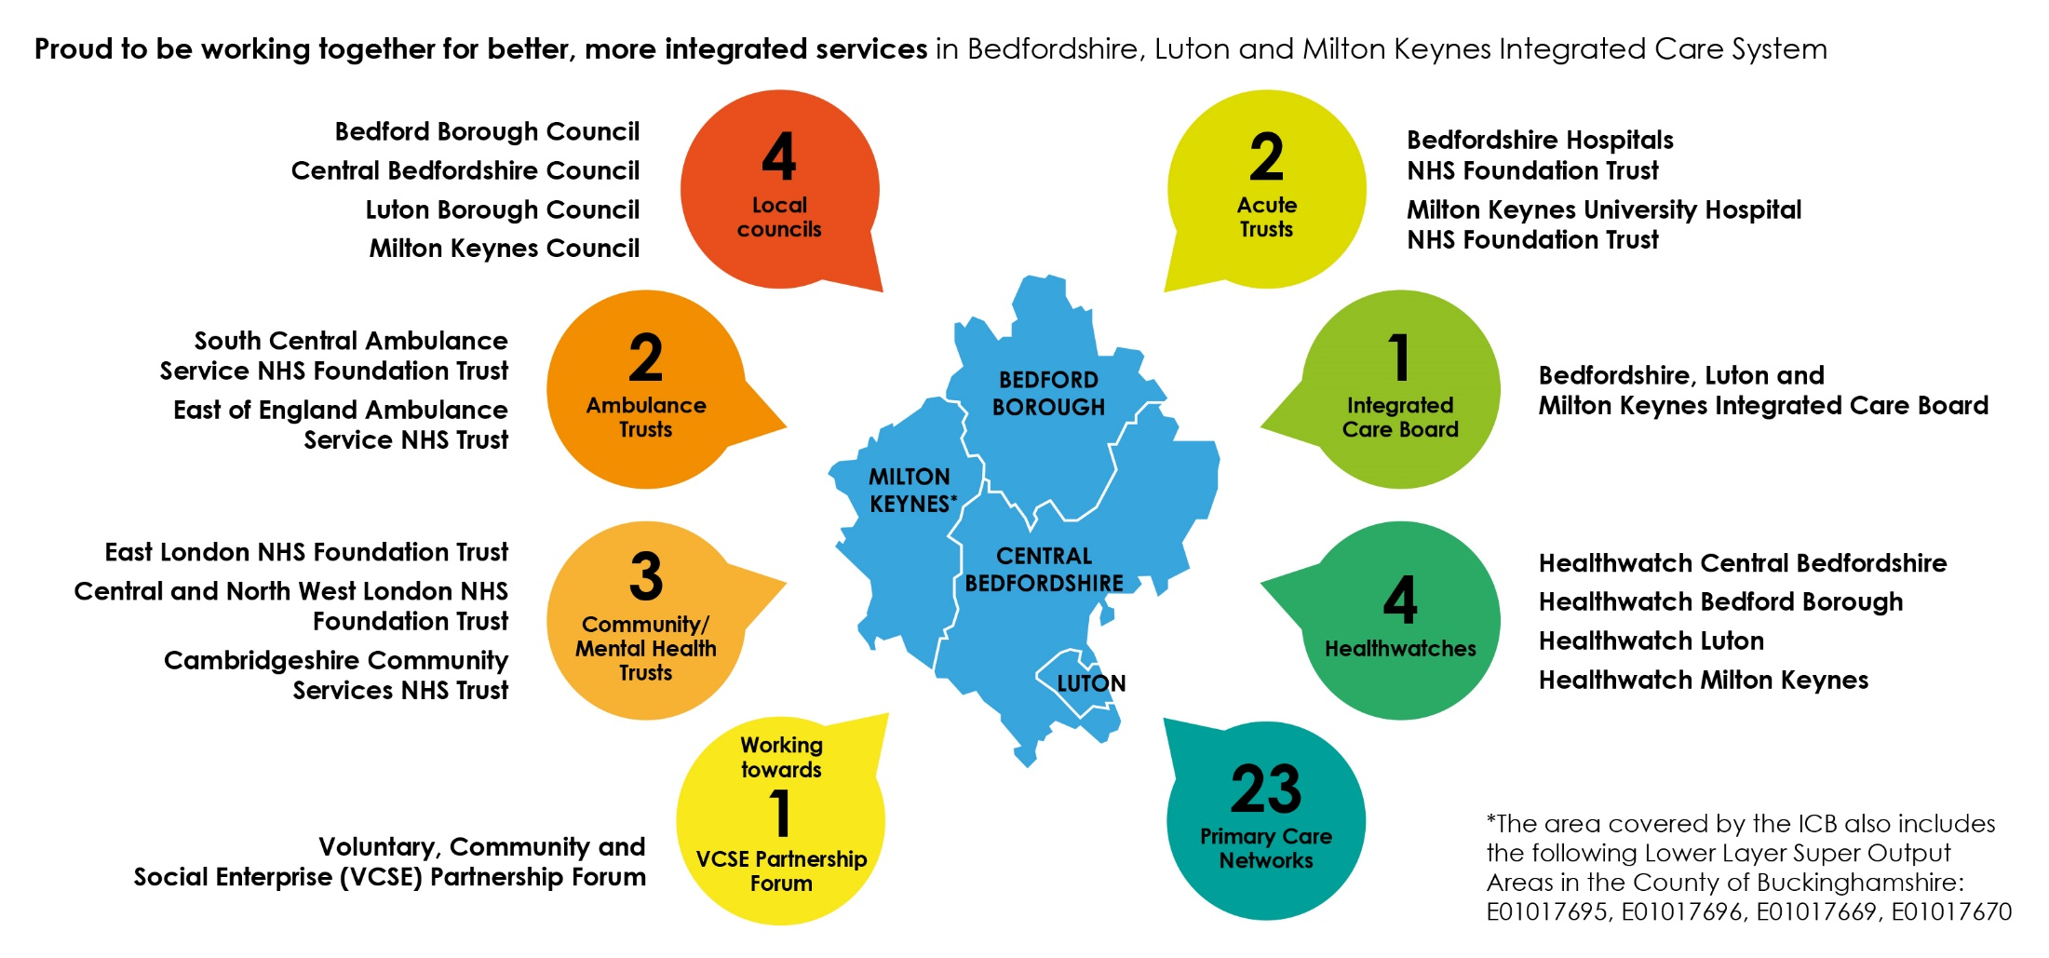
Welcome to the ICS

Slide 6
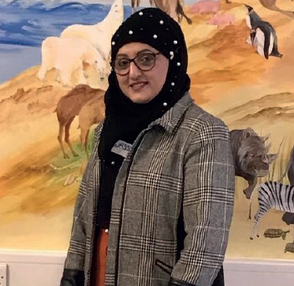
Programmes that matter
The ICB has accessed funds and is supporting the Diabetes Prevention programme to tackle poor health. It’s already delivering results.
Originally started as a pilot in Luton, funding from the NHS was secured to roll the programme across Bedfordshire and Milton Keynes.
People like Nasreen, who were pre-diabetic and enrolled onto the programme are now within the healthy range and living healthy lives.
Notes:
KEY MESSAGE – Before the ICS was established, pockets of best practice would be run in some areas and small amounts of funding secured. working across a bigger geography, we are able to apply clinical excellence across the system and secure funding for a larger population.
We’ve only been established since 1 July this year – but we’ve made a good start….Take Nasreen for example.
Nasreen is one person who has benefitted from a new Diabetes Prevention Programme, which was started as a pilot here in Luton, but that has since been rolled out to the rest of the system.
Nasreen is a young mother from Luton who was diagnosed as pre-diabetic after some routine bloods from her GP.
She realised that her lifestyle was impacting her health negatively and knew that she had to make changes
The Diabetes prevention programme has helped her to look at her lifestyle closely and change her diet for the better.
She now eats the right food and portion sizes, and also incorporated exercising into her daily routine. Nasreen has said that her tutor was approachable and supportive in all aspects of the course, and she reported that she has learnt so much, including how to understand Glycaemic index (GI).
As a result of the programme, Nasreen’s blood glucose has lowered significantly, and is now in a healthy range. She has lost some weight and has more energy. Her family has supported her by taking part in exercise with her at weekends. She now has smart goals and has maintained her lifestyle changes.
Nasreen said: “I would recommend this programme because it can help someone to understand the food they eat, as it did for me, plus understand the importance of physical activity. I thought I knew more than I actually did, and it became apparent there was a lot I didn’t know. My children keep me on the straight and narrow and have become my diet police because they want a happy and healthy mum.”
Nasreen’s story is important because:
There are 59,933 people living with diabetes in our area and each month.
In areas of high deprivation, there is a significant percentage of people with diabetes.
In Luton, diabetes was a problem – particularly in the south east Asian communities and was contributing to lower life expectancy.
Without the funding from NHSE, there would be a diabetes timebomb in our area with people living shorter lives in poor health and accessing more interventionist health care as they get older.
The solution
A pilot, led by Dr Chirag Bakhai (Diabetes Clinical Lead) in Luton was rolled out to identify undiagnosed diabetes and begin a diabetes prevention programme to help people live healthier and longer lives.
The funding was allocated by NHSE – who commissions the service, but the monitoring and roll out is delivered locally by the ICB.
This was later rolled out in Central Bedfordshire, Bedford Borough and Milton Keynes.
The outcome
GPs refer 1,000 people on average each month to the diabetes prevention programme.
It is already starting to positively impact on lives.

Slide 7
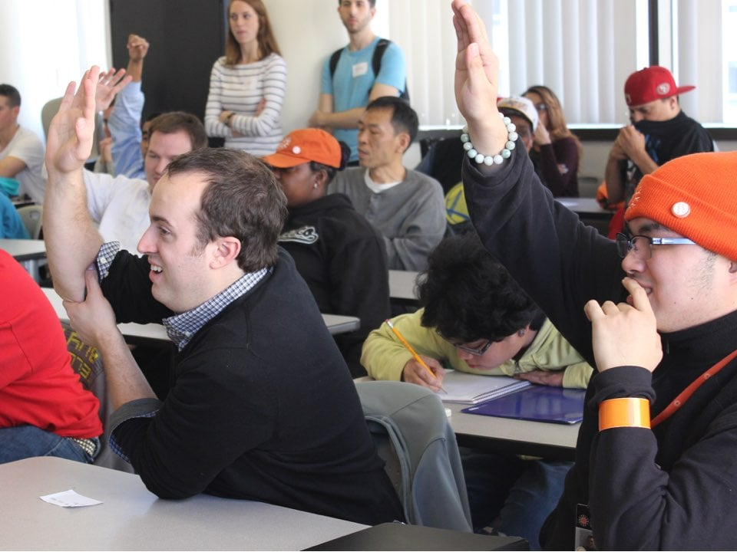
Funding where it matters
ICB funding for key workers means that young people, like L who have a learning disability can get help to reach their potential.
The Keyworker service provides support to young people who have learning disabilities and autism.
The team help young people and their families to understand a diagnosis and navigate the health and care system, often building community support packages.

Slide 8
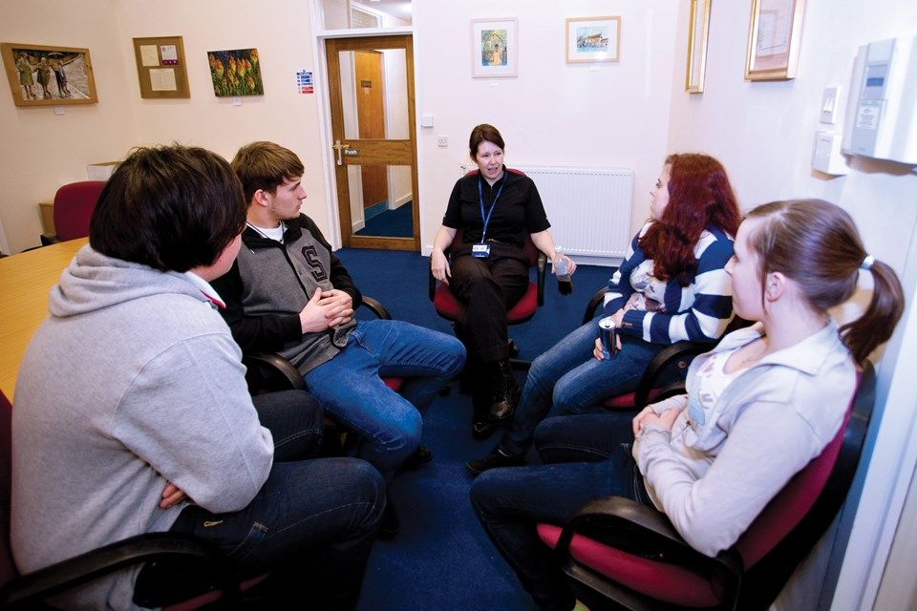
Collaborating when it matters
The ICS is empowering people to get involved in shaping their own health and care.
Paediatricians from Bedfordshire and Luton Community Health Services have worked with 13-17 year olds to design a treatment form for young people to use.
The new ways of working have been well received by young people who feel ‘in the driving seat’ in designing their own care.
These principles are being rolled through the ICS as best practice.

Slide 9
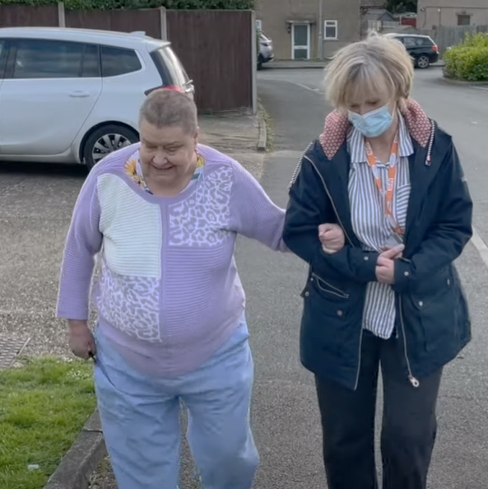
Supporting where it matters
A social prescribing programme, facilitated and funded by the ICB is helping people like Jane live healthier and happier lives.
Social prescribers are working within Primary Care Networks to support people with non-clinical support that will help improve their health and wellbeing.
Jane is one of the people this has benefitted. She accessed help with benefits and repairs to her home, and now socialising and exercising.

Slide 10
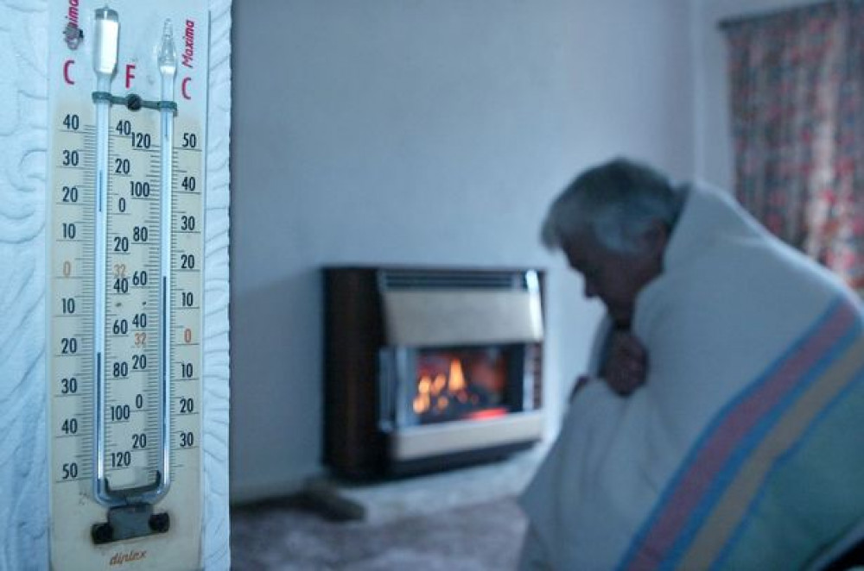
At times that matter
Funding to tackle health inequalities is keeping people warm in Bedford Borough this winter.
With more people experiencing poverty as a result of increases in cost of living, the ICB has provided inequalities funding to all four Places to enable the VCSE to help the most vulnerable.
In Bedford Borough some of the funding will pay for volunteers who can help people with advice on a range of issues from energy bills, to homelessness and loneliness.

Slide 11
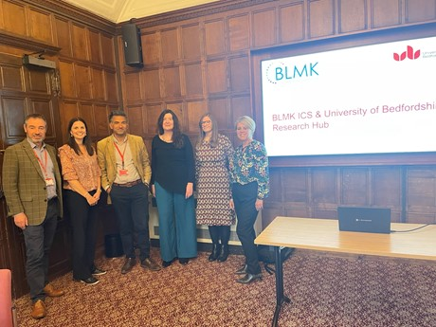
Investing where it matters
We have established a Research and Innovation Hub with the University of Bedfordshire, which will focus on ways to improve health and social care inequalities in Bedfordshire, Luton and Milton Keynes.
Researchers and academics from the Institute for Health Research and the Institute of Applied Social Research will join forces with health and care professionals to work on a number of areas over three years.

Slide 12
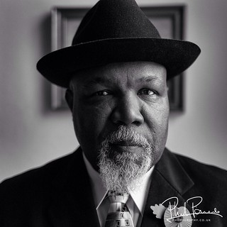
With people that matter
The stories people tell are powerful.
They tell us of their lived experiences and the barriers they have overcome to get the help, support and care they need.
We want to hear more, so we can make positive changes.
The Denny Review is one of the ways we’re doing this.
Listening to the voices that haven’t always been the loudest and have not always been heard.

Slide 13
Your stories

