Slide 1
Tacking health inequalities: supporting Luton to become a ‘Marmot town’
Felicity Cox, Chief Executive, Bedfordshire, Luton and Milton Keynes Integrated Care Board
25 January 2023

Slide 2
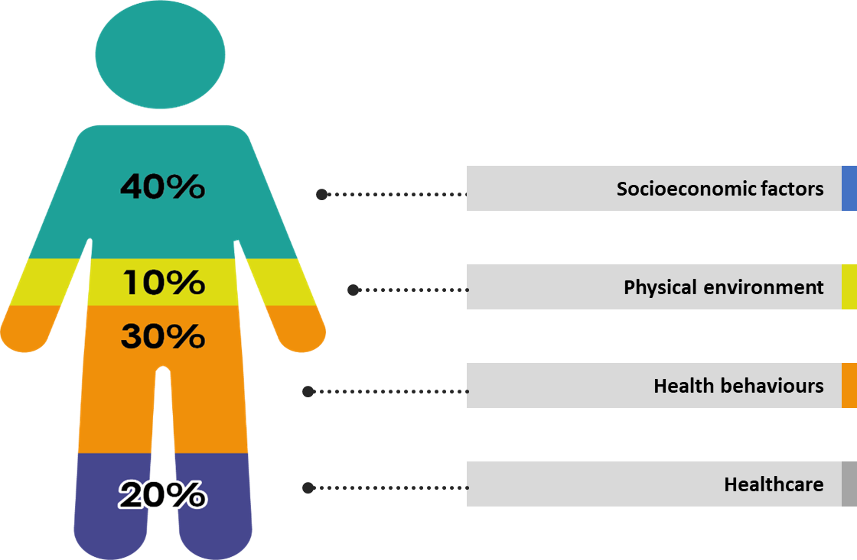
Lots of factors affect whether we live a long, healthy life…

Slide 3

…and unequal health outcomes are a real problem in Luton.
Higher preventable deaths
Highest levels of deprivation
Highest smoking rate
Higher number of low birth-weight babies
Highest children obesity
rates
Highest HIV diagnosis rates

Slide 4
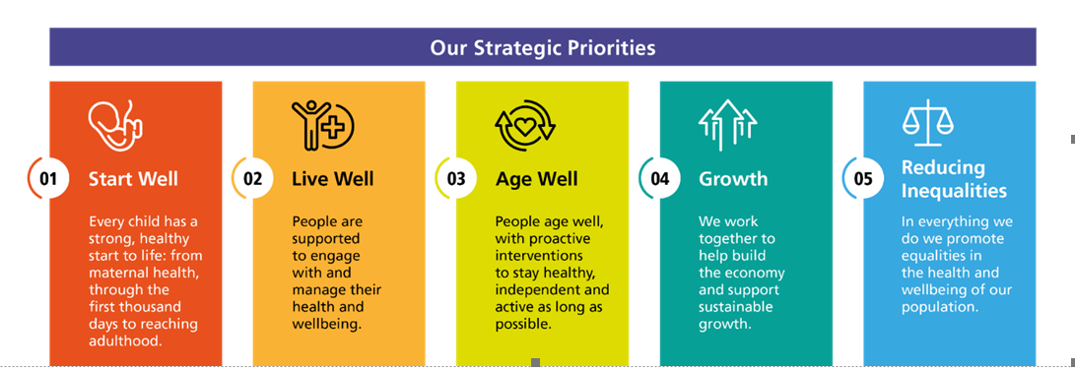
How we’ll make a difference…

Slide 5

A leading role on the journey to becoming a Marmot town…
Work to prevent poor health
Asking local leaders, like Rev Lloyd Denny, how we can get better
This means communicating in the right language and tackling racism and discrimination
We’re also trying to improve vaccination rates by getting out into our local community…
..and supporting pregnant women to quit smoking
Source: NHS England

Slide 6
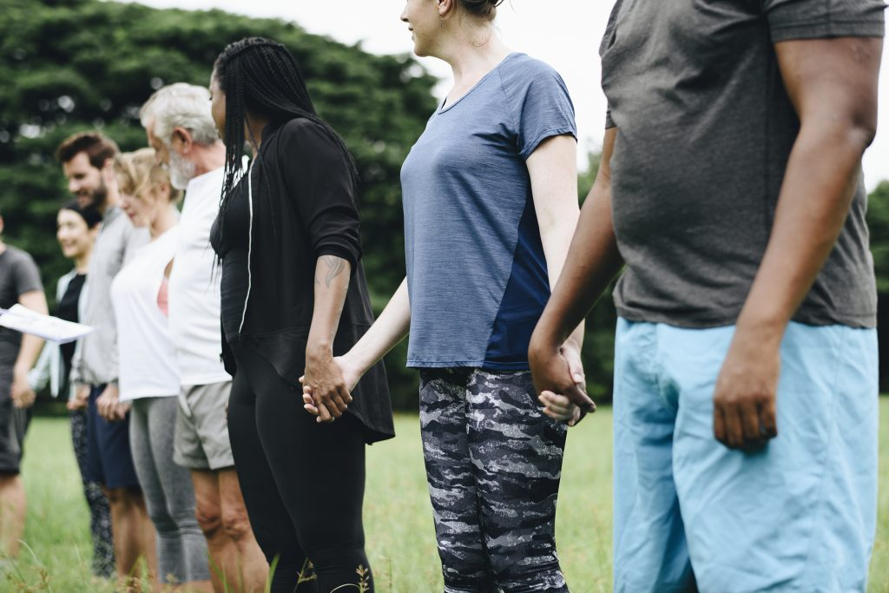
…and we’re making progress…
System support to deliver Luton priorities
Investing in system-wide programmes that support priority areas
Community Connectors
Funding for local projects

Slide 7
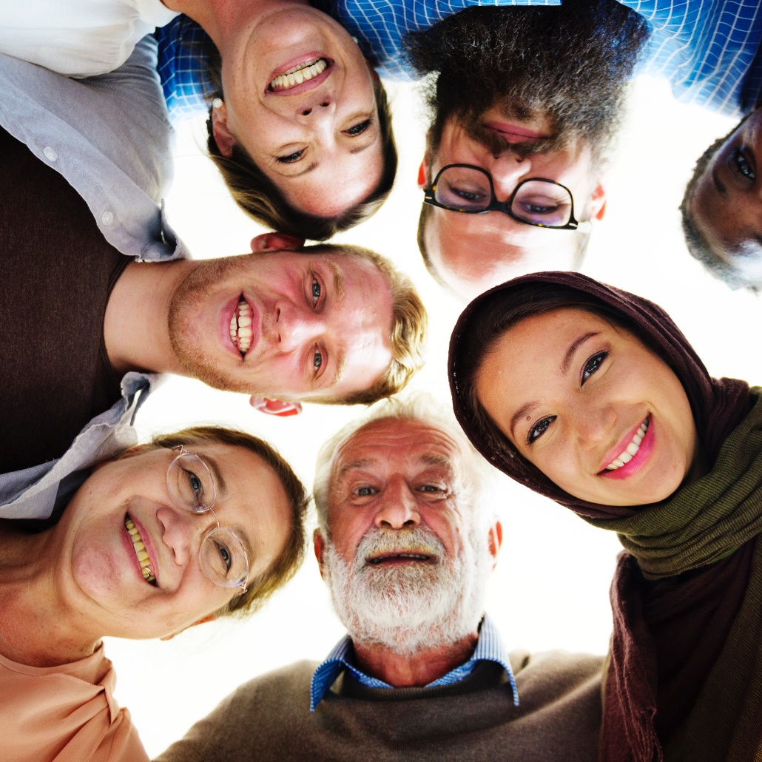
..progress that makes a difference for people in Luton
Personal health budgets are helping people have more choice
Diabetes prevention programmes
Empowering young people with ADHD
Helping children living with epilepsy
Life changing Lung Health Checks programme
Clinical Dashboard Pilot supports vulnerable older people

Slide 8
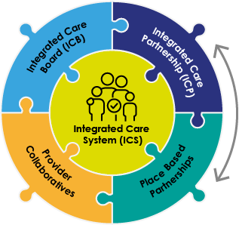
We’re bringing people and partners together to deliver for Luton…
Place based partnerships set the strategy and delivery plan for Place

Slide 9
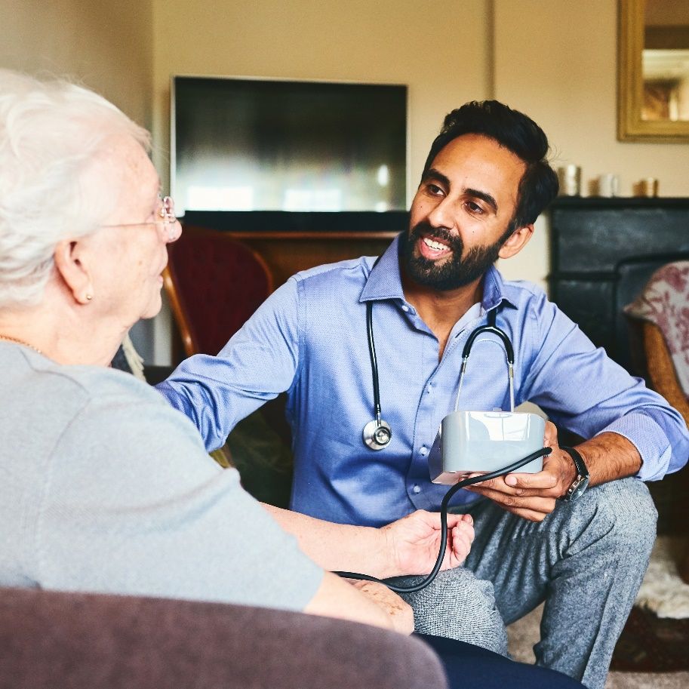
…and working together to tackle inequalities
Luton Place Board, Children’s Trust Board and Inequalities Board
Place Plans and Partnership Strategy
Fuller Programme: our four pillars:
  Neighbourhood Teams
  Streamlined same-day urgent care
  Proactive personalised care for people with complex needs
  Joined-up approach to prevention
Working with communities as equal partners

Slide 10
For more information or to get involved visit:
https://bedfordshirelutonandmiltonkeynes.icb.nhs.uk/ and https://blmkhealthandcarepartnership.org

