Slide 1
Moments that matter
How the ICS is making a difference
Felicity Cox, Chief Executive

Slide 2


Funding the voluntary sector to help local people
Isolated communities are now able to access help and care thanks to funding allocated by the ICS.
The Bedfordshire Rural Communities Charity is helping people in rural areas to access digital support and equipment to help them connect to others.
The British Red Cross has been able to roll out the ‘Home Safe’ programme which sees volunteers ‘checking in’ on people who have been discharged from hospital.
Notes:
£416,000 was awarded to BLMK ICB to support residents.
We worked with The British Red Cross and Bedfordshire Rural Communities Charity to fund initiatives which will support vulnerable people living in our communities.
These schemes are now operational in our area and making a real difference to people’s lives locally.

Slide 3
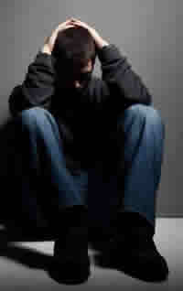
Funding the voluntary sector to help local people
The ICS has supported YMCA Milton Keynes to help volunteers at Milton Keynes Hospital transform lives.
Milton Keynes Hospital, Thames Valley Police and the YMCA MK volunteers are working in the Emergency Department to help young people that have been affected by assault, serious violence, substance abuse, mental health issues and self harm.
B is one of 14 young people who are being helped by this specialist team.
Notes:
The ICS is working with partners in the voluntary and community sector to support young people.
This scheme brings together the YMCA, MK Hospital, the Police and other partners to fund volunteers who work with people who have experienced assault, serious violence and mental health issues to prevent long term issues from developing and support people in making positive changes to their lives.

Slide 4
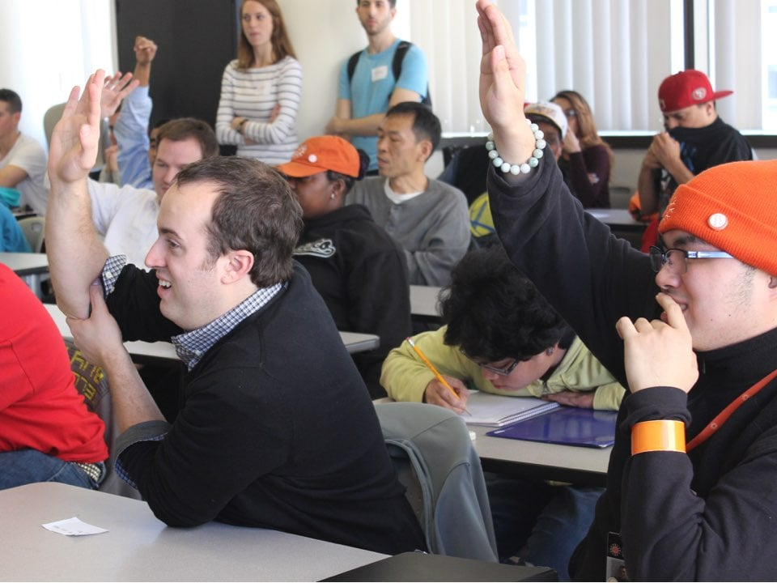
Funding the keyworker service
ICB funding for key workers means that young people, like L who have a learning disability can get help to reach their potential.
The Keyworker service provides support to young people who have learning disabilities and autism.
The team help young people and their families to understand a diagnosis and navigate the health and care system, often building community support packages.
Notes:
In 2020, £247,292 funding from the NHS was allocated to this as a pilot, and a further £495k was allocated for 2021/22.
The new keyworker service provides young people with a dedicated care worker, make sure they’re listened to, and fully involved in their care plans, benefitting young people in our area.
funding for schemes like this, allow young people with learning disabilities and autism to reach their full potential.

Slide 5
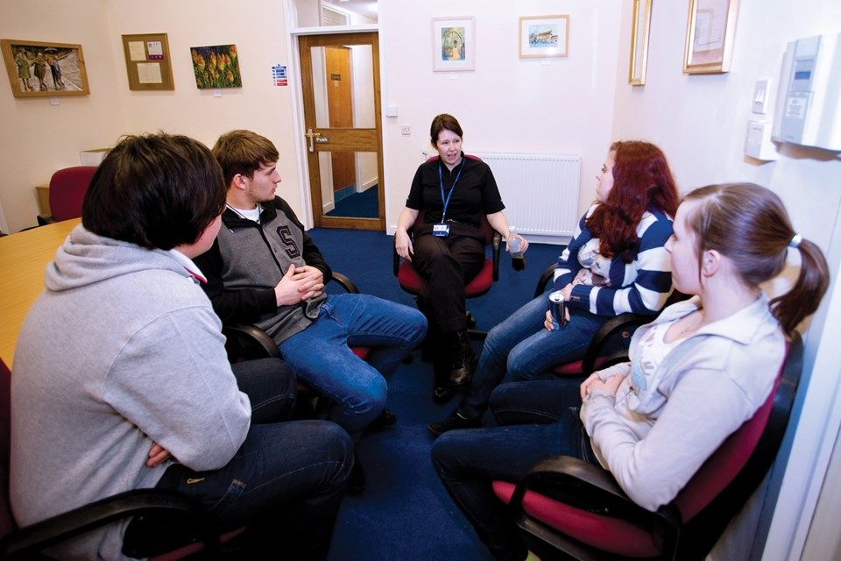
People first approach
The ICS is empowering people to get involved in shaping their own health and care.
Paediatricians from Bedfordshire and Luton Community Health Services have worked with 13-17 year olds to design a treatment form for young people to use.
The new ways of working have been well received by young people who feel ‘in the driving seat’ in designing their own care.
These principles are being rolled through the ICS as best practice.
Notes:
Bedfordshire and Luton Community Health services worked with four young people who have ADHD to empower them to be a part of their own ADHD management.
Together, they have created a treatment response form – made by young people for young people.
The form was written to ensure it was easy for young people to understand whilst remaining clinically accurate. This form is now used by young people and community paediatrics in Bedfordshire and Luton, empowering young people to have a voice in managing their ADHD treatment.

Slide 6
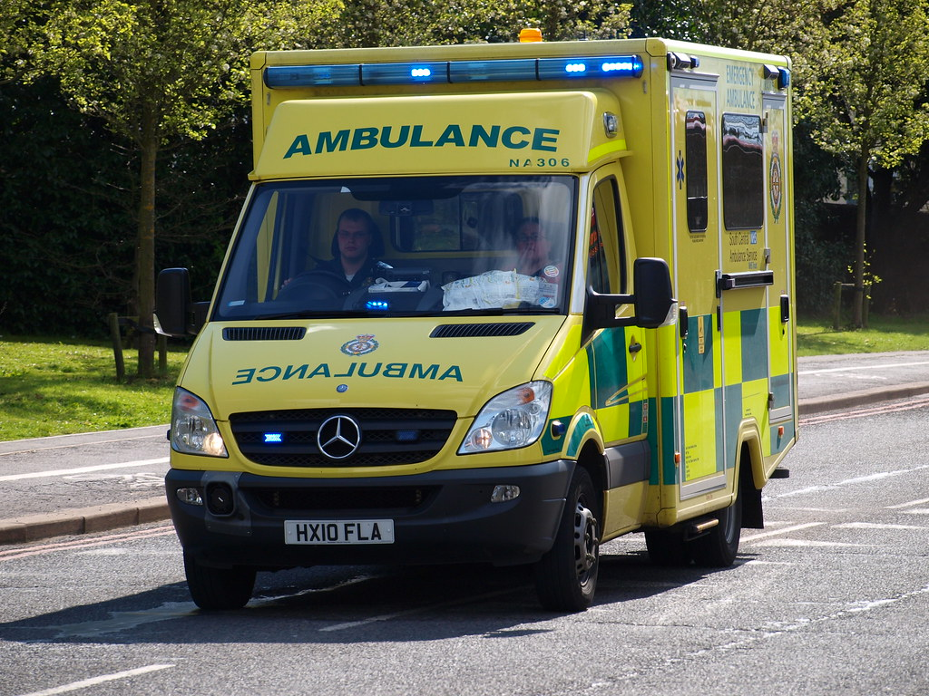
More Community First Responders
There are more Community First Responders out saving lives in Milton Keynes this winter, thanks to ICS funding.
South Central Ambulance Service is drawing support from Community First Responders to attend emergencies to help with potentially life threatening emergencies in the vital first minutes.
Funding has paid for valuable equipment to support the scheme.
First Responders are also helping with discharging patients from Milton Keynes Hospital.
Notes:
As part of a larger bid, the ICB worked with System partners to put together a bid to NHS Charities Together. The integration between all partners made the bid for funding more attractive.
£416k was allocated to the ICS with South Central Ambulance Service assessing funds to buy equipment and train Community First Responders
Milton Keynes Hospital supported with the training for enhanced community first responders, out of hospital cardiac arrest and the community care home project across Milton Keynes. Community first responders (CFRs) have been trained and provided with the necessary equipment to attend life threatening emergencies and provide vital care in the moments before a Paramedic team arrives on site.
The service will be operational in Milton Keynes this winter – providing valuable support to residents.

Slide 7
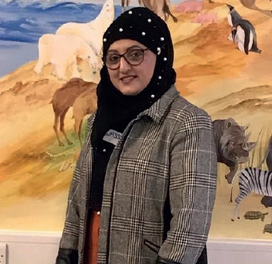
Proactive clinical prevention
The ICB has accessed funds and is supporting the Diabetes Prevention programme to tackle poor health. It’s already delivering results.
Originally started as a pilot in Luton, funding from the NHS was secured to roll the programme across Bedfordshire and Milton Keynes.
People like Nasreen, who were pre-diabetic and enrolled onto the programme are now within the healthy range and living healthy lives.
Notes:
A pilot, led by Dr Chirag Bakhai (Diabetes Clinical Lead) in Luton was rolled out to identify undiagnosed diabetes and begin a diabetes prevention programme to help people live healthier and longer lives. The funding was allocated by NHSE – who commissions the service, but the monitoring and roll out is delivered locally by the ICB.
people are benefitting from support under the diabetes prevention programme, It is already starting to positively impact on lives.
Without the funding from NHSE, there would be a diabetes timebomb in our area with people living shorter lives in poor health and accessing more interventionist health care as they get older.

Slide 8
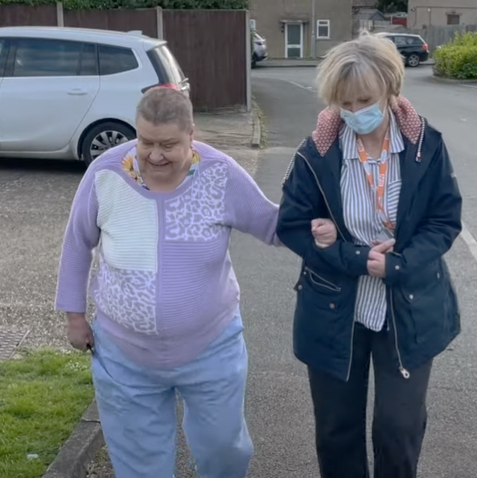
Helping the person, not the problem
A social prescribing programme, facilitated and funded by the ICB is helping people like Jane live healthier and happier lives.
Social prescribers are working within Primary Care Networks to support people with non-clinical support that will help improve their health and wellbeing.
Jane is one of the people this has benefitted. She accessed help with benefits and repairs to her home, and now socialising and exercising.
Notes:
funding was allocated to supporting social prescribing for adults in BLMK. In October 2021, an additional £170k allocated for children – so they can access social prescribers.
This has started to transform lives. Social prescribing teams rk came together with professionals from health and care to support people with non-clinical support allowing them to live healthier and happier lives.

Slide 9
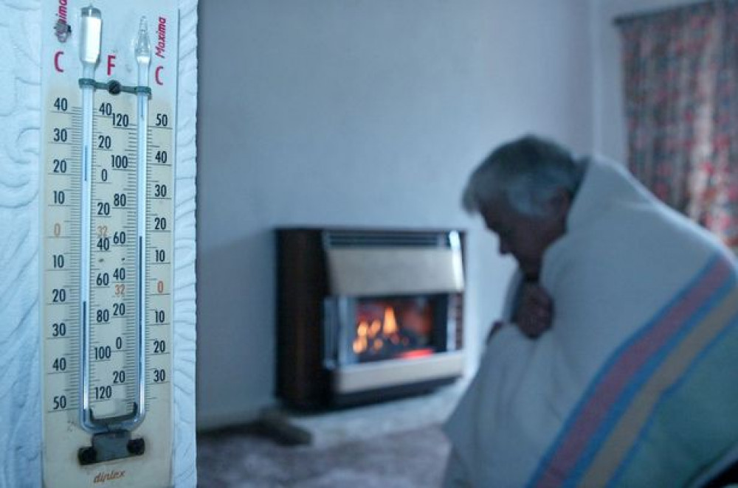
Funding warm spaces
Funding to tackle health inequalities is keeping people warm in Bedford Borough this winter.
With more people experiencing poverty as a result of increases in cost of living, the ICB has provided inequalities funding to all four Places to enable the VCSE to help the most vulnerable.
In Bedford Borough some of the funding will pay for volunteers who can help people with advice on a range of issues from energy bills, to homelessness and loneliness.
Notes:
The ICB secured £3m funding to help tackle health inequalities in our area and this has been shared in all four places for real help to be delivered on the ground.
Bedford Borough Council and partners are using the funding to address the cost of living crisis, including through council tax discounts and exemptions, a cost of living advice hub has been set up on it’s website, the Warm Homes Bedford Borough initiative in partnership with the ICS is operational, and a sustainable warmth scheme has been established.
The council is using health inequalities funding from the ICS to provide resilience and sustainability grant fund to support local VCSE organisations facing hardship as a result of cost of living pressures, and to support the development of a warm spaces network in Bedford Borough – places where residents are welcome to sit down with a hot drink and have the opportunity to socialise and join in activities with others.
These funds will support the VCSE to provide advice and support with the cost of living crisis, including food, debt and benefits, homelessness, housing and energy, mental health and bereavement, help with social isolation and loneliness.

Slide 10
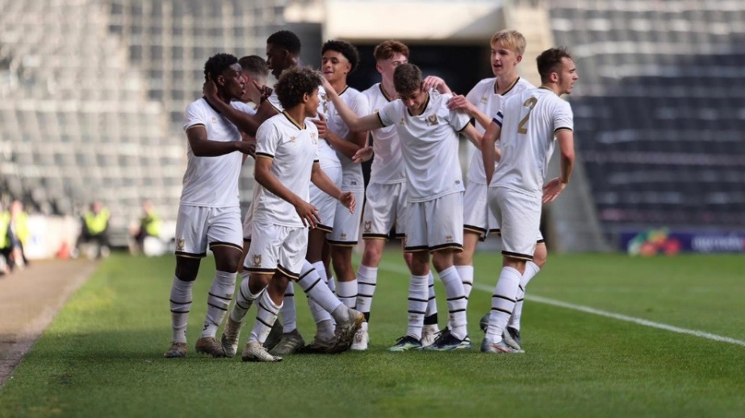
Private sector partnerships
Big organisations have an important role to play in creating healthy lives. MK Dons is one partner who is helping to turn young lives around.
Working in partnership with local businesses to tackle the health of BLMK Is a priority for the ICS.
MK Dons has joined us by offering coaching sessions to young people from deprived backgrounds, to tackle mental health, anxiety and obesity.
Notes:
Public Health in Milton Keynes has joined forces with mental health trusts and anchor institutions to tackle the obesity problem in the city.
Funding has been allocated for mental health practitioners and coaches from MK Dons to run free exercise sessions for young men who are from hard to reach areas in the city.
The sessions give young people access to coaches and mental health practitioners, where they can talk about anything from dealing with family issues, social isolation and how to manage their emotions.

