Slide 1
Bedfordshire, Luton and Milton Keynes
Integrated Care System
A new approach to health and care

Slide 2
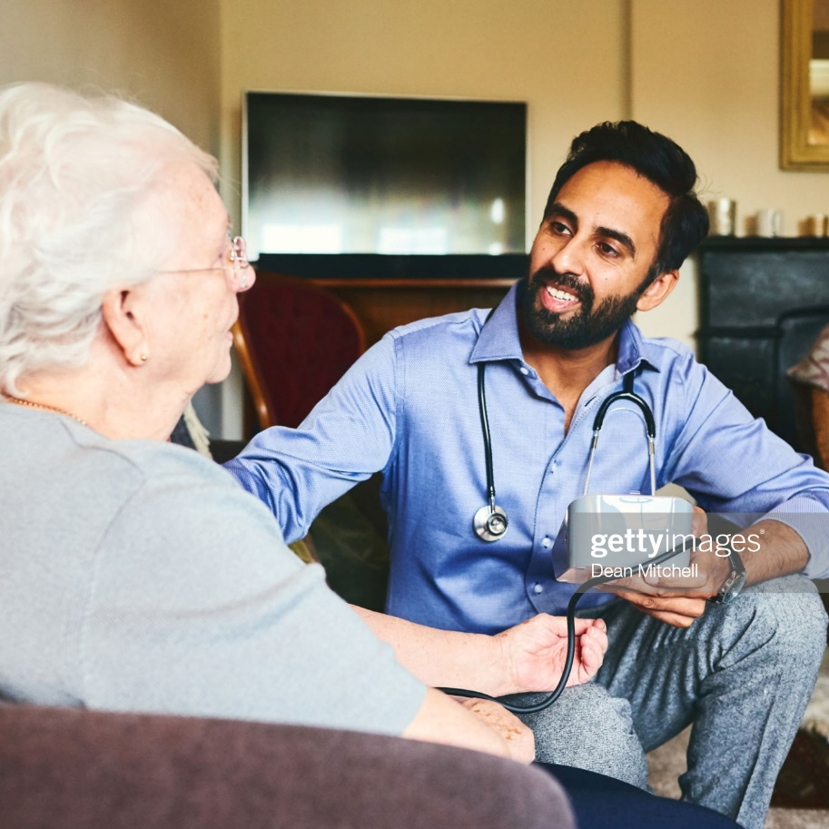
Who we are
01
The Bedfordshire, Luton and Milton Keynes Health and Care Partnership is a group of our four local councils, our local NHS organisations and our local voluntary and community organisations, working together with local people to support and improve everyone’s health and wellbeing in our area.

Slide 3


A better future
02
Our aim is simple;
We want everyone in our towns,
villages and communities to live a
longer, healthier life
We are working with our communities to
improve the things that are most important to
us – like giving our children the best start in life, helping our 1m population be healthier, and working to grow our economy so that we can
all live well for longer.

Slide 4
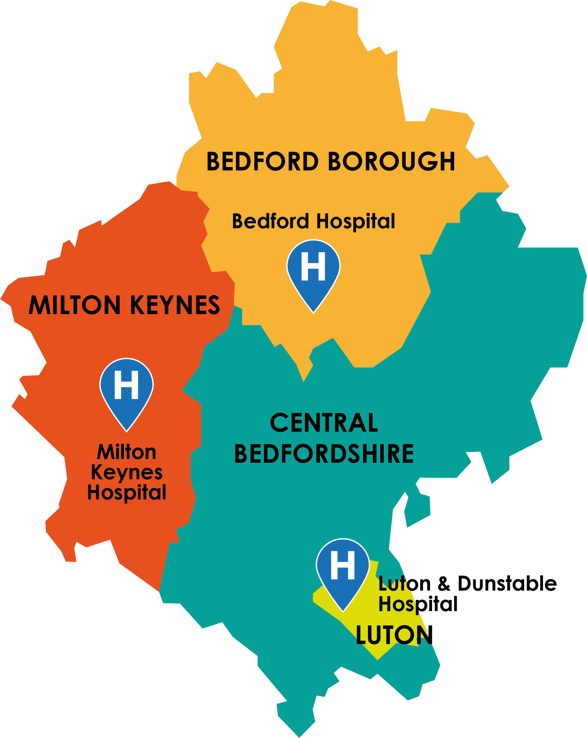
Our area
03
The four places in our Integrated Care System are vibrant and culturally diverse and cover a population of 1million. Whilst there are health inequalities, there is growth and opportunities for us to improve the health and wellbeing of people who live here.
Bedford Borough
A diverse Borough with up to 100 different ethnicities and 149 spoken languages. Two thirds of the population live
in our urban centres
whilst the remaining live
in our many rural areas.
Central Bedfordshire
A diverse area, with over half of the population living in rural areas and the rest in market towns. The area is generally affluent but there are areas of deprivation.
Luton
Diverse, densely populated town with over 150 languages and dialects spoken. It has a younger than average population and above average levels of unemployment and deprivation, with high levels of child poverty.
Milton Keynes
A mixture of urban and rural areas including distinct
towns and villages. 140 languages are spoken in our schools; the population is young with 27% of residents aged 19 or younger.

Slide 5




A great place to live
03
Our area covers four places Bedford, Central Bedfordshire, Luton and Milton Keynes - all vibrant, unique and rich in cultural heritage. Our population is diverse with more than 150 languages spoken.
With 2million jobs we are one of the fastest growing economies in England, contributing £110bn to the economy. We are served by an airport, train and road networks and infrastructure.
Our five health providers are rated outstanding or good by CQC. Our health and care partners support a range of health conditions in and out of hospital.
We are also one of the fastest growing areas in the country, with the population expected to exceed 1.2m within the next decade.

Slide 6






Evidence says problems can be better addressed by us working together
04
There are areas where people live
shorter lives in poorer health.
Nationally, people with learning
disabilities can expect to live between
14 and 17 years less than the
general population.
In Luton, women can expect to live a healthy life until they are 60, but just a few miles
away in Central Bedfordshire, they
can expect to live healthily to 67.
The number of people with
preventable diseases and cancers in
Luton and Milton Keynes is higher
than the national average.
30-40% of children aged 10 to
11 years in our area are overweight
or obese.
People with serious mental illness
live between 15 and 20 years
less than the general population.

Slide 7
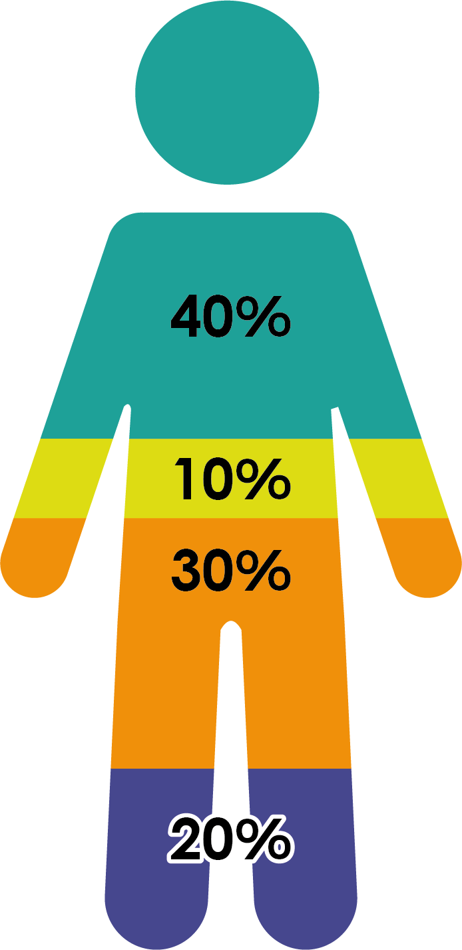
What contributes to a person’s health outcome
05
Socioeconomic factors
Physical environment
Health behaviours
Healthcare

Slide 8
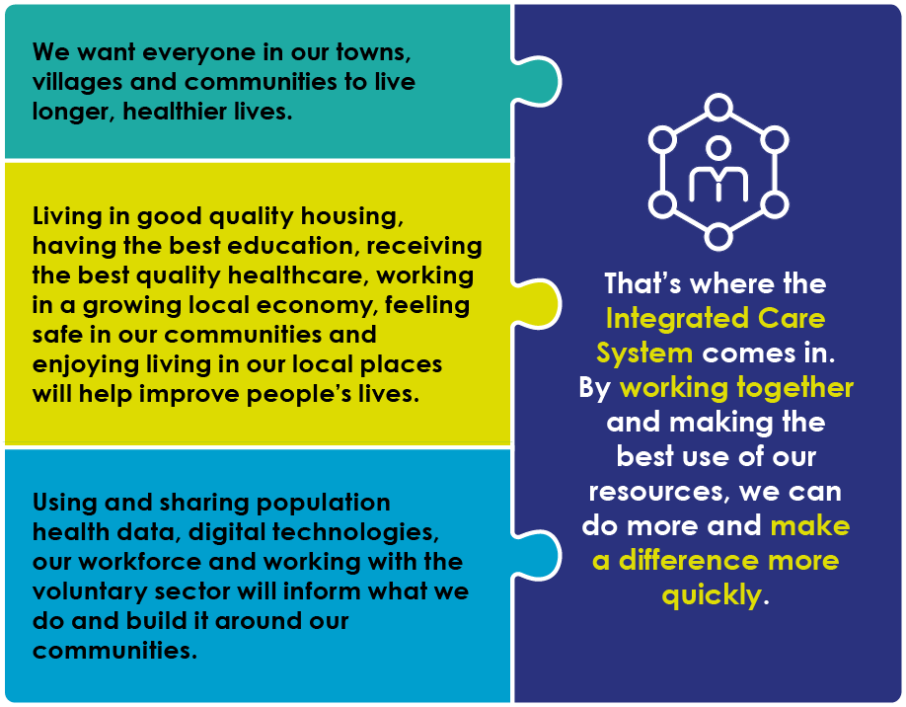
Coming together to try to accelerate change
06

Slide 9
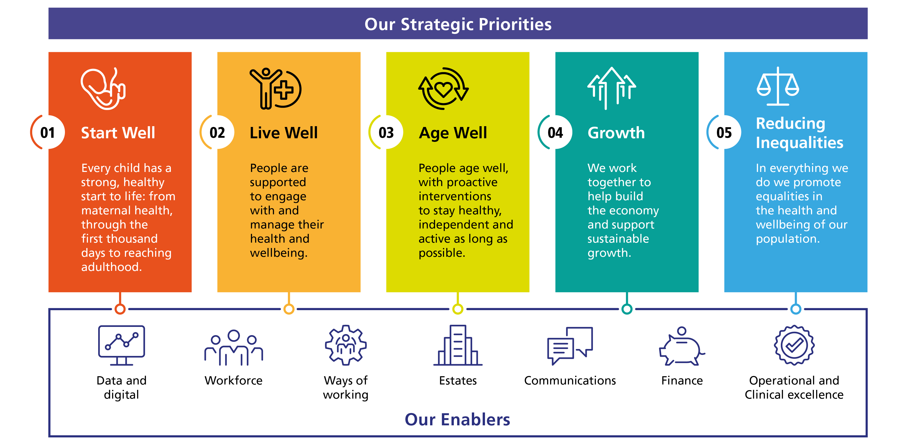
What’s our plan?
07

Slide 10

What problems could the ICS help solve?
08
Mary’s story…
89-year-old Mary is admitted to hospital following a fall. She lives
alone, has mild dementia, Type 2 diabetes and is feeling isolated.
The longer Mary stays in hospital, the more likely she will need additional support
at home when she is discharged.
To go home she needs a complete care package that includes:
Nursing care to dress her wounds
Physiotherapy to help her mobility,
Additional care to make sure she is eating regularly eating, managing her diabetes and generally looking after herself.
If Mary has one team co-ordinating her varying needs, including a link to local groups for more social interaction, she can return home more quickly and stay independent for longer.

Slide 11

What problems could the ICS help solve?
09
Helen’s story…
Helen is a 28 year old mum of three who is referred to local
mental health support by her GP.
She is experiencing physical, mental and sexual assault from her partner,
while living with her three children in a two bed flat. She is suffering with depression and low self-esteem and is self-harming.
If Helen has one team that works together: the NHS, the local council, school and
Children and Family Practice, Helen and her family could be rehoused locally
so the children can attend their existing school, and Helen can receive
ongoing support.
Helen could also access talking therapies while being supported to look for work
and re-train.
If Helen received a more co-ordinated approach to care, she and her children could be happier and settled in their new home more quickly.

Slide 12
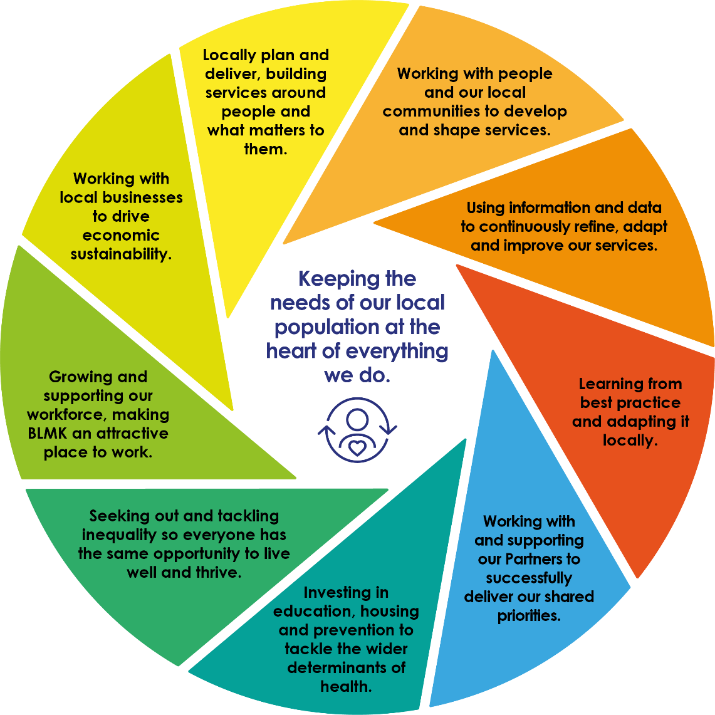
What’s going to change?
10

Slide 13
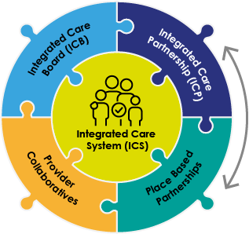
New roles in the ICS (from 1 July 2022)
11
A legal organisation reporting to NHSE/I. Delivering the integrated care strategy for BLMK and reporting on system quality, finance and operational performance.
All partners, including Healthwatch and the voluntary sector, working together to set the population health strategy for BLMK.
Strategy development
Groups of partners working together to deliver specific services across a wider geography than place. E.g. Bedfordshire Care Alliance and East of England Children & Young People Provider Collaborative.
Partners, including Health & Wellbeing Boards and Primary Care Networks, in the four local authority areas, working together to set strategy and deliver services locally.

Slide 14
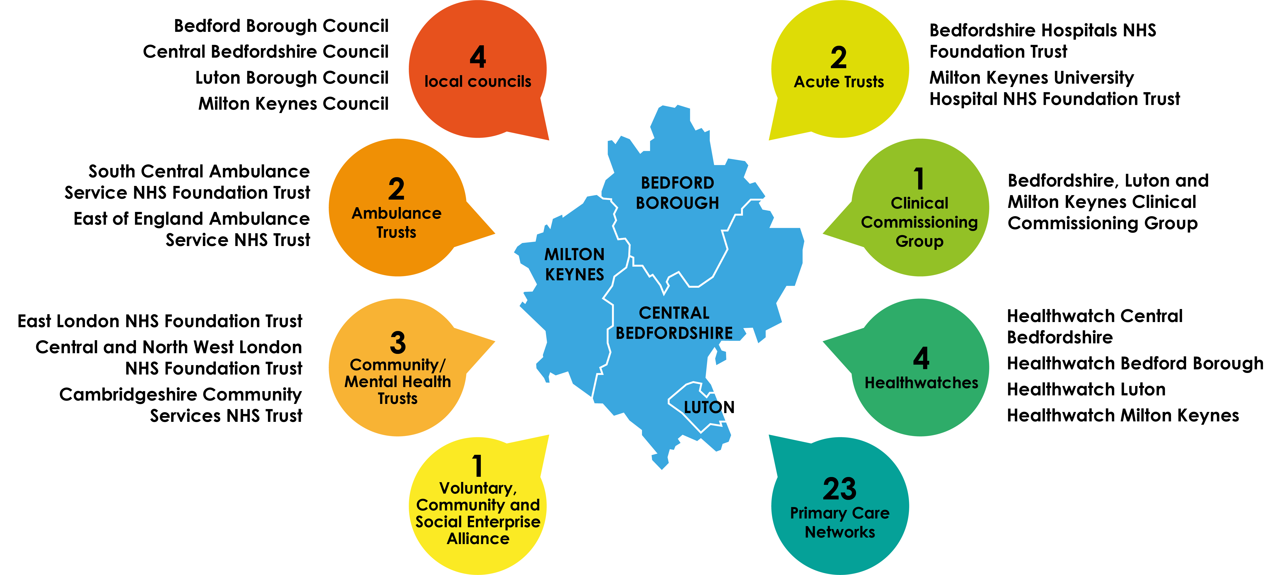
Our partners
12
Proud to be working together for better, more integrated services
in Bedfordshire, Luton and Milton Keynes Integrated Care System

Slide 15
More information
13
For more information, visit
www.blmkccg.nhs.uk

