Slide 1
Bedfordshire, Luton and Milton Keynes Health and Care Strategy – Summary
January 2023

Slide 2
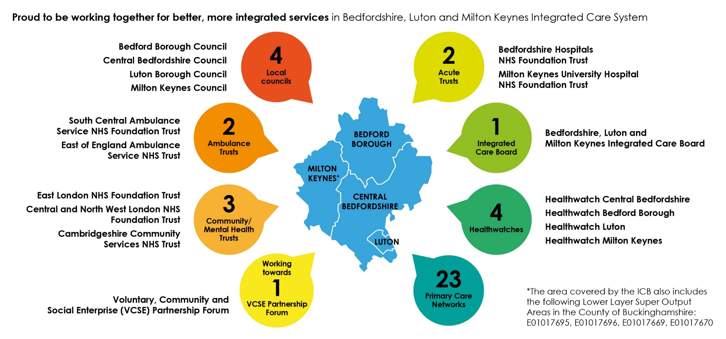
Our vision is for everyone in our towns, villages and communities to live a longer, healthier life
The Bedfordshire, Luton and Milton Keynes Health and Care Partnership aims to improve the health and wellbeing of our population.
Our partnership will help people involved in
your health and care work more closely together. In this way we can do more than
we can as separate organisations, keeping
the needs of residents at the centre of everything we do.
Doing this well relies on strong partnerships:
with you and your family, the voluntary and community groups who keep people connected
and well, our Councils and our NHS.
We know times are tough. But together we can, and will, improve services to help you, your family and your community to thrive.
Over 2,000
Over 2,000 registered charities and voluntary organisations, supported by
a similar number of community and
mutual aid groups
The area covered by the ICB also includes Lower Layer Super Output Areas in the County of Buckinghamshire: E01017695, E01017696, E0101799,and E01017670
VCSE partner organisations
Our system strategy sets out our ambition for improving health outcomes and reducing inequalities.
It shows how we will work together, and what this will mean for people and communities, across Bedfordshire, Luton and Milton Keynes.

Slide 3
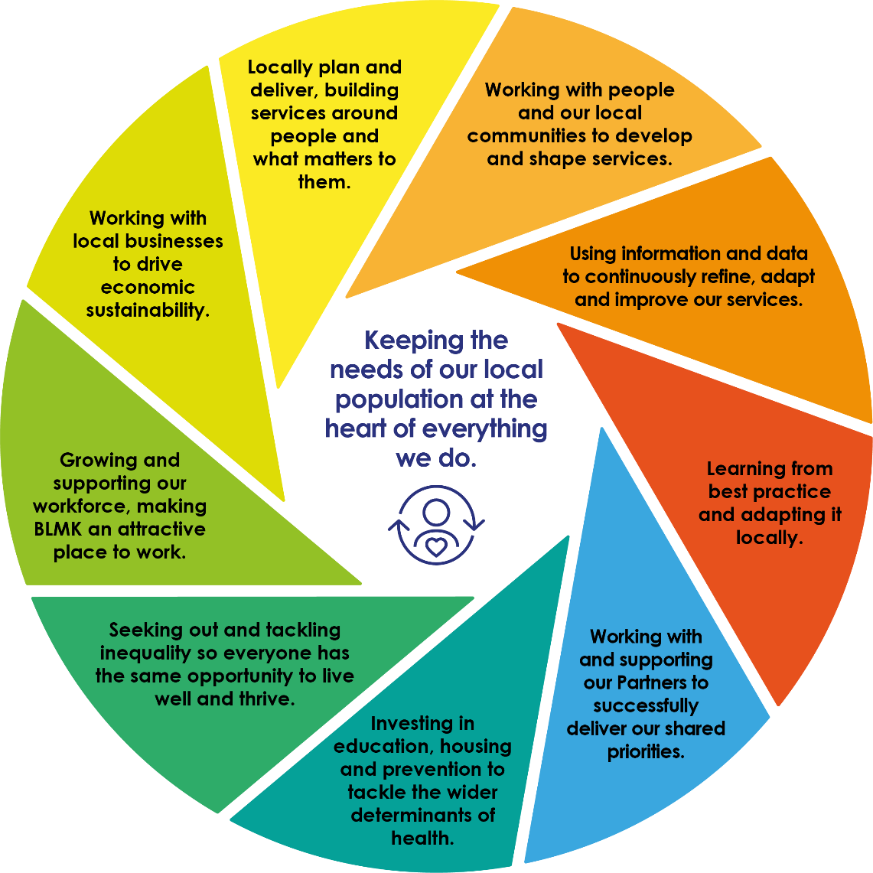
Our overarching ambition is…
to increase the number of years people spend in good health and reduce the gap between the healthiest and least healthy in our community.
Working with local businesses and VCSE partners to drive
economic
sustainability
Our Health and Care Partnership is looking to answer three questions:
Are we doing the right things to improve health outcomes and tackle inequalities for all our residents?
Are we making the best use of partnerships between public services, VCSE partners and local communities?
Are we working with local communities to understand what matters to our residents, and co-designing and co-producing sustainable solutions?
Protecting our environment so we all
can have a healthier future

Slide 4

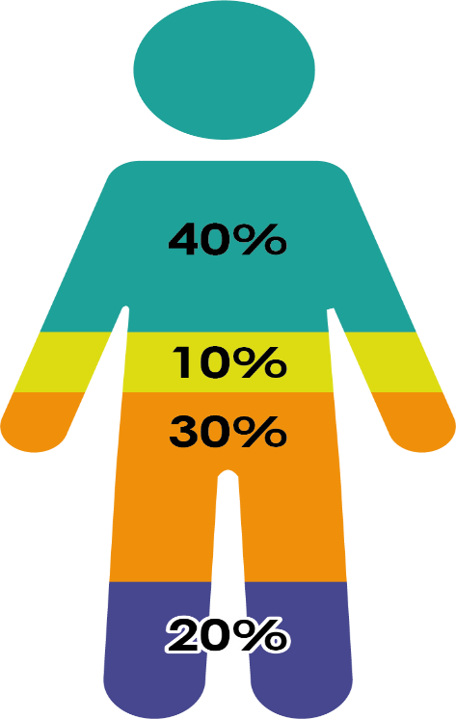


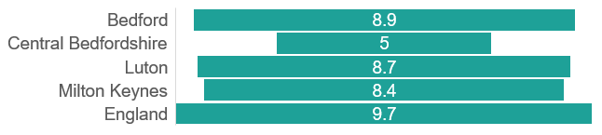
Supporting our communities to thrive
A longer, healthier life for everyone means improving life expectancy and increasing the number of years people live in good health.
We know that both of these measures vary widely across our area, and can lag behind other parts of the country.
Years difference in Life Expectancy: most vs. least deprived
Bedford Borough
There are lots of factors that affect our chances of living a longer, healthier life.
Bedford Borough
Socioeconomic factors
Access to high quality healthcare is very important. But a good education, decent housing, access to the natural environment, working in a growing local economy, keeping active, and enjoying time with other people all have an important part to play.
Prevention, personalised and joined up care also offer people greater control over their own health, to stay well and live longer, healthier lives.
Physical environment
Health behaviours
Healthcare

Slide 5
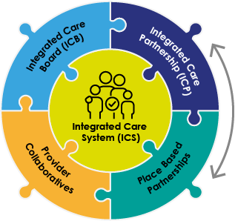
Building our partnership to deliver for our residents
There is no doubt that improving health outcomes and tackling inequalities against the backdrop of increased demand for health and care services, the impact of COVID, and cost of living challenges, is not easy.
We will need to work together, and much smarter, to achieve a greater impact for our residents.
We already have strong foundations in place including:
The commitment across Councils and NHS to improve health outcomes and tackle inequalities.
Our Voluntary, Community and Social Enterprise (VCSE) organisations in all our communities.
Strong partnerships between local Councils and NHS organisations.
All partners, including Healthwatch and the VSCE sector come together at the Health and Care Partnership to oversee our system strategy.
The Integrated Care Board brings together senior leaders from our Councils and the NHS to support delivery against this strategy.
Our place based partnerships bring together partners across a local Council area to agree priorities and take action to meet local needs.
Provider collaboratives work together to tackle specific issues. These include the Bedfordshire Care Alliance and the Mental Health, Learning Disabilities and Autism Collaborative, alongside the East of England children and young people and specialist mental health collaboratives.
Health and Care Partnership

Slide 6
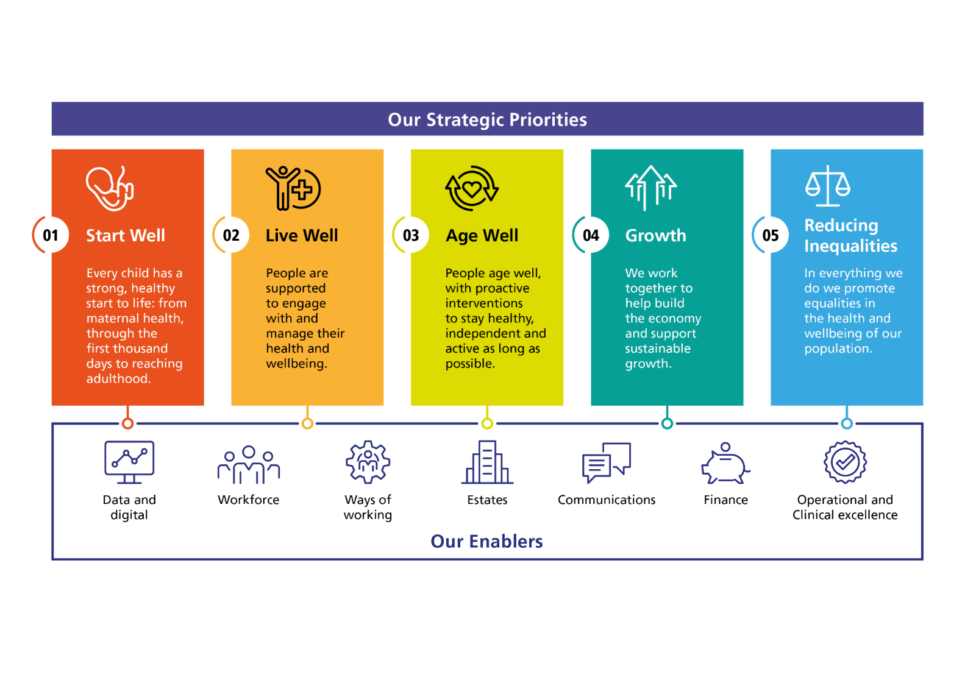
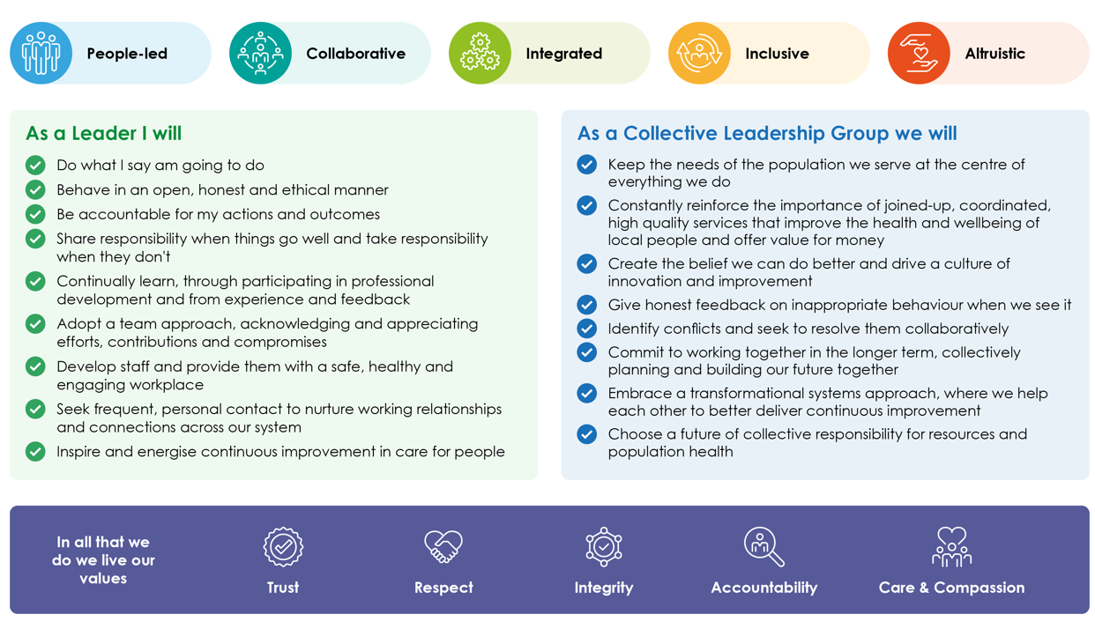
Where we will focus our efforts
Our Health and Care Partnership has five priorities which focus on improving health outcomes and tackling inequalities for people of all ages.
They reflect the importance of growth and sustainability in tackling inequalities, both in physical or mental health, and in social factors such as housing, employment and isolation.
These priorities are supported by seven enabler programmes, which will help us to make progress.
These enablers are underpinned by our system commitment to co-production, population health management, partnership with the VCSE sector, the development of neighbourhood models, and personalised care.
The way we do things is as important as what we do. This is reflected in our system values, which are:
Trust
Respect
Integrity
Accountability
Care and Compassion

Slide 7


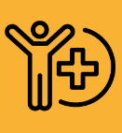
What this means for me and my family
Start well: Every child has a strong start in life
Rapid mental health support, with a focus on prevention to help people stay mentally healthy.
Care is tailored to an individual’s needs for example for people with Learning Disabilities, Veterans, and those in end of life care.
More conditions are prevented and detected early including heart disease, respiratory illness, diabetes and cancer.
Our most disadvantaged babies and their families are offered tailored support through the first 1,001 days of life.
Young people are prepared for adulthood and supported across services, in education and into employment.
All our children are enabled to thrive. They have tools to stay fit and healthy, and support to manage complex care and mental health needs, with extra support for disadvantaged children.
Age well: People age well, staying healthy and independent for as long as possible
Older people are supported to stay well at home, and in their community, tackling loneliness and isolation and maintain independence with support to manage conditions, including dementia.
People are supported with recovery, rehabilitation and reablement, at home or in hospital.
People are supported to die at home if that is their wish, with support for them and their family.
Live well: People are supported to manage their health and wellbeing
People have access to services and tools to take control of their life, wellbeing and health.
Care is built around neighbourhood teams, with accessible primary and personalised care.

Slide 8
Tackling inequalities
What this means for me and my community
Growth and sustainability
People are more likely to live happy, healthy lives if they have the best start in life, use their skills, and have control over their lives.
This includes access to good, fair employment, a decent standard of living, with help to stop people getting ill, and access to healthy sustainable places and communities.
Our commitments to growth and sustainability include:
Environmental sustainability: moving to net zero carbon emissions to reduce the effects of climate change.
Sustainable economic growth: improving opportunities for prosperity for all our population.
Delivering social value: ensuring our work contributes to our whole society, so everyone has the chance of a decent standard of living.
Addressing inequalities in outcomes, access and experience is a golden thread that runs through all our priorities.
Through working with people and communities we aim to understand more about the causes of inequalities and how to address them.
We already know that the way we provide services makes a big difference to how they are used by our residents, and how they impact on health and wellbeing. We are determined that across our partnership, services and support will be fair and accessible to all.
We will also work to tackle the root causes of disadvantages in life, to support people to live longer in good health.

Slide 9
The collaborations designed to meet local needs
Our system is built on the principle that planning and delivery are best done as close to people as possible.
The most important collaboration in our system is the one we have with our people and communities. We will work in a way that represents the views of all our communities and support staff and residents to get involved in designing and delivering care.
Our new neighbourhood teams bring together NHS, Council and VCSE partners around a group of GP practices to support integrated care. These teams will compliment existing partnerships to support children and young people in place across our system.
The Bedfordshire Care Alliance focuses on things that are best done once for the whole of Bedfordshire, including promoting care at home. The Mental Health, Learning Disability and Autism Provider Collaborative supports our services and workforce, promoting emotional wellbeing for children and young people and support for people with autism.
Our place based partnerships have also come together to set out their local priorities in draft place plans:
Bedford Borough
Understanding our communities
Promoting prevention and health promotion
Transforming care with primary care and the VCSE
Central Bedfordshire
Improving access and supporting healthy choices
Supporting independence for older people
Tackling inequalities and wider health determinants
Luton
Giving every child the best start in life
Sustainable communities and tackling inequalities
Reducing frailty and supporting independence
Milton Keynes
Children and young people’s mental health
Tackling obesity
Supporting people with complex needs
Reducing avoidable hospital admissions

Slide 10
Working smarter across our system
We are committed to working together to use our enablers to improve outcomes for our residents:
Building a health and care workforce that is at the heart of our efforts to improve population health.
Our one workforce approach will support staff to work across settings, and ensure we have enough trained, engaged and valued workforce who represent our population, drawing people from all backgrounds.
Delivering excellent care, every time
Our Clinical Services Strategy will support our staff to work at the top of their game. Clinical pathways will focus on quality, be built on best practice, and be co-designed with patients, carers and staff.
We will use safety standards to tackle the root causes of safety issues, and make the changes we need.
We will promote innovation and research to find new and improved ways to support people – implementing, evaluating and spreading innovation.
Planning care around our population’s needs
Good information is essential to plan, deliver and improve services. Shared intelligence will give us a consistent view to tailor activities to residents’ needs.
Making the best use of our resources
Working with partners to spend our health system budget as efficiently as possible. Our place-based approach will help us support communities to thrive.
We will revisit the way we use our estates to adapt to changes in how we work as a result of the pandemic, and our focus on preventative and personalised care.
Taking advantage of advances in technology
We are developing a system-wide single shared health and care record to provide seamless care, supporting access to digital information and tools, and building Virtual Wards to help patients be cared for at home.

