Slide 1
2022/2023
BLMK
Local Transformation Plan update
C&YP
October 2022

Slide 2
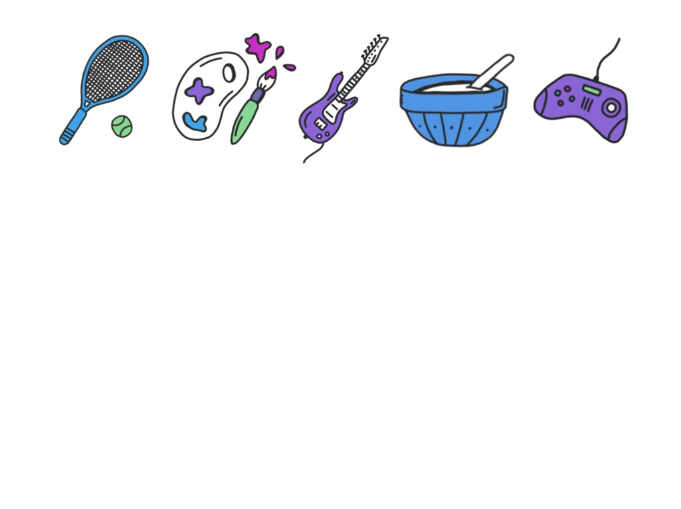
The BLMK Transformation Journey
The following presentation will consider the following areas
The LTP 21/22 and C&YP understanding of this.
I Thrive
Key achievements from 2021 / 2022
The Better Days Programme
Key Highlights 21/22 “we have” & NEXT STEPS For 2022/23 – “we will”
New areas of focus for 2022/23
BLMK 10 year MH and wellbeing plan

Slide 3
Local Transformation Plan 2021 / 22
The involvement of C&Y….in the transformation of C&YP MH services is crucial to those developing services across BLMK.
We wanted to ensure that young people were engaged in the process and understood what we were trying to achieve.
CYP considered this and fedback their collective understanding of the LTP using the medium of art.
The next slide captures this.. With thanks to Jay.. And the the team of young people

Slide 5
Better Days placeholder
=

Slide 6

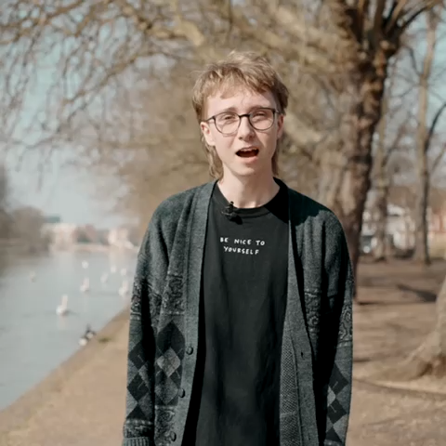
Better days video
Please click on the photograph above to access the Better Days video

Slide 7
Priority areas from 20 21 LTP placeholder
Here’s an overview of what we done against the priorities so far to date - RAG rating / we track delivery

Slide 8

Understanding needs and inequalities AIMS
During 2021 We Have | During 22/23 We will
BLMK inequalities group in place The Better Days Programme Launched the Discovery College Worked with our Parent Carer forums by holding SEND focus groups & received SEND surveys Developed a Social Prescribing pilot | Engage system partners with the Mental Health Insights Data Pack ( 0-25 years) Understand changes in plans due to the impact of the COVID19 pandemic & progress actions from CYP Deep Dive Align work to Core 25 plus5 & Population Health workstreams Double efforts for SP
Notes:
Move all reporting t MHMDS - make user friendly!!
Use BLMK colours - different one for weach page

Slide 9
Workforce
During 2021 We Have | During 22/23 We will
Undertaken BLMK MH workforce events Recruitment strategies for ELFT & CNWL in place Understood our workforce challenges by completing a workforce submission to NHSE and completing the CAMHS Deep Dive. | Drive forward the delivery or our mental health workforce ambitions using our BLMK Mental Health workforce strategy and action plan. Work with NHSE and HEE to access workforce development training opportunities Mobilise Service Development Fund programmes in partnership with the VCSE - and monitor / evaluate impact Progress actions from CYP Deep Dive - develop new workforce / new skills
Notes:
Move all reporting t MHMDS - make user friendly!!
Use BLMK colours - different one for weach page

Slide 10
Health & Justice
During 2021 We Have | During 22/23 We will
Linked specialist CAMHS, SALT and school nurses with our Youth Offending Teams (YOT) to ensure there is quick and early access to care. Accessed specialist forensic CAMHS service to support the care pathway for a young person. Behavioural Improvement Team that targets school input to our Pupil Referral Units. | Continue to be a strategic partner within our 3 youth offending boards and develop the national reporting requirements for MH in 2023 Review needs assessments to ensure our services are meeting the needs of these children and young people. Further understand the role and impact of our street triage service who support our young adults.
Notes:
Move all reporting t MHMDS - make user friendly!!
Use BLMK colours - different one for weach page

Slide 11
Eating Disorders
During 2021 We Have | During 22/23 We will
Expanded the eating disorder services, including medium term investment to provide Intense Home treatment across BLMK. Continued to provide a B&L ARFID service. Established a CYP Eating Disorders Clinical Reference Group (CRG). Developed an integrated clinical protocol for Children with Eating Disorders. Provided a ICS position statement for medical monitoring. | We will expand our services to support children with eating disorders. Develop ARFID pathways across BLMK. Continue progress against the Eating Disorders CRG Action Plan. Continue to monitor the ICS ED access target risk.
Notes:
Move all reporting t MHMDS - make user friendly!!
Use BLMK colours - different one for weach page

Slide 12
Data, Access & Outcomes Across Bedfordshire, Luton and Milton Keynes, we aiming to improving quality of mental health data with our providers and being compliant with data flow to the Mental Health Services Data Set (MHSDS) is a priority for us.
During 2021 We Have | During 22/23 We will
Adapted to the access target change Worked with the VCSE to ensure providers submit data to MHMDS Regular reporting of patient satisfaction rates | Move all reporting to MHMDS Monitor performance against ROMs CQUIN Progress actions from CYP Deep Dive - waiting times
Notes:
Move all reporting t MHMDS - make user friendly!!
Use BLMK colours - different one for weach page

Slide 13
Urgent & Emergency (Crisis) Mental Health Care for Children
During 2021 We Have | During 22/23 We will
Across BLMK developed 111*2 & 24 hour telephone crisis support 7 day working arrangements Mobilised LDA & CED’s Intensive Support Teams | Our Extended Home Treatment Team will proactively work with our community services to avoid admission and to facilitate early discharge Launch the Evergreen Go Live Actively monitor admission avoidance and acute Length of Stays Further develop system working to support CYP / Families with complex need / LDA
Notes:
Move all reporting t MHMDS - make user friendly!!
Use BLMK colours - different one for weach page

Slide 14

Early Intervention in Psychosis
During 2021 We Have | During 22/23 We will
Completed the national clinical audit of psychosis. For Bedfordshire and Luton - ELFT the provisional result is Level 3 (Performing Well). For Milton Keynes - CNWL the provisional result is Level 4 . | The Early Intervention in Psychosis Services for BLMK will continue to meet the access standard of a maximum wait of two weeks from referral to start of treatment, and provide a service for young people from age 14. The Bedfordshire and Luton Service also has a provision for people with an At Risk Mental State (ARMS). Work towards developing the ARMS offer for all our children ( 23/24) *clarify as Adults lead
Notes:
Move all reporting t MHMDS - make user friendly!!
Use BLMK colours - different one for weach page

Slide 15
Mental Health Services working with education settings
During 2021 We Have | During 22/23 We will
Been awarded a multiyear bid process, with Local Authorities supporting the application process and understanding of schools in highest areas of deprivation A BLMK Mental Health and Education Meeting (With a focus on MHST’s) in place | BLMK have four mental health school teams and will mobilise a further seven teams over the next two years. We are currently mobilising three of these teams this academic year. Mobilise the final wave MHSTs Ensure robust reporting in relation to Whole School Approach / 1:1 interventions Map provision for non – MHST schools at place ( including digital offers & increase whole system working )
Notes:
Move all reporting t MHMDS - make user friendly!!
Use BLMK colours - different one for weach page

Slide 16
Digitally Enabled Care Pathways
During 2021 We Have | During 22/23 We will
Completed an evaluation of Kooth Developed the CHUMS online self help offer Developed the guided self help for MHST’s (vimeo) Launched Discovery College | We are establishing new ways of providing services for our children, building on the rapid mobilisation of our digital care pathway as a result of the Pandemic.
Notes:
Move all reporting t MHMDS - make user friendly!!
Use BLMK colours - different one for weach page

Slide 17

New areas of focus and priorities for systems in 2022/23
  Whole System working - describe ICS and focus on Deep Dive and I Thrive leadership whole system working outcomes
  Wider Transformation - focus on Prevention and Early help, Better Days. Start to do things differently
  Young Adults - focus on 18-25 SDF funding & data collection (*adults lead)
  In 2022/23, we want to use the SDF data collection to better understand systems progress on improving services for young adults. Systems will be asked to report against 8 key areas to improve mental health services for young adults.
Notes:
Move all reporting t MHMDS - make user friendly!!
Use BLMK colours - different one for weach page

Slide 18
BLMK 10 year mental health and wellbeing plan
Our vision in Bedfordshire, Luton and Milton Keynes is centred around preventing our residents from becoming unwell, promoting good mental health and supporting people living with mental illness to recover and live well. We commit to doing this by:
Supporting the general population to take action and look after their mental wellbeing.
Preventing the onset of mental health difficulties, by taking action to address the factors which play a crucial role in shaping mental health and wellbeing outcomes for adults and children.
Supporting services to continue to expand and transform to meet the needs of people who require specialist support.
Notes:
Move all reporting t MHMDS - make user friendly!!
Use BLMK colours - different one for weach page

Slide 19
We recognise workforce is our biggest risk

Slide 20
BLMK Better Days Workshop - Themes
What isn’t working?
Knowing who to refer where / understanding local offers…./ pathways
Not all professionals understand CAMHS thresholds or know where to signpost
Language across the system – move away from medical model and focus on recover – TOO CLINICAL
CYP with NDD conditions / that come to service late and haven’t had support to understand their conditions
Duplication across the system…how can we work smarter.
Misunderstanding of presentation/behaviours due to different cultural reasons and norms. i.e. he/she is not engaging.
“It fells like NHS mental health service staff are often trying to meet a quota and palm people off on to meds instead of actually trying to help.”
The wider system is diagnosis/crisis led and too medical, not on a needs-led basis.
Improved understanding and communication between professionals.
Use of language to destigmatise conversations around mental health.
Themes
Notes:
This is what we’ve heard isnt working
Themes from improvement - - bottom two

Slide 21
What can we improve?
Feeling like we are competing with each other is a barrier to partnership working. This requires a very honest discussion with commissioners/grantmakers & voluntary organisations. Until we do this there will be a reluctance to work in true and honest partnership.
Advertising of support available that is accessible. How to reach you people that don’t access any services of know about current forums?
Support in early years and schools-emotional well being as a priority with techniques for managing feeling, etc being embedded into routines. Building skills from a very early age. Also for parents to understand more about emotional wellbeing – their children’s & their own.
“As a young person, time is not the issue but rather the lack of communication. Having someone being in contact with you and keeping you up to date would be a lot more helpful than just waiting in the dark.”
Transitions
Joined up approach/better information sharing between service to avoid young people having to repeat their stories to numerous strangers.
Better understanding of what’s available – for young people themselves and professionals – the landscape constantly changes so useful to have an up date.
Extending brief/crisis interventions with something creative like this? Not just signposting but really facilitation them to get into this programme.
Finding a more effective way to engage with marginalised groups.
Themes
Adopting even more person-centred/holistic approach to working with YP.
Improve accessibility to information, resources, events & support.
Improved communication between partner agencies.

Slide 22
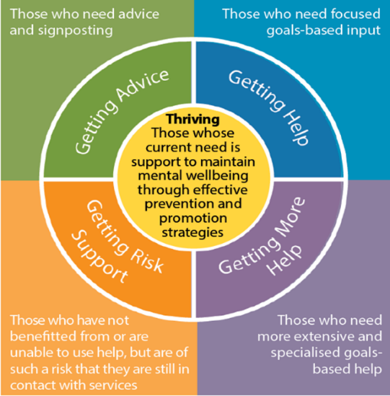
I THRIVE
Thriving
Getting Advice
Children and young people with mild or temporary difficulties AND those with fluctuating or ongoing severe difficulties, who are managing their own health and not wanting goals-based specialist input.
Getting Help
Children, young people and families who would benefit from focused, evidence-based help and support, with clear aims, and criteria for assessing whether these aims have been achieved – CHUMS, Counselling etc
Getting More Help
Children , young people who need EXTENSIVE, focused and evidence-based interventions. Children with a range of overlapping needs that mean they may require greater input, such as the coexistence of autistic spectrum disorder (ASD), major trauma or broken attachment
Getting Risk Support
C&YP who despite extensive input, they or their family are currently unable to make use of help, more help or advice AND they remain a risk to self or others.
Notes:
CD

Slide 23
Introduction to I thrive I THRIVE
…
We are moving towards system thinking using the I thieve pruinicple – a bit fo infiormatiokn
Around 80% of children at any one time are experiencing the normal ups and downs of life but do not need individualised advice or support around their mental health issues.
They may benefit from prevention and promotion strategies to maintain wellbeing
Notes:
CD

Slide 24
Key Achievements 2021 / 2022
Here’s an snap shot of what we done against the priorities so far to date -
Getting Advice
Social Prescribing supporting C&YP…. / impact
Discovery College offer that is open to
Service Development funding to increase counselling capacity
The delivery of Parent / Carer Psychoeducation
Getting Help
Mental Health Schools Teams - cover ag
Primary Care Access Service - B&L
Single CHUMS contract - B&L
Getting More Help
CAMHS SPOE
Eating Disorders service - BLMK
Neuro Developmental service – B&L
Getting Risk Support
Crisis / Home Treatment service Segment from thrive – cropped as image
Evergreen Inpatient service
Intensive support teams
  Eating Disorder
  Neuro Developmental

