Slide 1





BLMK “Future of Digitisation” Care Conference 2024
Wednesday
4 September 2024
Progressing digitisation and innovation in partnership with our BLMK care providers
#BLMKdigitalcare2024

Slide 2
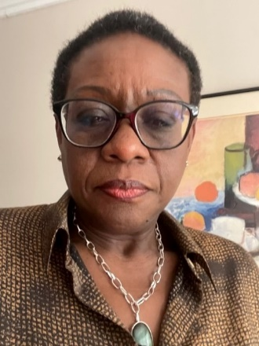
The Future Digitisation of Social Care
Patricia Coker, Senior Responsible Officer
Head of Integration (Health and Adult Social Care)
Adult Social Care and Housing
Central Bedfordshire Council
Bedfordshire, Luton and Milton Keynes Health and Care Partnership

Slide 3
Welcome
This conference is a unique forum connecting social care with NHS Digital, NHS England (NHSE), Integrated Care Board (ICB), decision-makers, health services and healthcare organisations to:
Exchange new ideas and innovations
Network with colleagues, system providers, regulator, NHSE, and professionals from across the healthcare community
Showcase DiSC accomplishments and share future plans
Listen to your peers' experiences of using digital technology
Share your experiences, views, and requirements
Share knowledge and good practice in digital transformation, leadership, management and service delivery
Health and Safety – Fire alarms // Toilets // Facilities // Feedback

Slide 4
Our partners
4
local authorities
2
acute trusts
3
mental health trusts
2 ambulance services
25
primary care networks
484
care providers
One Integrated Care System:
Containing
89
GP practices
121
care homes
127
LD/MH homes
236
domiciliary/ home care
Three unique features:
System-wide relationships supported by a dedicated team
Highly effective partnership working based on true co-design
Significant benefits for our residents and our care providers.

Slide 5
Key challenges
Timeframe – almost all the schemes are funded on a proof-of-concept basis working with new or evolving technology, not long enough timeframe to produce evidence of long-term impact.
DiSC team sustainability – formed in 2021, we brought together the four local authorities, hospitals and community services to support adult social care digital transformation across BLMK. As the national funding reduces each year, it’s difficult to sustain the current model for future transformation and support the delivery of strategic priorities consistently.
Building confidence with the care sector – barriers to engage and trust include change management, digital literacy, and data security and privacy concerns. We have continuously encouraged and supported through regular communication and engagement, providing resources, and strengthening relationships.

Slide 6
Your feedback
We have listened and acted on your feedback from last year’s conference to make this year’s event even better:
Reduced marketplace size to allow more time to speak with suppliers, and time for networking
Evaluation form available in paper format or online to complete before you leave
Interactive sessions – panel discussion, workshops and masterclass
The opportunity to see some of the technology and to speak directly with the tech suppliers.

Slide 7








Programme
We have speakers and suppliers in the marketplace from:

Slide 8
Programme
10.15 BLMK ICS
10.30 NHS Digital
10.45 NHS England
11.00 Refreshment break, networking and marketplace
11.45 Panel discussion
12.00 Provider stories
12.15 DiSC Team
12.30 Better Security Better Care - Masterclass
13.00 Lunch and marketplace
13.45 Workshop 1 – Lockyer Suite for domiciliary care and others
Workshop 2 – Davis Suite for nursing and residential care
14.30 Feedback and panel Q&A
14.50 Closing remarks and evaluation
Health and Safety – Fire alarms // Toilets // Facilities // Feedback

Slide 9

Digitisation of Social Care
Clare Steward
DiSC Programme Director
Bedfordshire, Luton and Milton Keynes Integrated Care System

Slide 10
BLMK ICS DiSC Programme
In line with the national Social Care Programme, the BLMK ICS DiSC programme continues to support local government, the NHS, and the wider adult social care sector to improve the digital maturity of adult social care delivery and support digitisation across the healthcare system.
We secured a total investment of £1,592,610 in 2023/24 from various national funding streams. Total funds secured to date are £5,363,238. Funding primarily covers the technology, training, design and evaluation.
“To promote independence, choice and quality of life for our residents.”
Aims:
driving rapid adoption of digital social care records – to enable secure sharing of information across health and care services and free-up time for care staff and managers
testing, evaluating and scaling technologies based on local priorities, building the evidence base for future investment – to increase the use of technologies that improve the quality and safety of care, reduce avoidable hospital admissions, and promote independent living
supporting care providers to boost their digital readiness, including digital skills, connectivity and cyber security – to give the social care workforce the confidence, skills, support and infrastructure to effectively use technology to provide high quality care.

Slide 11
Overview of externally-secured resource investment and costs to date
The BLMK DiSC Programme has successfully secured funding, not least due to its reputation and strong system-wide governance arrangements
Funding is aligned to specific project delivery targets. It primarily covers the technology costs, training, maintenance, licenses, design, evaluation and in many instances a portion of the staffing resource; this does not tend to cover ‘business as usual’ work
In Years 1and 2 the majority of the funds have come from other income streams. Typically several of the bids required match funding. The total funds secured to date includes funding for projects that have since completed and for which ongoing central funding has not been available
Average income to the system = £1,787,746 per annum.
Year 1
(partial year)
2021/22
£738,000
Year 2
2022/23
£2,096,079
Year 3
2023/24
£1,592,610
Year 4
(partial year)
2024/25
£936,549
Total funds secured to date
£5,363,238

Slide 12
Reflections on 2023/24
ICS partners have invested time and effort to better understand and address our care market’s evolving digital needs, preferences and priorities:
Aligning our programme more closely with our local authorities’ objectives, particularly the
Care Act 2014 and What Good Looks Like
Conducting digital needs assessments, involving stakeholders in the redesign process, and aligning objectives with organisational goals and strategic initiatives
Working with stakeholders to evaluate/update governance processes/structure.
I would like to thank the DiSC team, care providers, system suppliers, our community and voluntary services, residents, professionals, BLMK ICS and local authority leadership team for their continuing support. Thanks also to the NHS England and Department of Health and Social Care regional team for their support and guidance.
Bedfordshire, Luton and Milton Keynes Health and Care Partnership
Notes:
I’m incredibly proud of the progress we’ve made in 2023/24 and excited for the opportunities that lie ahead. The DiSC programme (hosted by CBC) is committed to harnessing technology to revolutionise the social care we provide to our residents. Our collaborative approach identifies the key areas for future investment – to ensure that everyone receives the high-quality, person-centred care they deserve.

Slide 13



Summary of 2023/24
This year, our focus has been on accelerating the current delivery of our three inter-related workstreams (see diagram)
– achieving transformative impacts on adult social care and health delivery, promoting interoperability, efficiency, and resident-centred care.
Through collaborative partnerships, innovation, and continuous improvement, we have laid the foundation for a digitally-enabled healthcare system that prioritises residents’ wellbeing and delivers value-based care.
As a result of the 2022 Adult Social Care Digital Transformation Fund three-year strategy, we have delivered significant changes to the use of technology by adult social care providers in BLMK, and significantly improved our digital footprint. From a relatively low base in 2022, our approach has positioned us well into becoming more digitally mature across the adult social care partner organisations in BLMK.
We have achieved significant milestones and delivered tangible benefits across various aspects of healthcare delivery.
Digital
records
Remote monitoring
Falls prevention

Slide 14
Key highlights
As we reflect on our journey, we celebrate the progress made in enhancing access, coordination, and quality of care for individuals across our communities. 2023/24 has been a transformative year, marked by significant achievements and impactful outcomes in advancing digital solutions for adult social care.
Secured additional funding to expand remote monitoring across BLMK ICS
Achieved the 80% national Digital Social Care Records target
Engaged with stakeholders from diverse backgrounds, fostering collaboration and partnership to drive innovation and address key challenges in the social care landscape
Coordinated the successful Accelerating Reform Fund (ARF) bid of £795,750 plus £300,000 set up cost on behalf of the four local authorities
Shortlisted at the HSJ Digital Awards 2023 in the ‘Connecting health and social care through Digital’ category
Secured £1.1 million to develop the Enhancing Wellbeing through Digital programme – introducing PainChek and RoboPets
Agreed the DiSC Year 3 plan funding of £400k
Invited to participate in a national DSCR Research initiative
Reviewed and updated programme governance arrangements
Restructured to be more cost effective, reducing programme running costs by 20%
Outline Business Case to support the sustainability of the DiSC programme.

Slide 15









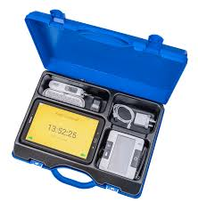




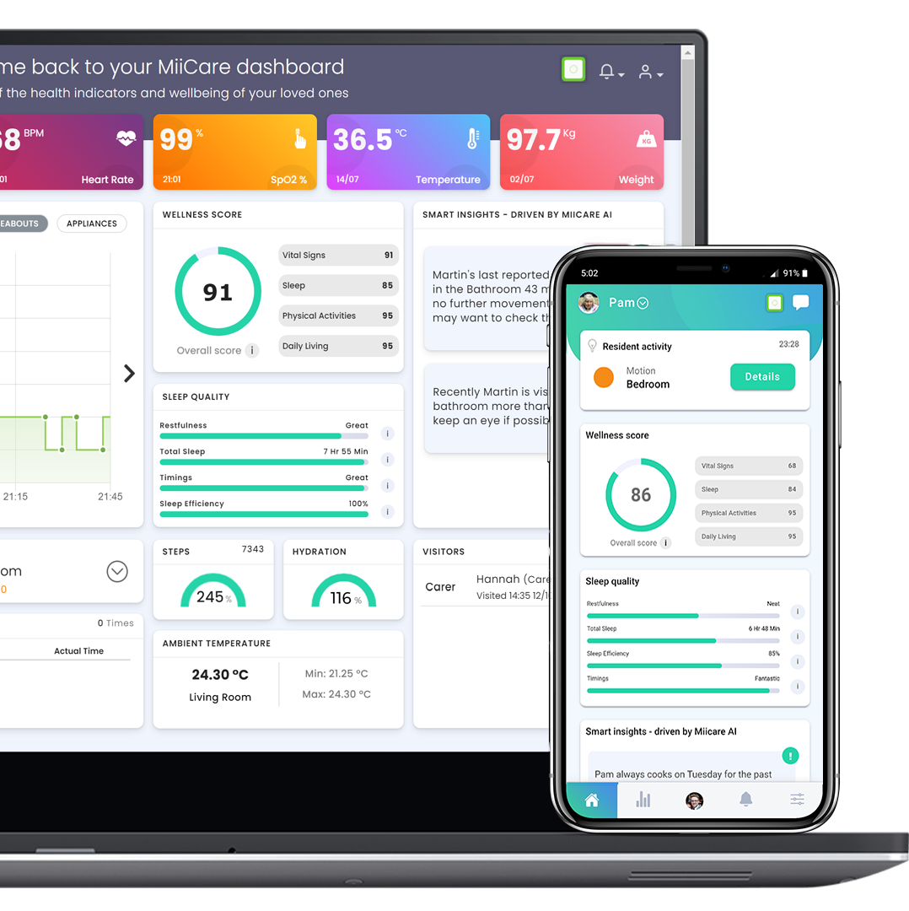
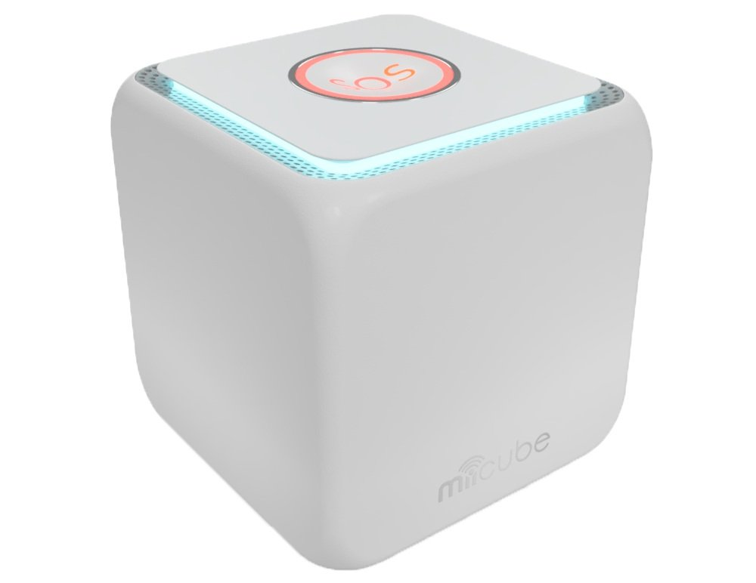



Delivery and achievements 2023/24
Digital Social Care Records
Data Security and Protection Toolkit
DIGITAL RECORDS
80% of providers now using NHS-assured DSCR (against 70% target)
70% of providers have met the standards, measured compliance against legislation and central guidance
NHSmail
Raizer II Chairs
80% residents have a digital social care record
175 Raizer Chairs installed
145 care locations
Increased digital solutions available to care providers
123 active NHSmail accounts
Allowing the safe sharing of information/records
FALLS PREVENTION
34% have full access to GP services for someone they care for (against 20% target)
Whzan
Proxy Access
3,079 residents supported
1,034 days of staff time saved
343 residents supported
12 care homes
Fewer emails and
calls from care
homes to surgery
90 care homes
30 kits installed
44% reduction of nighttime checks, 6,758 a month
6% drop in A&E attendance
Supporting 39 residents living at home
Audit trail and reduced admin
25% reduction in routine site contacts
Acoustic Monitoring
Sensor-based falls prevention
REMOTE MONITORING
MiiCare
Supporting independent living

Slide 16
What helps our approach to ensure effective partnership working
We have effective collaboration between health and social care partners
We are increasingly familiar with working together
The way we do business is to co-design with care providers and product companies
Our annual Digitising Social Care event is open to the care market and digital system providers
We attend regular meetings to ensure our partners are updated on our progress
We regularly review how are products are working to ensure they meet the needs of care homes and residents

Slide 17
Looking ahead
Scaling up remote monitoring – supporting 181 Discharge to Assess Beds, 53 additional care locations, pilot to test how it will work in domiciliary care settings, and S1 integration. Scaling up falls prevention – piloting how Raizer Chairs in domiciliary care settings will support residents living at home.
Data-driven decision-making – leveraging the power of data analytics to inform service delivery for remote monitoring, pain management, mental health and fall prevention – enabling a more targeted interventions improving outcomes for service users.
Integration and interoperability – ensuring seamless integration and interoperability between different digital platforms used in social care to create a more holistic view of service users' needs and streamline care coordination.
Collaboration and innovation – continuing to foster collaboration between stakeholders (including government agencies, technology providers, social care providers and service users) to drive further innovation in the digital transformation of social care.

Slide 18
With thanks to yourselves, the team, and our partners
BLMK ICB – Clare Steward
clare.steward@nhs.net
Central Bedfordshire – Patricia Coker
patricia.coker@centralbedfordshire.gov.uk
NHSE – Caroline Day
caroline.day16@nhs.net
Central Bedfordshire – Joanne Harlen
joanne.harlen@centralbedfordshire.gov.uk
BLMK ICB – Amtar Ali
amtar.ali2@nhs.net
Central Bedfordshire – Cheryl Stimson
cheryl.stimson@centralbedfordshire.gov.uk
BLMK ICB – Anna Ellis
anna.ellis6@nhs.net
AGEM & ML CSUs – Amy Egan
amy.egan@nhs.net
Luton – Lisa Burke
lisa.burke@luton.gov.uk
Bedford Borough – Terry Wright
terry@bedscaregroupltd.co.uk
BLMK ICB – Sherry Adeboye
serifat.adeboye@nhs.net
AGEM & ML CSUs – Sarah Makin
sarah.makin@nhs.net
Bedford Borough – Nigel Murray
nigel@bedscaregroupltd.co.uk
Central Bedfordshire – Rachel Austin
rachel.austin@centralbedfordshire.gov.uk
Beds Care Group
Health Innovation East
University of Hertfordshire
Email the team: blmkicb.digital.socialcare@nhs.net
DiSC webpages: https://blmkhealthandcarepartnership.org/our-priorities/data-and-digital/digitising-social-care-disc-programme/

Slide 19

Mark Thomas
Chief Digital and Information Officer
Bedfordshire, Luton and Milton Keynes Integrated Care System
Bedfordshire, Luton and Milton Keynes Health and Care Partnership

Slide 20
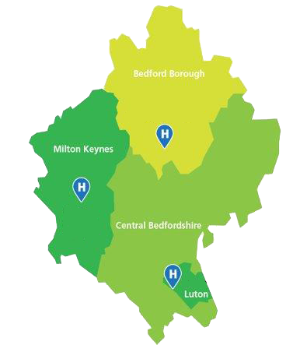


Bringing the pieces together

Slide 21

Bringing the pieces together
Share for Care
Your achievements
SVoTT
Our opportunities
Caroline Day
Programme Manager
Digitising Social Care Programme
Mark Nicholas
Deputy Director for Platforms and Services
The future vision

Slide 22
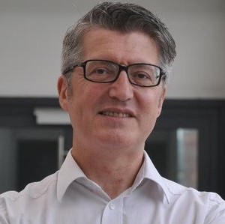
Mark Nicholas
Deputy Director and Chief Social Worker
NHS England Transformation Directorate
Bedfordshire, Luton and Milton Keynes Health and Care Partnership

Slide 23


Digital Health and Social Care
Mark Nicholas
Deputy Director & Chief Social Worker NHS England Transformation Directorate

Slide 24
Early indicators for digital healthcare?
Innovation and adoption strategy – faster procurement and regulatory approval
Focus on patient control – managing medicines, appointments, notifications via NHS App
Patient safety – digital aspects?
Shift from acute to primary and community – sharing information across professionals and organisations
National Care Service – national standards, emphasis on consistency across the country
‘Home First’ principle – living independently as long as possible
Hospital discharge and looking at role of social care in delivering health
treatment/monitoring
Social determinants of health – importance of data
Use of AI – health and social care

Slide 25
Relevant TD work programmes
DiSC
Greatly increased functionality in the NHS App – ‘the front door to the NHS’
Proxy access standard
Digital health checks
Client level data
  LAs
  Providers – CQC interest
Federated Data Platform
  Connecting existing systems’ data and enabling it to flow between them
Children’s social care
  CP-IS
  Cross government work on information sharing and LA system suppliers
Shared care records
  Across primary, acute and community, but including social care
Development of DDaT skills and Clinical Informaticians
  ‘Clinician’ involvement in design, delivery and deployment of new systems

Slide 26
Implications for social care providers
Continued focus on digitisation across health and social care
Increased ability for users of services and their families to be able to access services digitally
Importance of data, both for service and system planning
Opportunities for accessing and providing information for direct care
Opportunities for building digital skills
DSP Toolkit
Evaluation/re-evaluation of business case for digital investment
Sustainability – large vs small provider

Slide 27
Thank You
@nhsengland company/nhsengland england.nhs.uk
5

Slide 28
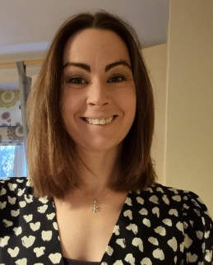
Caroline Day
Programme Manager – Implementation Support,
East of England and South West Regional Lead
Digitising Social Care Programme
NHS Transformation Directorate
NHS England
Bedfordshire, Luton and Milton Keynes Health and Care Partnership

Slide 29
Digitising Social Care Programme
September 2024

Slide 30

Programme Objectives
Drive the rapid adoption of digital social care records.
Test, evaluate and scale care technologies based on local priorities, building the evidence base for future investment.
Help care providers to boost their digital readiness, including digital skills, connectivity and cyber security.
Notes:
Drive the rapid adoption of digital social care records. This will enable secure sharing of information across health and care services and will free up time for care staff and managers.
Test, evaluate and scale care technologies based on local priorities, building the evidence base for future investment - this will increase the use of technologies that improve the quality and safety of care, reduce avoidable hospital admissions, and promote independent living.
Help care providers to boost their digital readiness, including digital skills, connectivity and cyber security - this will give the social care workforce the confidence, skills, support and infrastructure to effectively use technology to provide high quality care.

Slide 31




Benefits Position
90% reduction in stationary costs and savings of up to £120,000 per year on archive storage costs
Initial care assessments completed in 3 days, instead of 7 days of a new resident arriving in a care home
Time taken to review and update a resident's care plans reduced from 4 hours, to 30 minutes
1 hours per shift saved per care worker, who no longer needs to write up notes
Financial savings
Initial assessments
Care plan reviews
Time savings from tasks
Notes:
We are proud to say that 1 in 3 people in receipt of adult social care now have a digital care plan in place thanks to the works delivered as part of this programme.
By the end of the programme we expect this to rise to 1 in 2 people.
BLMK have been at the forefront of this work. The only Integrated Care System in the region to secure Care Technology Funding.
Developed a team of talented people working across BLMK to help you on your digital journey. – Shows their commitment to social care providers and to helping you to be the best you can be.

Slide 32
Benefits Position
90% reduction in stationery costs and savings of up to £120,000 per year on archive storage costs
Initial care assessments completed in 3 days, instead of 7 days of a new resident arriving in a care home
Time taken to review and update a resident's care plans reduced from 4 hours, to 30 minutes
1 hours per shift saved per care worker, who no longer needs to write up notes
Initial assessments
Care plan reviews
Time savings from tasks
Financial savings

Slide 33
Benefits Position
90% reduction in stationary costs and savings of up to £120,000 per year on archive storage costs
Initial care assessments completed in 3 days, instead of 7 days of a new resident arriving in a care home
Time taken to review and update a resident's care plans reduced from 4 hours, to 30 minutes
1 hours per shift saved per care worker, who no longer needs to write up notes
Financial savings
Care plan reviews
Time savings from tasks
Initial assessments

Slide 34
Benefits Position
90% reduction in stationary costs and savings of up to £120,000 per year on archive storage costs
Initial care assessments completed in 3 days, instead of 7 days of a new resident arriving in a care home
Time taken to review and update a resident's care plans reduced from 4 hours, to 30 minutes
1 hours per shift saved per care worker, who no longer needs to write up notes
Financial savings
Initial assessments
Time savings from tasks
Care plan reviews

Slide 35
Benefits Position
90% reduction in stationary costs and savings of up to £120,000 per year on archive storage costs
Initial care assessments completed in 3 days, instead of 7 days of a new resident arriving in a care home
Time taken to review and update a resident's care plans reduced from 4 hours, to 30 minutes
1 hour per shift saved per care worker, who no longer needs to write up notes
Financial savings
Initial assessments
Care plan reviews
Time savings from tasks

Slide 36
Care Technology
Piloting & Scaling Projects

Slide 37
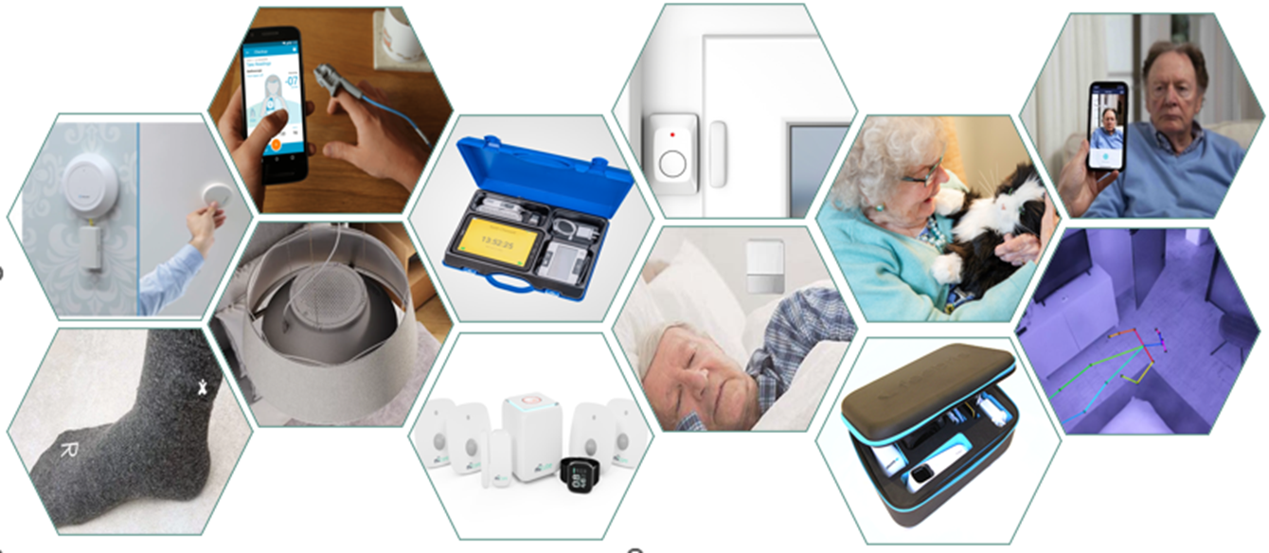
Piloting and Scaling Projects
Notes:
DHSC and NHSE are funding hundreds of projects across the country to test and scale care technology
Acoustic monitoring
Remote monitoring kits
Companion pets
Smart light bulbs
Smart socks
Home health coaches
Fire alarm pillows
Acoustic monitoring
4D Radar devices
Hydration mugs
Home sensor kits
Wearable devices such as watches and wristbands
Medication reminder kits
Some of this technology has been shown to reduce falls by up to 84%.

Slide 38
Social Care
Data Interoperability

Slide 39




Benefits of data sharing
DIRECT CARE
POPULATION HEALTH MANAGEMENT
OVERSIGHT & SERVICE MANAGEMENT
RESEARCH & INNOVATION
Live Care Data to support frontline services
Person Centred Care
Benchmarking
Improved data quality
Preventative Approaches
Learning and Sharing Practices
Inform Policy Making
Timely Care
Safeguarding
Inform decision making
Holistic Overview
Collective data to identify themes in solutions/issues
Audit, benchmarking, research and quality
Data Driven Innovation
Notes:
Where do we go from here? ………………
Sharing best practice, sharing data, improving health and social care for the people at the heart of the service we deliver.
If we don’t join up the system, we miss out on the benefits.

Slide 40
Find out more by visiting www.digitisingsocialcare.co.uk

Slide 41

Refreshment break, networking and marketplace
#BLMKdigitalcare2024
Please return by 11:45am
Bedfordshire, Luton and Milton Keynes Health and Care Partnership

Slide 42
Panel discussion
Questions for speakers
Bedfordshire, Luton and Milton Keynes Health and Care Partnership

Slide 43
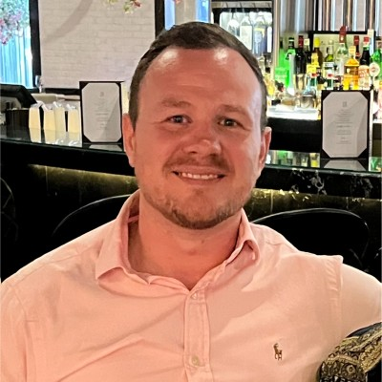

Provider stories
Gareth Tindall
Head of Business Support
Bedford Citizens Housing Association
Bedfordshire, Luton and Milton Keynes Health and Care Partnership

Slide 44

Digitalisation in Care
BEDFORD CITIZENS HOUSING ASSOCIATION
GARETH TINDALL

Slide 45
Who am I?
Notes:
My name is Gareth Tindall and I am the Head of Business Support for Bedford Citizen Housing Association. We are a housing association in Bedford and provide housing for older people in addition to having a registered care home.
I have worked for BCHA for 7 years. I have had a background of working in local government, housing and property.
In my role I am responsible for BCHA’s Housing stock, Property services, HR and IT.
I came to work I left the world of housing to explore an exciting new career in for a utilities provider. I found myself missing housing which lead to me joining Bedford Citizens HA. Prior to this my experience of care was visiting my grandfather who was cared for in a home in Bedford. Whilst I believe the care he received was good and he was looked after an people did care
From the moment I visited Bedford Charter House this was totally different to my experience of care before, this was a purpose built building was way a way from the converted Victorian house I had experienced.
Since then I have been learning everyday from the wonderful care professionals I work with everyday. Learning experiences like implementing digital care system and emar systems have allowed me to understand more about care. I feel very smug now where I hear someone say they are taking naproxen and I can add that they should also be taking ompersol to protect their stomach lining.

Slide 46
Who are BCHA?

Slide 47




Who are BCHA?
1957
1969
1980
2015
BCHA
CARE HOME
MERGER
DEVELOPMENT
The organization was formed
The first Charter House opened
BCHA merged with Maydenbury HA
The new Charter House & Oak Way House
Notes:
In 1957, BCHA was formed as a not-for profit organisation to provide great-quality rented accommodation for people who were unable to afford to rent or buy somewhere to live. The organisation was founded by a group of Bedford residents, hence our name ‘Bedford Citizens’ Whilst how we do things and the services we provide have changed considerably over the years, our purpose and objectives remain the same and are very much at the heart of what we do. The first BCHA flats opened in 1958 and we initially purchased existing properties and redeveloped them. By the end of the first decade, BCHA had developed a better understanding of the services that our residents needed and an ambition to build high-quality affordable homes for our residents.
It was at this time the organisation developed the first BCH purpose-built care home, which opened in 1969.
BCHA grew again through a merger with Maydenbury Housing Association in 1980. It was in this decade that we saw the introduction of our first sheltered flats in Bedford. Bedesman House opened first in 1983, and this was followed in 1988 by Maydenbury House
BCHA was keen to begin developing more new schemes that would help older people to live well in accommodation specifically designed to meet their needs. We were successful with our ambitions and the new Bedford Charter House care home was completed in 2015. In 2017 a brand-new Extra Care scheme was completed. Oak Way House was another exciting milestone in the re-development of the Kimbolton Road site providing 42 flats in a modern, comfortable setting tailored to our residents’ needs.

Slide 48
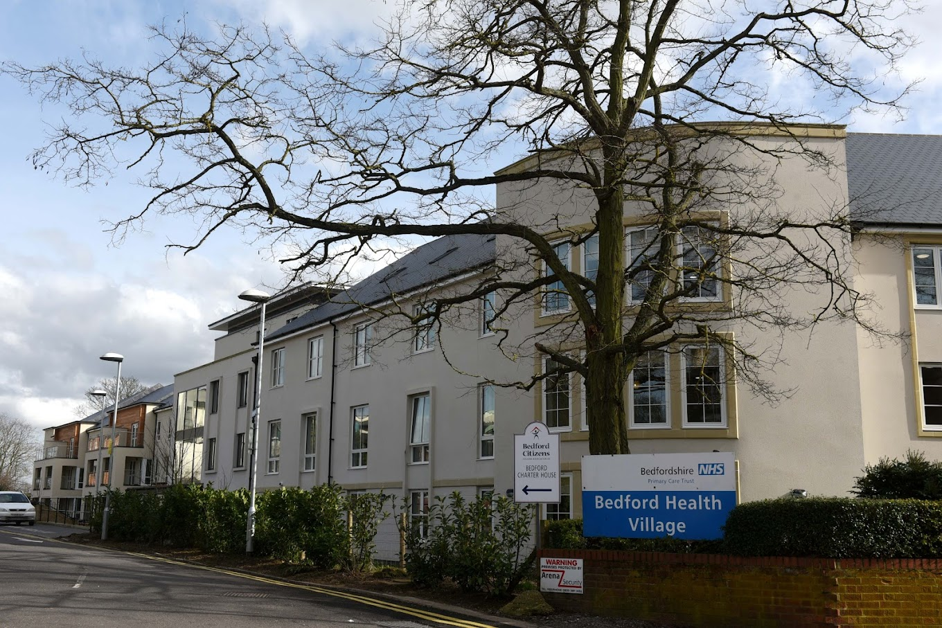
Who are BCHA?
Notes:
Today I will be taking about the digitalisation in our care service at Bedford Charter House.
Bedford Charter House is a purpose built 72 Bed residential care home in Bedford town centre (near north wing hospital site)
We support people with a wide range of care need such
Dementia
Physical Disability
Sensory Impairment
Respite Care
We have a staff team of circa 165 staff with a full time equivalent of 100 who are vital to the care we provide.

Slide 49
Technology in Care
Notes:
In the time that I have been at BCHA we have made huge changes in our use of technology to support our business processes.
We have got from having people submit leave requests by filling out a leave card and sliding this under the Care Managers door to utilising all of these services and probably more.

Slide 50


























Technology in Care

Slide 51
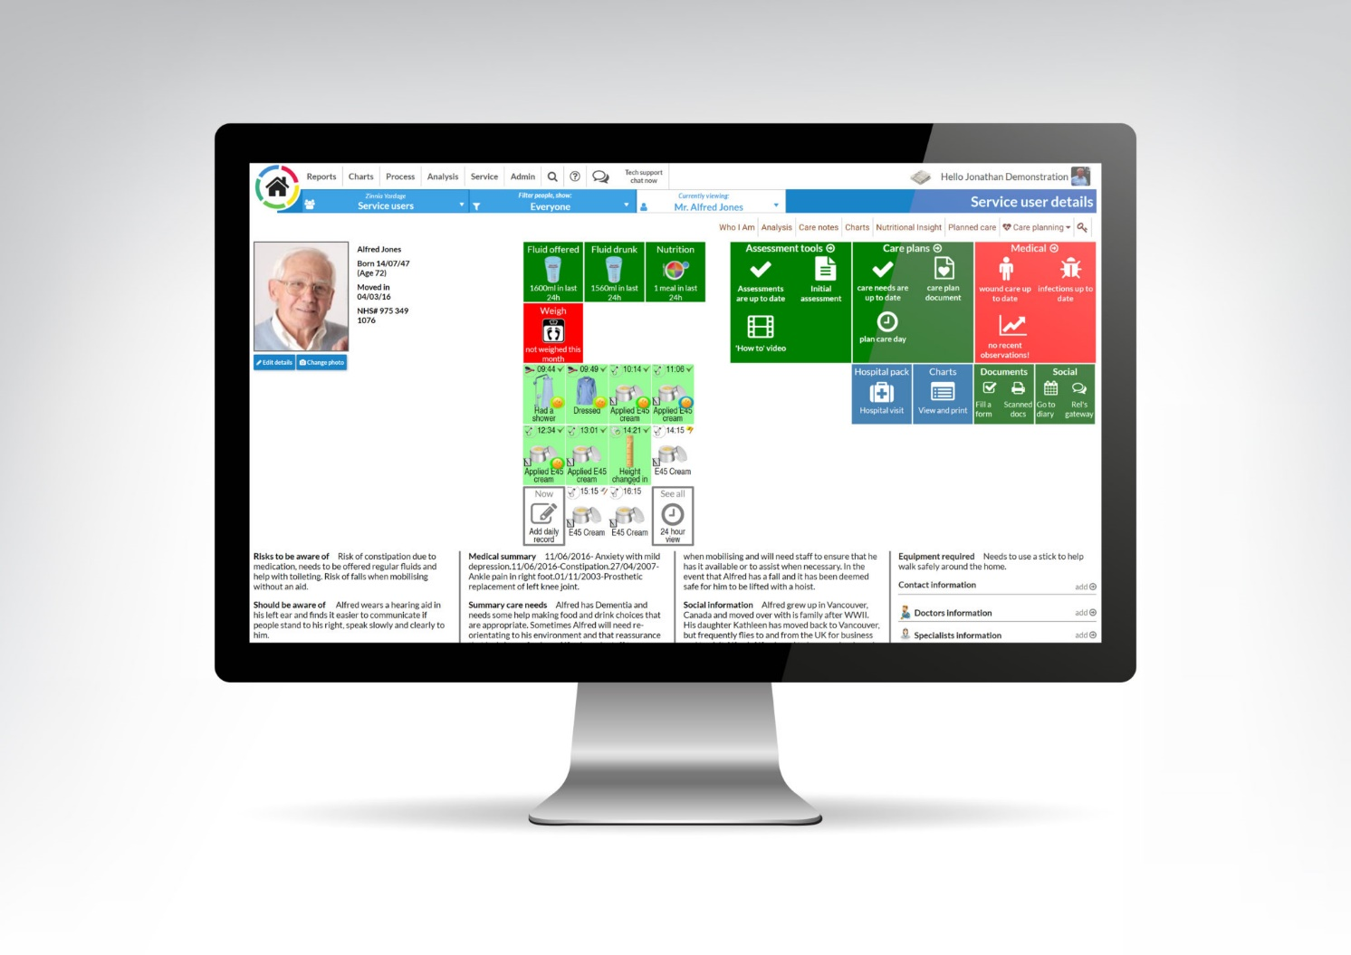
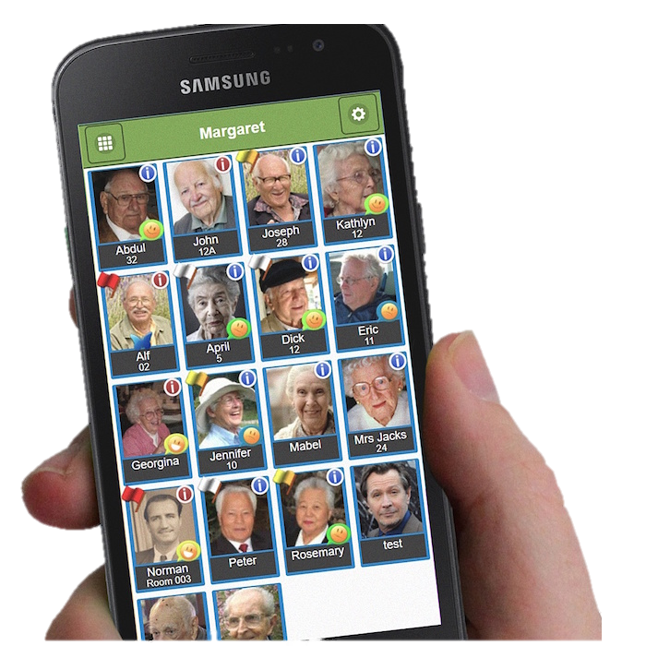
Person Centred Software
Notes:
Person Centred Software's Digital Care Planning System, mCare
There are three areas of the system
Mobile App
Using a handheld device, care staff can quickly and easily select the resident they are with during their shift by tapping on their profile photo.
They can select from a wide range of icons to create Care notes.
Care notes created through the device automatically update charts, reports, care plans and many other features in real-time throughout the digital care planning system.
Using relevant, personalised icons, staff can evidence the care they are giving; this pre-populates a care note and allows staff to add more detail if they wish, ensuring care notes are person-centred.
Desktop application
Care home managers have oversight of critical information covering care plans, risk assessments, daily records and charts, as well as information for audit purposes and inspections.
This is where
Relatives Gateway
The relatives gateways allows people with the relative permission to access their loved ones care notes to see how they have been and the details of the care delivered.

Slide 52
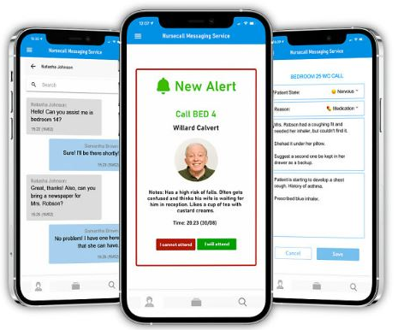
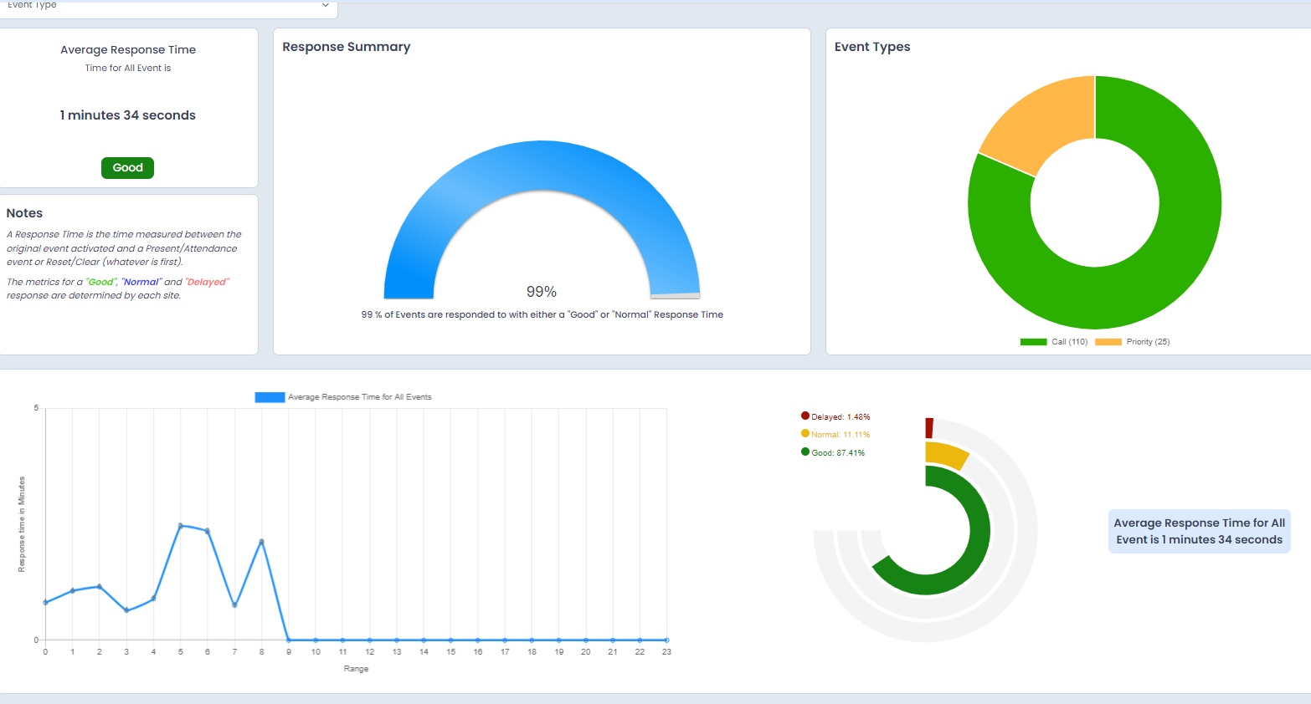
Nursecall Messaging Service
Notes:
Another product developed with Person Centred Software is the Nursecall Messaging Service.
This is a solution that removes the requirement for audible buzzers, pagers by allowing staff to access alerts, messages and notifications in one place via a single device.
How does Nursecall Messaging Service work?
A resident presses for a nurse call alert which triggers a notification on the staff’s devices to let all staff know that the resident requires help.
If a staff member accepts the notification alert request, the notification is removed from all other staff member devices to inform everyone that this alert is being seen to.
The staff member will attend to the resident and turn off the nurse call alert, they will be able to input information into the system around the resident’s call.
Removes the requirement for carrying pagers and using multiple devices
Removes the requirement for loud alarm
Increase Staff Accountability and efficiency when attending alerts – hopefully improving response times
Offere Instant message chat feature and a call function to support communication
Gives wide range of reports on the call bell performance for staff, residents or units

Slide 53

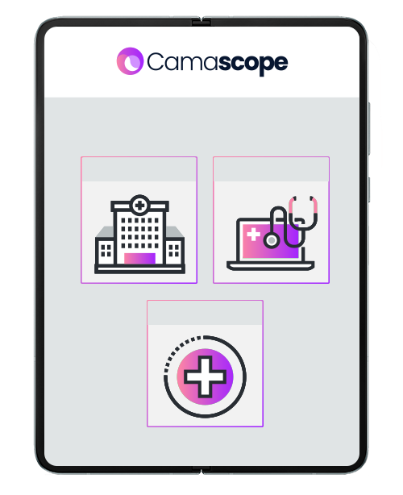

Camascope
Notes:
Camascope
Is our chosen Electronic Medication Administration Record (eMAR) which connects us with our pharmacy
The platform enables two-way pharmacy & BCH communication, displaying whether prescriptions have been processed or are out for delivery.
The system helps to improve medicine compliance and reduce errors by alerting care home staff to potential missed medicines
Care Home Group Dashboards
Care Home Group personnel can remotely keep track of & manage medicine compliance across all Group homes
Daily Email Summary
Receive automatic e-mail summaries of medicine compliance for an entire Group or individual home on a daily, weekly, monthly basis
eMAR integrates with Person Centred Software (PCS), allowing medicine and health information to be visible in a single place.

Slide 54
How does technology enhance care
Notes:
Ultimately whenever I speak to anyone working in the health and social care the one thing that always consistent is peoples commitment to ensure the people in their care receive the best possible care.
I feel that making use of technology can significantly enhance the care provided to residents by:
Improved Communication and Coordination
Sharing of information across the an internal team and external professionals is made much easier with Digital Care Planning Software.
Streamline tasks like care planning, documentation, and compliance tracking.
This reduces administrative burdens on staff, allowing them to spend more time with residents.
Allow for important events to be logged as scheduled planned care or events to ensure these are not missed.
Allow for quick access to residents' medical histories, current medications, and treatment plans.
Adding in the increased ability for communication using email, instant messaging and Voice Recognition Technology: such as speech to futher support the work that people do.
This transparency and access to information ensures that all team members are on the same page, reducing the risk of errors.
Meaning care is safer and better quality of services are provide to the residents.
Data-Driven Decision Making
Analytics and Reporting Tools: By analyzing data collected from various sources, these tools help identify trends, predict potential health issues, and support informed decision-making for better care outcomes.
It allows some metrics to be produced around staff performance.
Training and Development
Online Training Platforms: Continuous education and training are crucial in health and social care. Online platforms provide your team with easy access to the latest protocols, best practices, and new technologies, ensuring high standards of care.
Resident and Family Involvement
Family Portals: allow families to stay informed about their loved one’s care and well-being, enhancing trust and satisfaction.
By integrating these technologies, your team can provide more responsive, personalized, and efficient care, ultimately leading to better outcomes and a higher quality of life for residents.

Slide 55


How does technology enhance care
COMMUNICATION &
COORDINATION
DATA DRIVEN DECISION
TRAINING & DEVELOPMENT
FAMILY INVOVLEMENT
Notes:
Improved Communication and Coordination
Sharing of information across the an internal team and external professionals is made much easier with Digital Care Planning Software.
Streamline tasks like care planning, documentation, and compliance tracking.
This reduces administrative burdens on staff, allowing them to spend more time with residents.
Allow for important events to be logged as scheduled planned care or events to ensure these are not missed.
Allow for quick access to residents' medical histories, current medications, and treatment plans.
Adding in the increased ability for communication using email, instant messaging and Voice Recognition Technology: such as speech to futher support the work that people do.
This transparency and access to information ensures that all team members are on the same page, reducing the risk of errors.
Meaning care is safer and better quality of services are provide to the residents.
Data-Driven Decision Making
Analytics and Reporting Tools: By analyzing data collected from various sources, these tools help identify trends, predict potential health issues, and support informed decision-making for better care outcomes.
It allows some metrics to be produced around staff performance.
Training and Development
Online Training Platforms: Continuous education and training are crucial in health and social care. Online platforms provide your team with easy access to the latest protocols, best practices, and new technologies, ensuring high standards of care.
Family Involvement
Family Portals: allow families to stay informed about their loved one’s care and well-being, enhancing trust and satisfaction.
By integrating these technologies, your team can provide more responsive, personalized, and efficient care, ultimately leading to better outcomes and a higher quality of life for residents.

Slide 56
What’s next for digital technology in care
Notes:
Today, I’d like to share my perspective on how technology will transform the care sector in the near future years. As our population continues to age and the need for care services grows, advancements in technology, will significantly enhance the quality and efficiency of care.

Slide 57
What’s next for digital technology in care
WEARABLE TECHNOLOGY
SMART HOME TECH
CCTV
ROBOTICS
AUTOMATION
Notes:
There is a plethora of new technologies being developed constantly. Lots of technologies which are currently in the marketplace for all of us are not widely used with in the health and social care industry.
wearable technology and the Internet of Things (IoT) will play a vital role in care. Devices like smartwatches and fitness trackers are already capable of monitoring vital signs such as heart rate, sleep patterns, physical activity and can detect falls. In the next five years, AI will further enhance these devices, enabling them to analyze vast amounts of health data and predict potential health issues before they arise. For instance, AI-powered wearables could identify subtle changes in a resident;s condition that may signal the onset of a serious health problem, allowing for early intervention and potentially saving lives. Smart sensors
Smart Home Technology - The role of voice-activated assistants like Alexa in care settings. Currently, Alexa can perform tasks such as setting reminders and controlling smart home devices. In the near future, AI will enable Alexa to provide even more personalized care by learning the routines and preferences of individuals, anticipating their needs, and offering tailored support. For example, Alexa could proactively suggest activities based on a person’s mood or health status, or seamlessly coordinate with providers to manage appointments and medications, ensuring a more integrated care experience.
CCTV With the reduction in the cost of cloud-based CCTV systems and advanced features like real-time threat detection and anomaly recognition. These systems can alert staff immediately of an event enabling quicker responses and enhancing overall safety. I feel this is also an area which more family may use to give assurance of good care. Alexa devices allow for a use to drop-in at any time via a video call or call.
Robotics and Automation - Assistive Robots: Robots designed to assist with daily tasks, such as fetching items, helping with mobility, or even providing social interaction, can significantly improve the quality of life.
Automated Medication Dispensers: These systems ensure that residents receive the correct medications at the right times, reducing the risk of missed or incorrect doses.
These innovations will not only improve the quality of care but also empower caregivers and patients alike, leading to better outcomes and a higher quality of life.

Slide 58
Challenges
Notes:
This does of course bring with itself challenges for providers:
Change management
Staff
Cost
Disaster recovery

Slide 59

Challenges
Notes:
This does of course bring with itself challenges for providers:
Change management
Staff
Cost
Disaster recovery

Slide 60
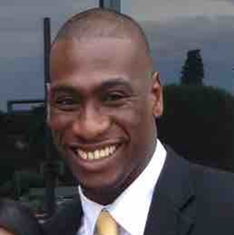

Provider stories
Ian Stewart
Manager
Roses Homecare Ltd
Bedfordshire, Luton and Milton Keynes Health and Care Partnership

Slide 61

Who are Roses Homecare

Slide 62
Digital Social Care Records (DSCR)
  Birdie:
    Roses Homecare have been using Birdie since Jan 2020. Why?
      Assessments/Reviews/Real Time info/data/Performance
      E-Signatures. Birdie/Looker

Slide 63
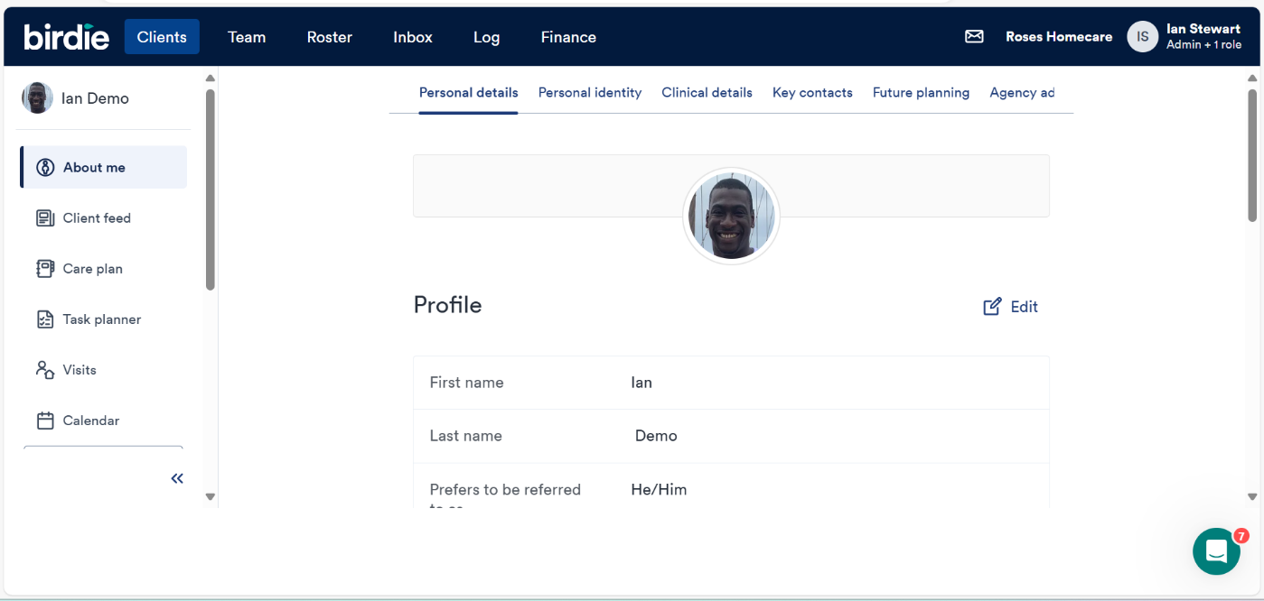
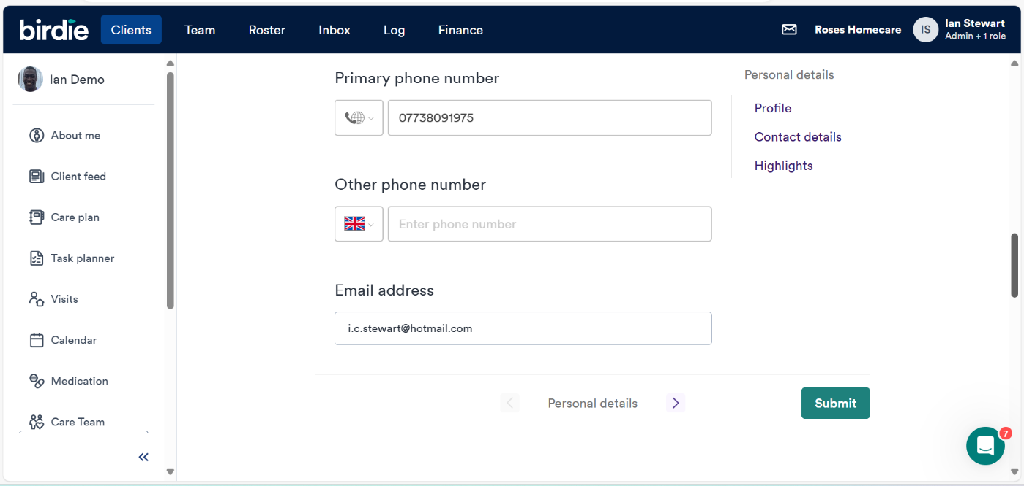
Introduction to Birdie

Slide 64
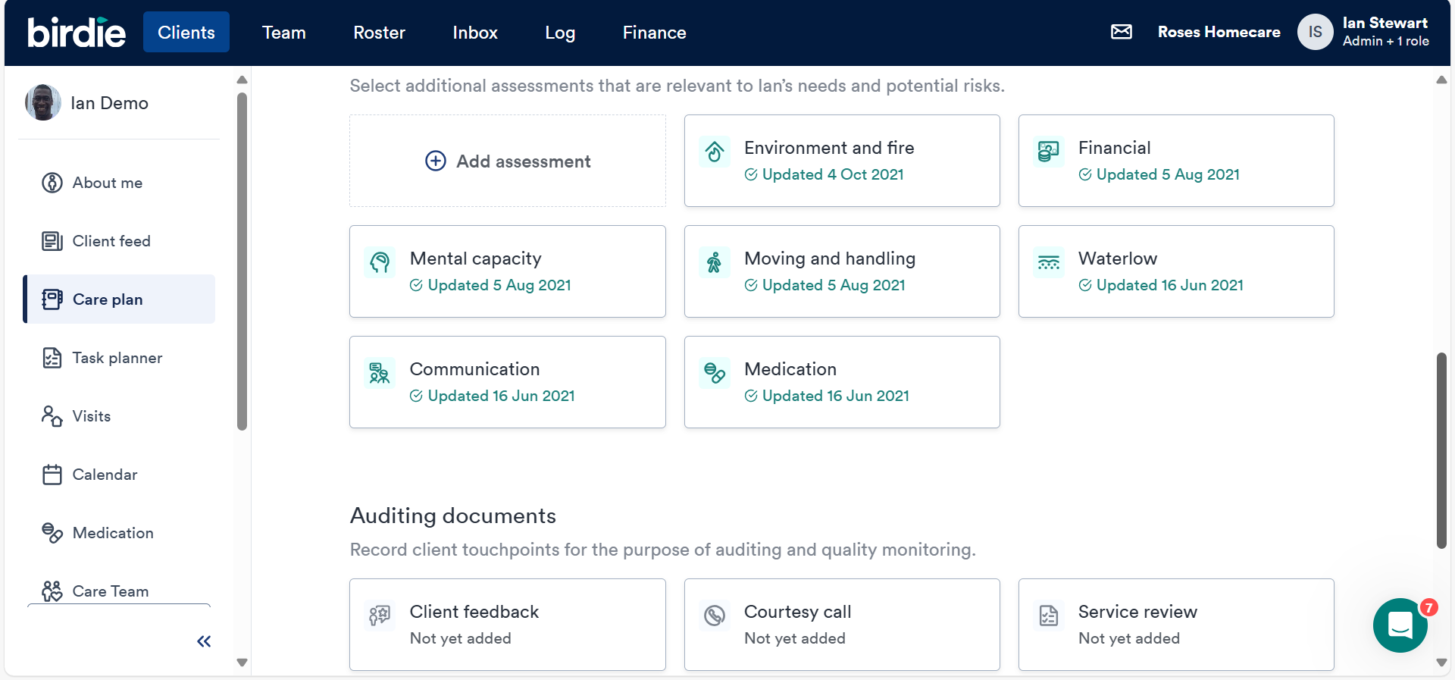
DSCR

Slide 65
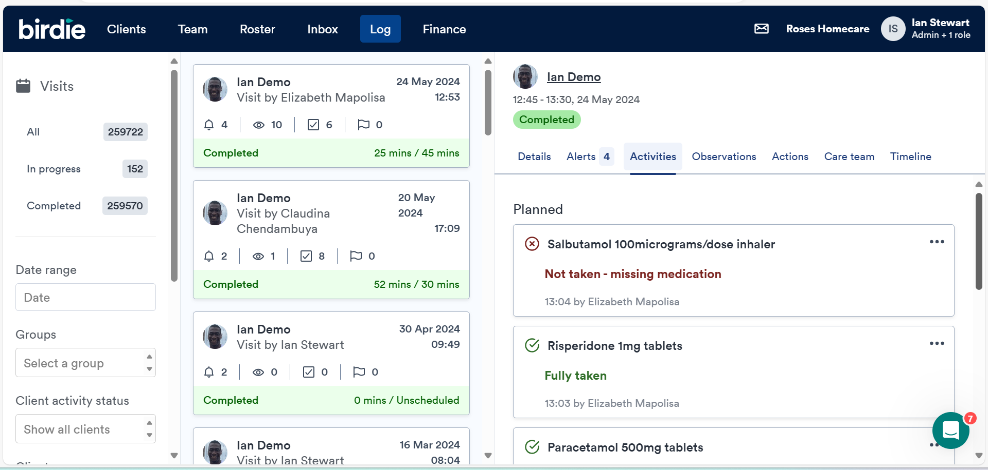
DSCR

Slide 66
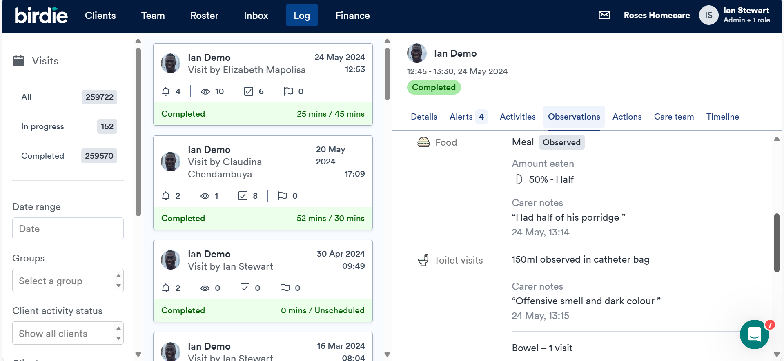
DSCR

Slide 67
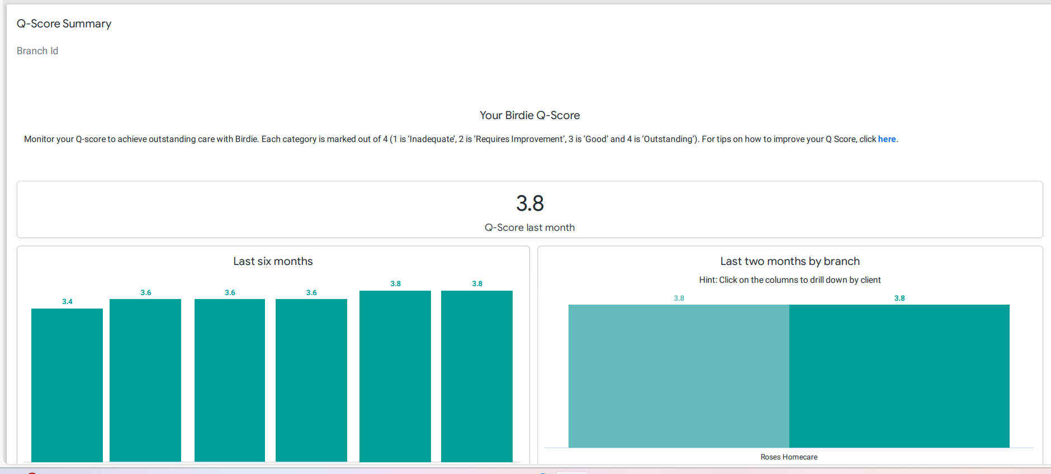
DSCR

Slide 68

Remote Health Monitoring
MiiCare: a remote monitoring system that includes a ‘virtual assistant’ to check a person’s wellbeing and daily routines to help them stay safe and well at home
Whzan Blue Box: a system that helps care home staff closely monitor the health of residents, enabling them to catch problems early

Slide 69

Falls Prevention
Raizer II: a chair that can be built around a person to lift them from the floor after a fall where there’s no injury

Slide 70

Contact details
Email - ian.stewart@roseshomecare.com or ian.stewart14@nhs.net
Phone - 01582453800
Website - www.roseshomecareuk.com

Slide 71
DiSC Team
Digitising Social Care Programme update
Bedfordshire, Luton and Milton Keynes Health and Care Partnership

Slide 72

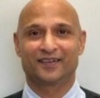


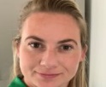




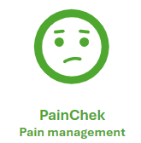

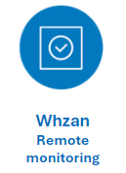
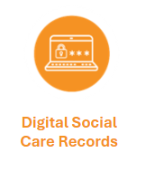




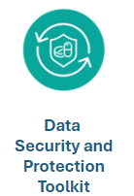

Meet The Team
Patricia Coker
Local Authority
SRO
Clare Steward
Programme
Director
Anna Ellis
DiSC Programme Manager
Amtar Ali
ASC Tech Fund Programme
Manager
Serifat Adeboye
Programme Support Officer
Lisa Burke
Digital Project Manager
Joanne Harlen
Digital Project Officer
Terry Wright
Digital Project Manager
Nigel Murray
Digital Project Officer
Cheryl Stimson
Digital Project Manager
Relationship: Luton & Central Beds
Relationship: Milton Keynes and Bedford
Relationship: BLMK

Slide 73
Current programme overview
Remote Monitoring expansion
MiiCare: Supporting 140 residents with independent living
Whzan: Expanding to 53 care locations and 12 D2A beds
Acoustic Monitoring: Continued support for six care locations to maximise the benefits.
Digital
records
Falls Prevention
Raizer Chair expansion: Equipping 20 domiciliary care providers with Raizer chairs to minimise fall risks and improve response times
GaitSmart pilot: Exploring personalised mobility improvement plans with four collaborating sites.
Remote monitoring
Digital Records:
Strengthening the foundation
Expanding adoption: Targeting 11 additional care locations for Digital Social Care Records
Enhanced collaboration: Facilitating data sharing and improved care coordination through digital records
Ongoing support: Continuing to assist care locations with secure NHSmail setup, full proxy access, and data security best practices.
Falls prevention

Slide 74



Get involved
There is still opportunity to get involved with these projects:
Visit our suppliers in the marketplace to find out more
and see some of the technology
Take a look at the brochure for more information
and to express an interest.
NHSmail
Proxy Access
Data Security and Protection Toolkit
Digital Social Care Records
Whzan
Remote monitoring
MiiCare
Supporting independent living
PainChek
Pain management
RoboPets
Mental health

Slide 75
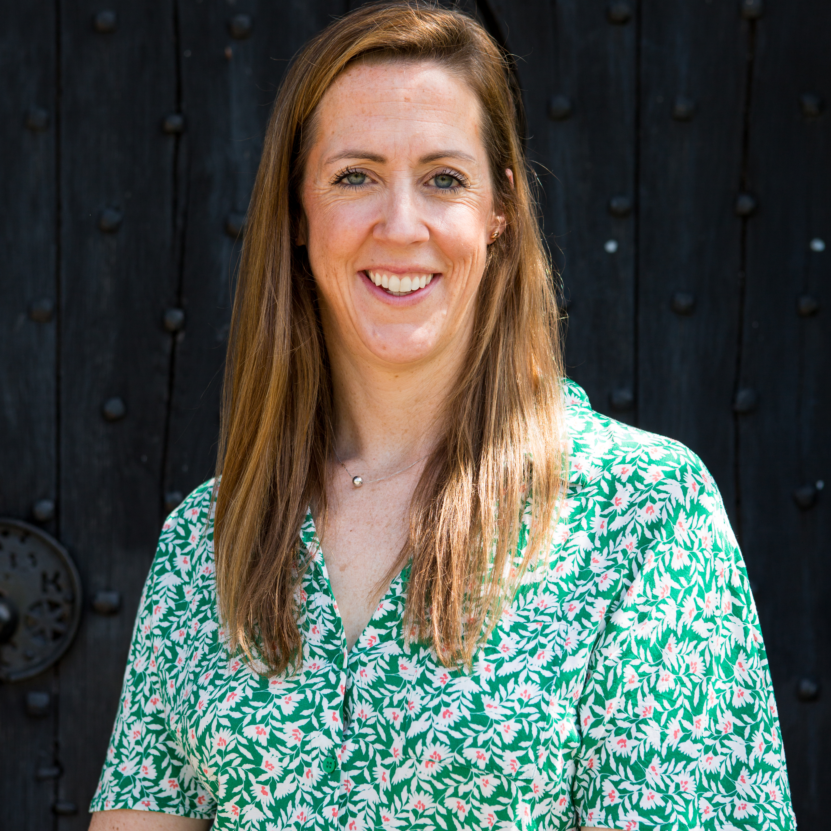

Masterclass
Eleanor Ryles Stephanie Johnson
Engagement Manager Engagement Manager
Better Security Better Care
Bedfordshire, Luton and Milton Keynes Health and Care Partnership

Slide 76
Well-Led: How digitisation can help care providers

Slide 77
Agenda
Who we are
What the CQC Single Assessment Framework says about technology
Case studies on how technology can help with CQC inspection
Resources
Photo by The Jopwell Collection on Unsplash

Slide 78
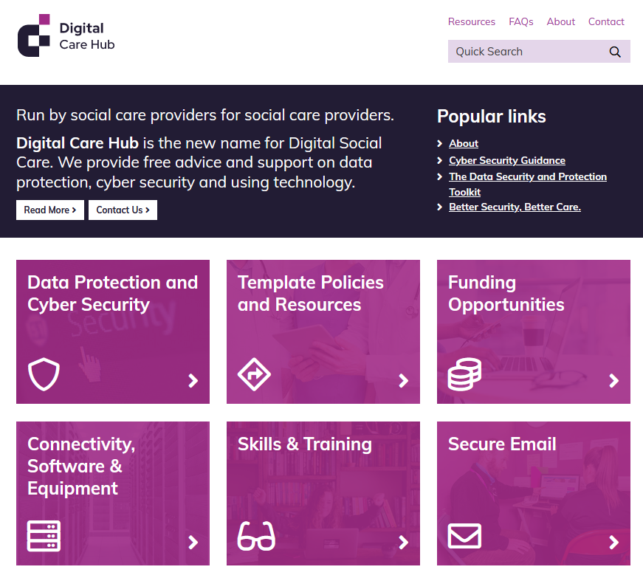
Digital Care Hub – who are we?
  A collaboration between the national trade associations – who represent care providers of adults with physical, sensory or learning disabilities, people with mental ill-health, and older people.
  Cover almost 10,000 organisations, employ more than 600,000 staff and support an estimated 1 million people.
  Run by social care providers, for social care providers.
  We work in partnership with providers, representative bodies, and statutory bodies to support the digital journey of adult social care providers in England.
  We are funded by Department of Health and Social Care and NHS England.

Slide 79
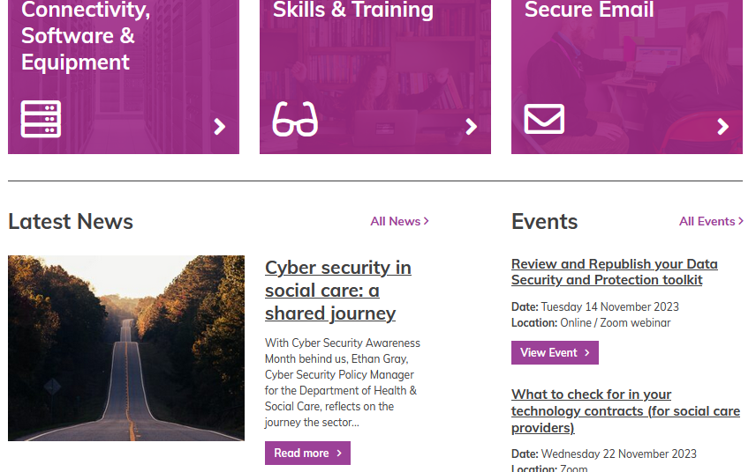
What do we do?
Guidance and support
Helpline
Success Stories
Newsletter
Funding resources
Events and webinars
Digital Special Interest Group
and more …

Slide 80
What does CQC say about digitisation in the single assessment framework?
Found in Well Led: Governance, management and sustainability
  Quality statement: “We have clear responsibilities, roles, systems of accountability and good governance. We use these to manage and deliver good quality, sustainable care, treatment and support. We act on the best information about risk, performance and outcomes, and we share this securely with others when appropriate.”
  Staff management: There are clear and effective governance, management and accountability arrangements. Staff understand their role and responsibilities. Managers can account for the actions, behaviours and performance of staff.
  Business management & Risk: The systems to manage current and future performance and risks to the quality of the service take a proportionate approach to managing risk that allows new and innovative ideas to be tested within the service.
  Data submissions: Data or notifications are consistently submitted to external organisations as required.
  Records & Data Management: There are robust arrangements for the availability, integrity and confidentiality of data, records and data management systems. Information is used effectively to monitor and improve the quality of care.
Notes:
We have added the titles in bold

Slide 81
How technology supports with staff management
“Staff understand their role and responsibilities.
Managers can account for the actions, behaviours and performance of staff.”
Somerset Care Group: Implementing online learning to 3,000 employees
https://www.digitalcarehub.co.uk/success-story/somerset-care-implementing-online-learning-to-3000-employees/
Somerset Care have 3,000 employees spread over a large area
The system allows them to offer online training, keep track of training records and monitor overdue training
Also allows for appraisals and compliance monitoring.
St Martins Care: Managing Staff Vacancies
https://www.digitalcarehub.co.uk/success-story/st-martins-care-gaining-greater-visibility-over-staff-levels-decreases-costs/
The system allows them to create rosters, time sheets and agency legers to better understand why staff are off and the costs associated with payroll
“Quantitatively, we have a level of detail we’ve never had before; we can extract data from CoolCare and use it to reconcile what we’re paying to what we were expecting to pay, and we can now better plan our budgets. As a qualitative management tool, we are ensuring we have right people rostered at the right time, and HR actions are done well and efficiently.”

Slide 82

How technology supports with business management and risk
  “The systems to manage current and future performance and risks to the quality of the service take a proportionate approach to managing risk that allows new and innovative ideas to be tested within the service.”
CQC have developed guidance on how to approach innovation in your service. This includes 6 overarching principles to consider:
    Develop and deploy innovations with the people that will use them –
    Coproduction
    Develop a culture where innovation can happen – talk about it
    Support your people – train staff
    Adopt the best ideas and share your learning – network (SIG)
    Focus on outcomes and impact – What do you need?
    Be flexible when managing change – involve the right stakeholders
For examples on how this has been implemented well, the National Care Forum has the Hubble Project which has been recommended by the CQC as best practice. A short video with an example from this project of how they used technology to manage risk and quality is on the next slide
https://www.digitalcarehub.co.uk/care-englands-smart-tool-a-free-tool-to-help-with-managing-your-care-service/
Notes:
Many people are concerned about CQC’s approach to technology innovation. This slide covers their approach and suggestions

Slide 83
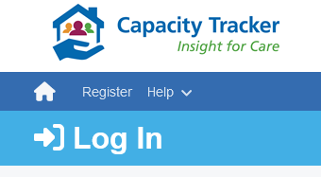
Technology supports data submission
  "Data or notifications are consistently submitted to external organisations as required."
The future
The minimum operational data standard and reporting data set: https://beta.digitisingsocialcare.co.uk/data-standards-social-care
Digital Social Care Records
Have reporting dashboards which are customisable and can support with data requirements.
Assured suppliers will comply with MODS and RDS.

Slide 84

Case study on how technology helps with data management
“There are robust arrangements for the availability, integrity and confidentiality of data, records and data management systems. Information is used effectively to monitor and improve the quality of care”
Using a Managed Service Provider
The benefits of outsourcing and the investment in IT:
Standardised WiFi across all of the homes and offices with different WiFi SSIDs so that residents can access their own devices and technology.
Standardised mobile handsets for staff with device management software that Swanton Care can manage remotely and control if needed.
VOIP Phone system which allows telephone calls to be made over internet connections.
Access to helpdesk support 7 days a week.
Free Support from Better Security, Better Care
https://www.digitalcarehub.co.uk/data-security-protecting-my-information/better-security-better-care/
Notes:
We have already covered many examples from DSCRs – additional considerations on this slide

Slide 85
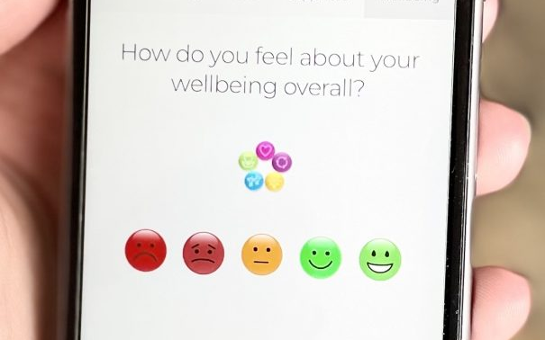
How technology can help with staff health and wellbeing
Sussex Grange: using an app to improve quantity and quality of staff feedback
https://www.digitalcarehub.co.uk/data-security-protecting-my-information/better-security-better-care/
Instant feedback from staff – increases particularly information from night staff
Allows more proactive conversations with the team which improves retention
Able to run reports to understand staff wellbeing and concerns and demonstrate this to CQC.

Slide 86

Not gone digital yet? What’s stopping you?

Slide 87
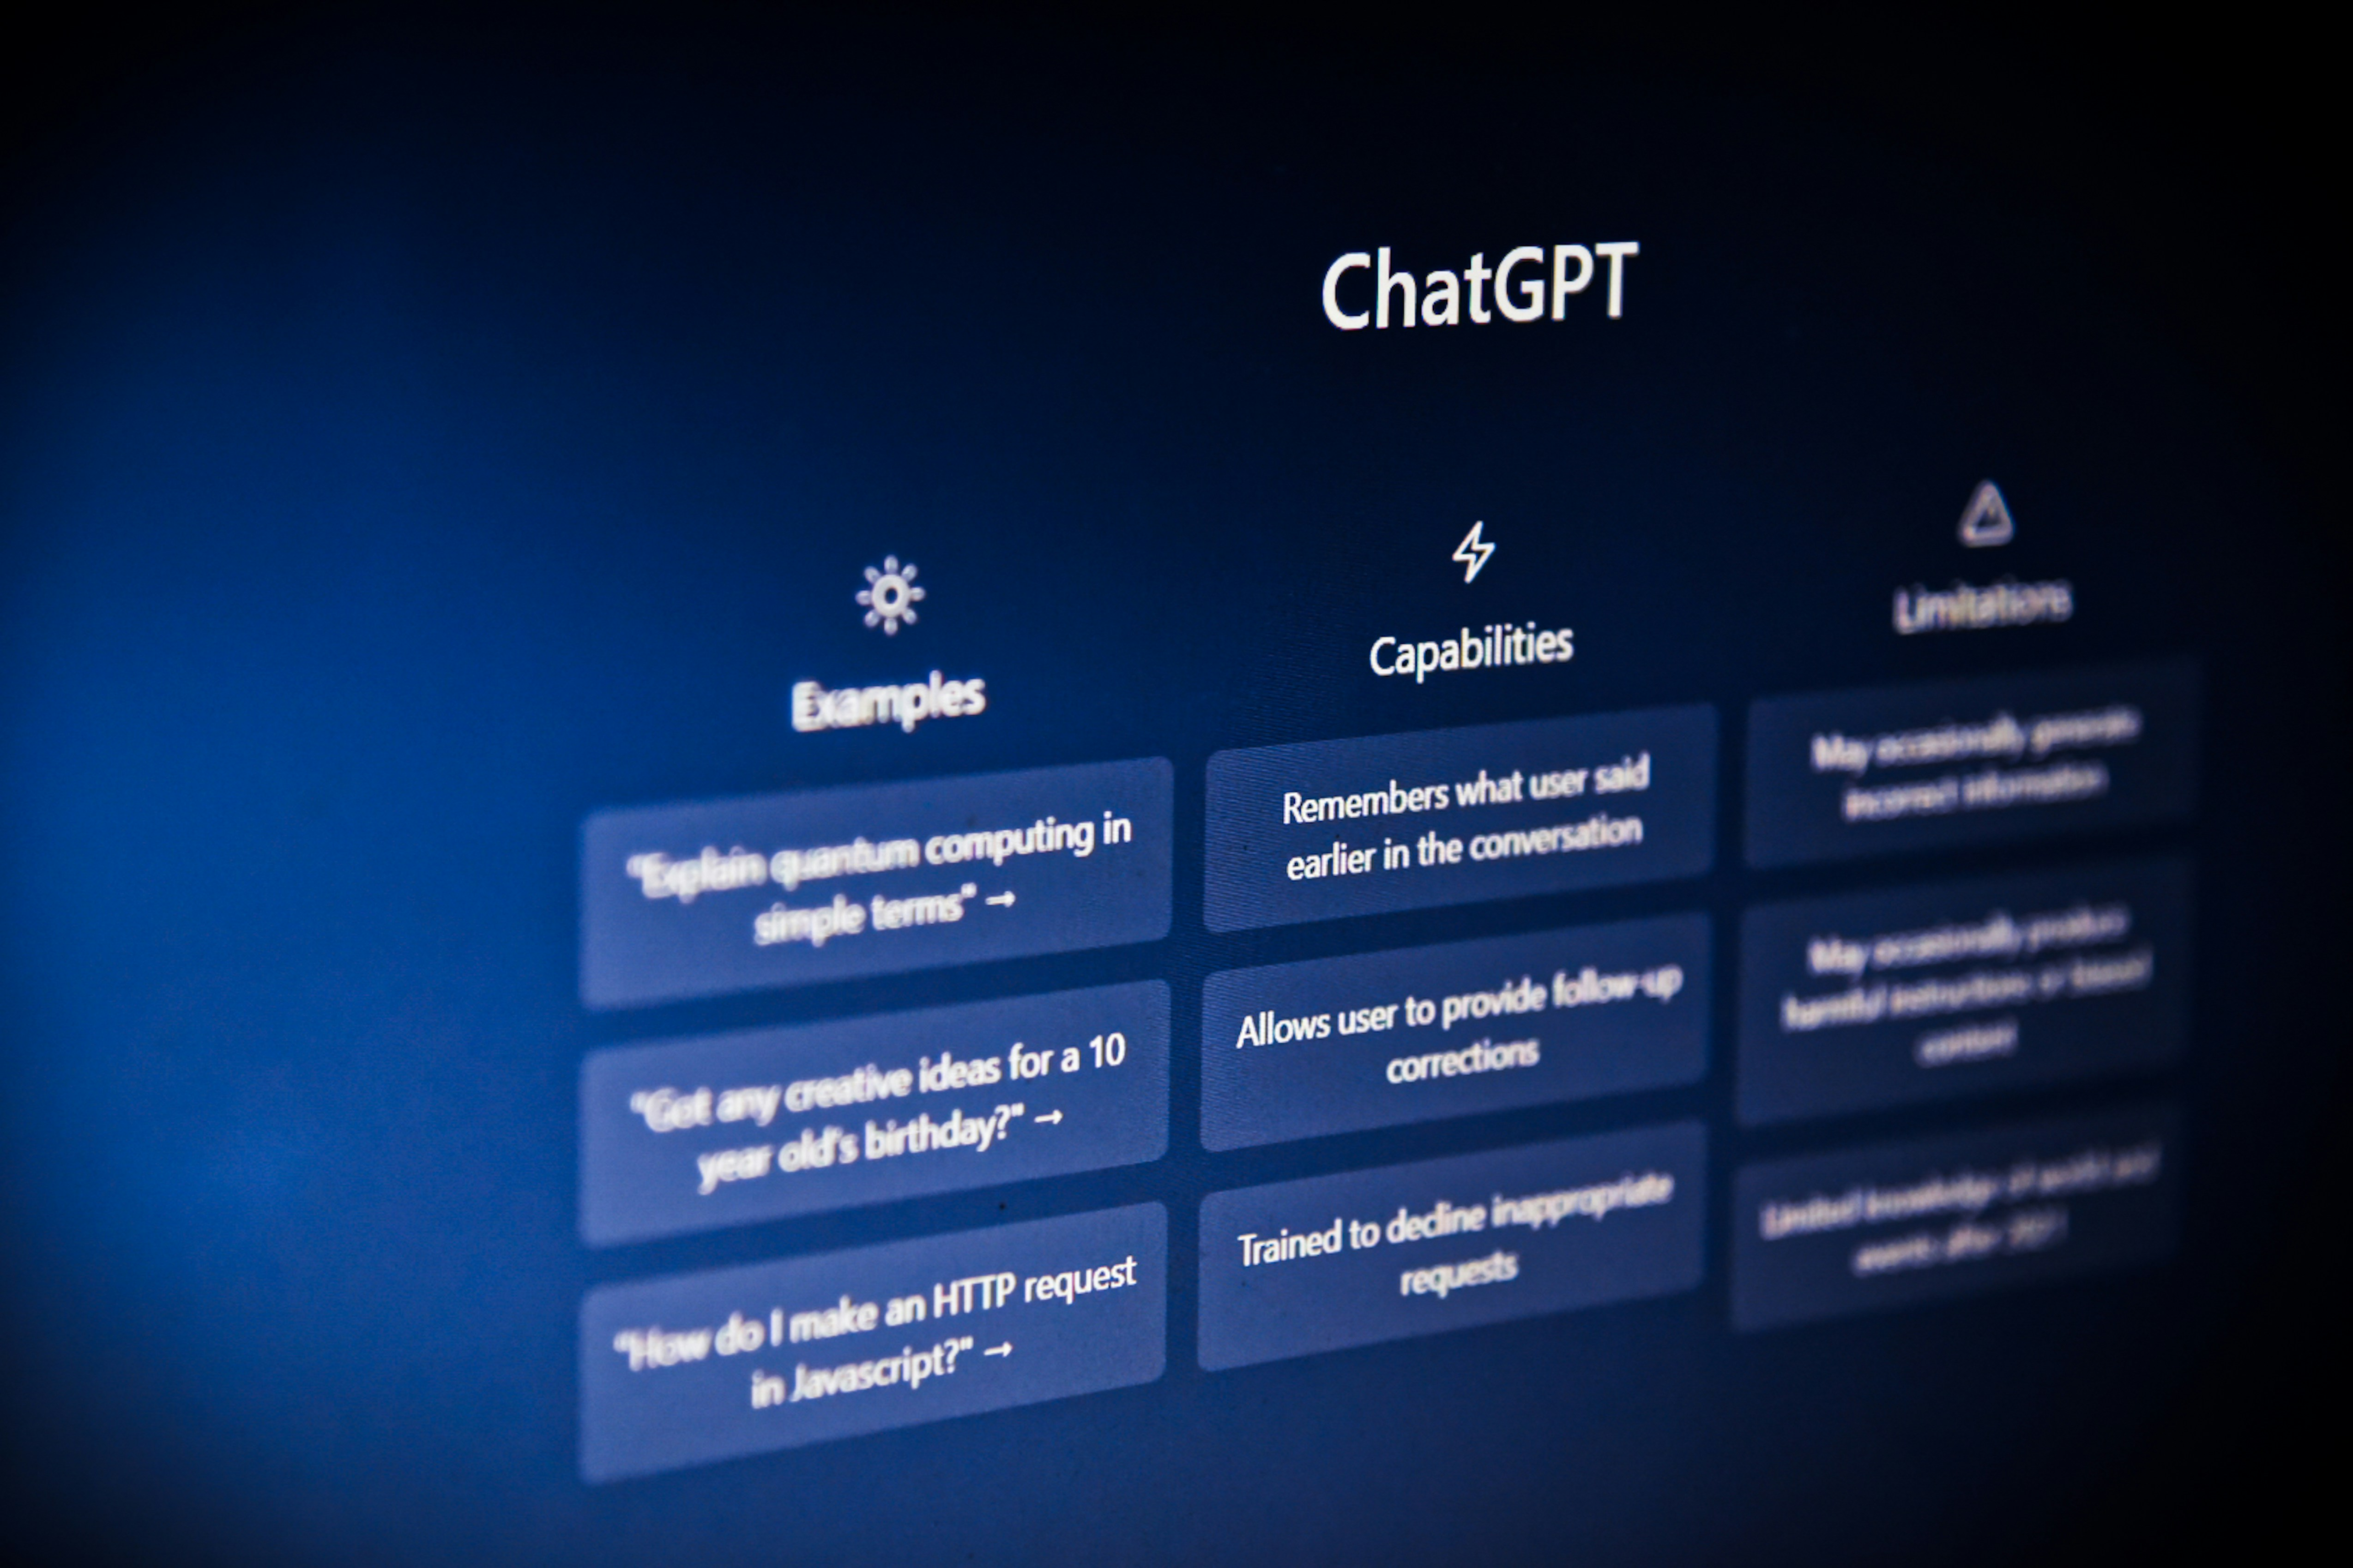


Emerging technology in adult social care – how care providers are starting to use AI
ChatBots
To respond to enquiries
To support staff
Efficiencies
To draft policies
To summarise meeting notes
To support with email responses
Activities
Sharing AI with clients and residents
Developing photos and games

Slide 88

The Oxford project on the Responsible Use of Generative AI in Social Care
Institute of Ethics in AI, Oxford University, Casson Consulting and Digital Care Hub
Have been working on the responsible use of AI in social care since February where we released a statement
Working groups for people with lived experience, care providers, care workers, academics and technology companies
Get involved!
https://www.digitalcarehub.co.uk/ai-and-robotics/oxford-project-the-responsible-use-of-generative-ai-in-social-care/

Slide 89
Get involved
Digital Care Hub Newsletter
https://www.digitalcarehub.co.uk/newsletter-signup/
Digital Care Hub Special Interest Group
contact hello@digitalcarehub.co.uk
NEW – Social Care Caldicott Guardian Network
contact hello@digitalcarehub.co.uk

Slide 90
Information and Resources
Digital Care Hub
  Funding
  Better Security, Better Care
  AI & Robotics
NHS England’s Digitising Social Care
  Assured Solution List
  Data Standards
  Digital Skills Framework
CQC
  Digital Record Keeping
Care Tech Guide
Notes:
Katie / Natalie to add

Slide 91
Thank you, any questions?
Digital Care Hub
hello@digitalcarehub.co.uk
@DigitalCareHub
LinkedIn
0808 196 4848

Slide 92
Lunch and marketplace
#BLMKdigitalcare2024
Workshops start at 1:45pm:
Workshop 1 - Domiciliary care providers (Lockyer Suite)
Workshop 2 - Care providers (Davis Suite)
Enhancing BLMK Care through digital solutions:
From Challenges to Solutions

Slide 93
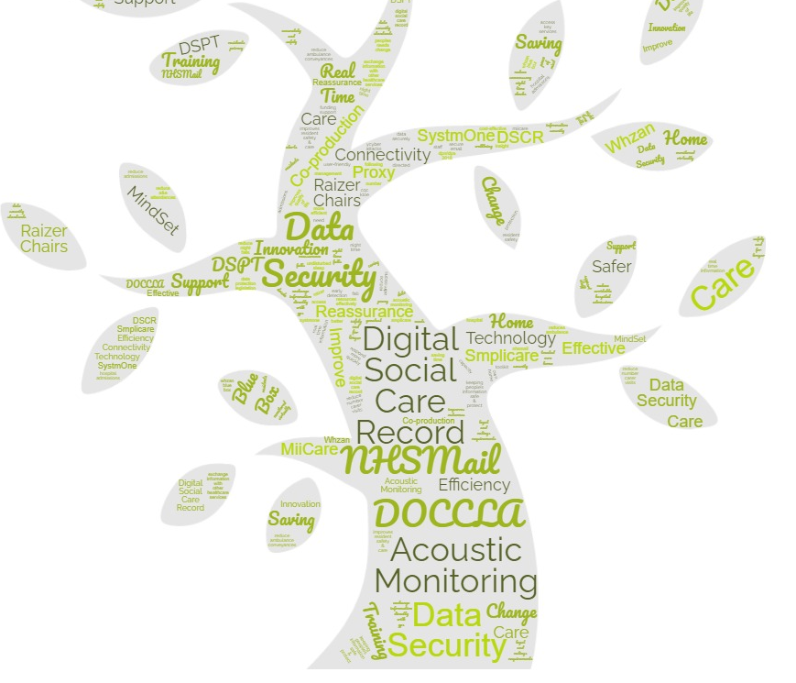
Care Conference Workshop Provider’s Programme Feedback
4 September 2024

Slide 94


Workshop Objectives
To learn about your experience of the programme
To take away some ideas about how we might do things differently/better

Slide 95







Feedback Focus
Awareness
Support
Involvement
Going live
Training
Delivery

Slide 96




“Compliance” Projects
Data Security and Protection Toolkit
NHS Mail
Proxy Access

Slide 97

DSCR Project
Digital Social Care Record

Slide 98
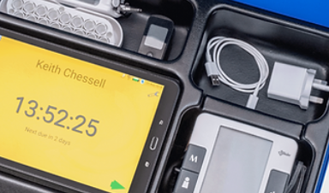

Whzan and MiiCare Projects
Whzan Blue Box
(NEWS2 & ISTUMBLE)
MiiCare
Monica Digital Assistant

Slide 99
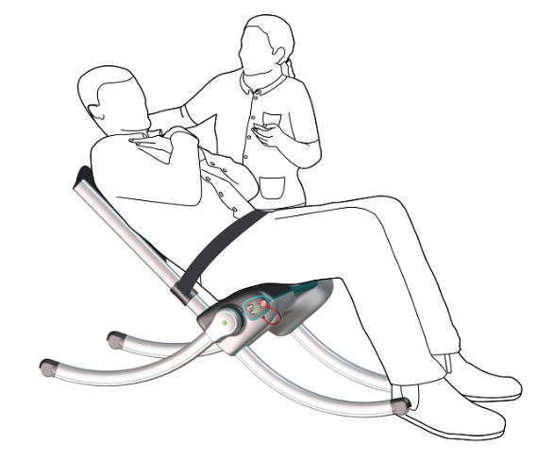
Raizer Chair and Acoustic Monitoring Projects
Raizer II Chair
AllyLabs “AllyCares”

Slide 100


New Projects: RoboPets and PainChek
RoboPets
PainChek

Slide 101
Feedback session
Review of the day
Clare Steward
#BLMKdigitalcare2024
Bedfordshire, Luton and Milton Keynes Health and Care Partnership

Slide 102
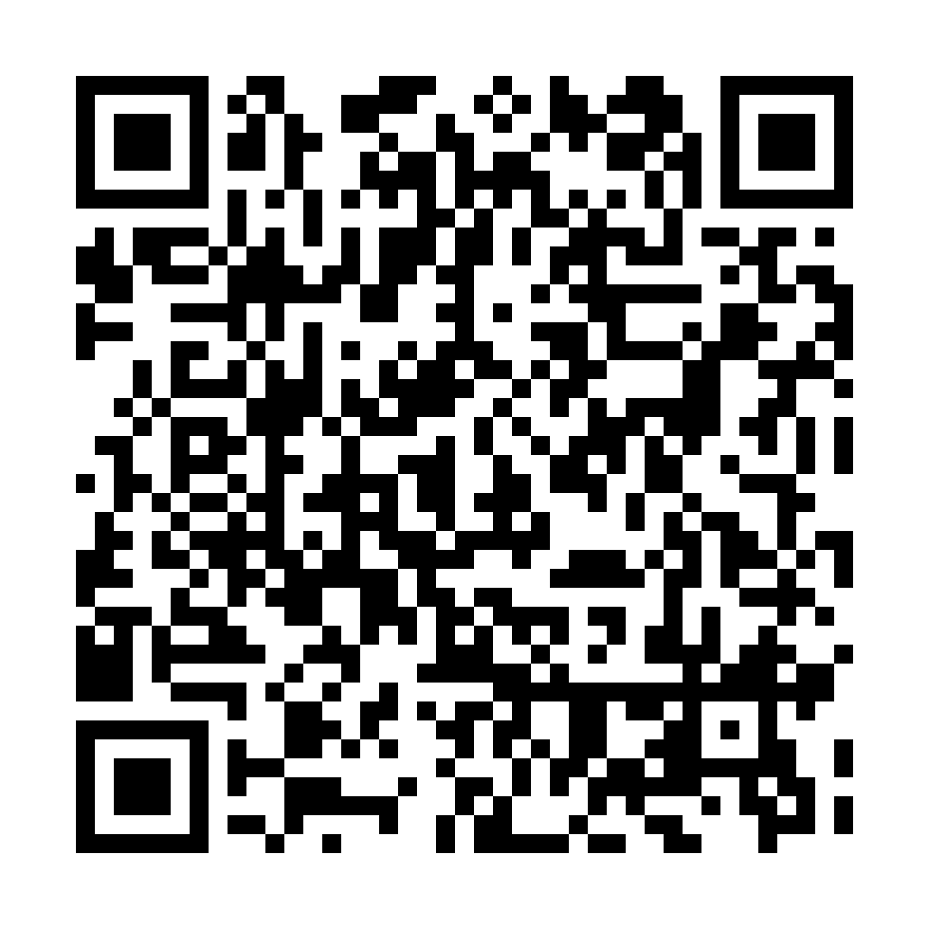
Closing remarks and evaluation
Clare Steward
Evaluation Code
#BLMKdigitalcare2024
Bedfordshire, Luton and Milton Keynes Health and Care Partnership

