Slide 1
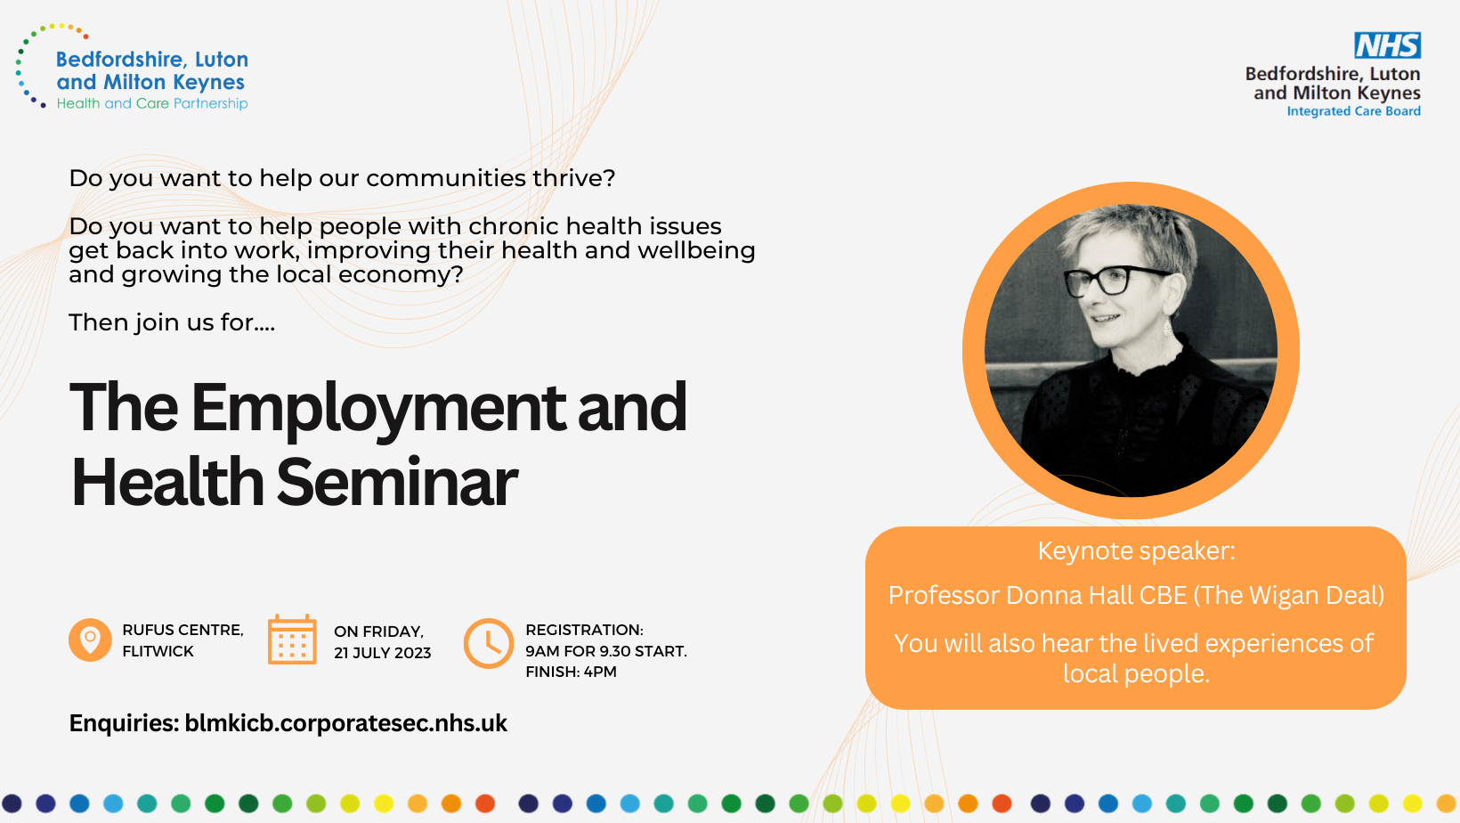
On 21 July 2023, BLMK ICB and ICP held a first-of-its-kind seminar on Health and Employment.
People from local authorities, the NHS and other public services, including the Prison Service and the Department for Work and Pensions, were joined by residents with lived experience and representatives of the voluntary, community and social enterprise sectors for a day of action planning on tackling poor health and employment outcomes.
The purpose of the seminar was to:
Further our understanding of how we, as a diverse partnership, contribute to both economic growth and health through employment.
Define our shared ambitions as an ICS for achieving economic growth through maximising opportunities for employment, particularly for those furthest from stable employment due to ill health.
Agree tangible steps partners will take together at place- and system-level to improve opportunities for those furthest from stable employment due to their health
These slides are a verbatim reproduction of all of the
ideas and suggestions made during the workshop discussions and will need further development by places to ensure alignment to existing plans and consideration of current capacity

Slide 2
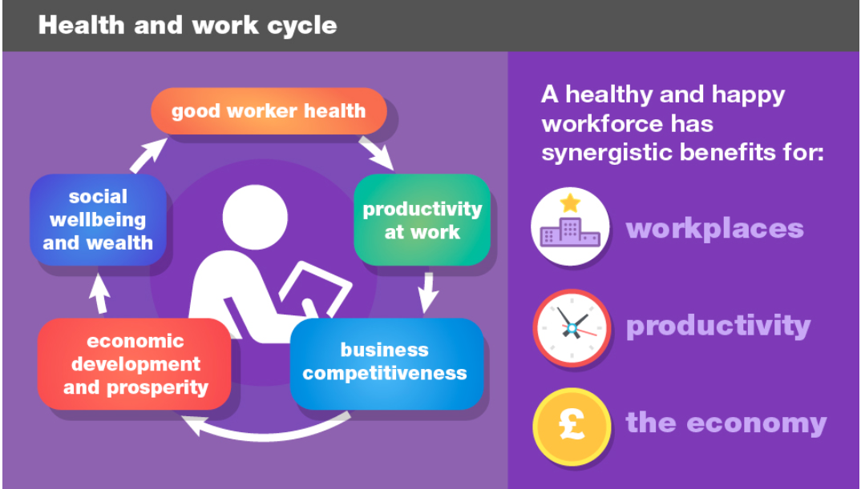
The world of work is evolving.
People are living and working longer.
We want to support as many people as possible to find, stay in and return to work, because almost all employment is good for individuals, for employers and for the economy.
Unemployment is associated with increased risk of long-term illness and worsening mental health, and impacts on families too.
Individuals in employment report higher levels of wellbeing than those unemployed, which is why one of the four purposes of Integrated Care Systems is to support social and economic development.
Workless and sickness absence leads to costs of over £100bn annually in the UK
Moving from employment to unemployment is estimated to increase GP consultation rates by 50%.
Around 300,000 people in the UK with a long-term mental health condition fall out of work every year.
Disabled people are 10 times more likely to leave work following long-term sickness absence than non-disabled people.
In BLMK, the learning disability employment rate gap is 70%.
In some parts of BLMK, the employment rate gap for those with serious mental illness is 75% (cf. ~60% for the EoE average)

Slide 3
Agenda
Registration from 0900 | Registration (Refreshments available)
0930 – 1115 | Welcome and Introductions
 | Voice of the Resident
 | Keynote Speaker: Prof Donna Hall CBE
Break | Break (Refreshments provided)
1145 – 1300 | What matters to me? Table discussions
Lunch | Lunch (provided)
1400 – 1440 | Place-based idea generation Breakout discussions
1440 – 1515 | Place-based action planning Breakout discussions
1520 – 1600 | Plenary Summary and Reflection
Close | Close

Slide 4

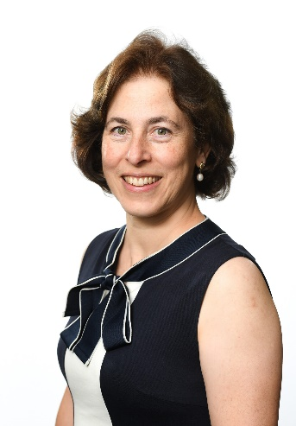
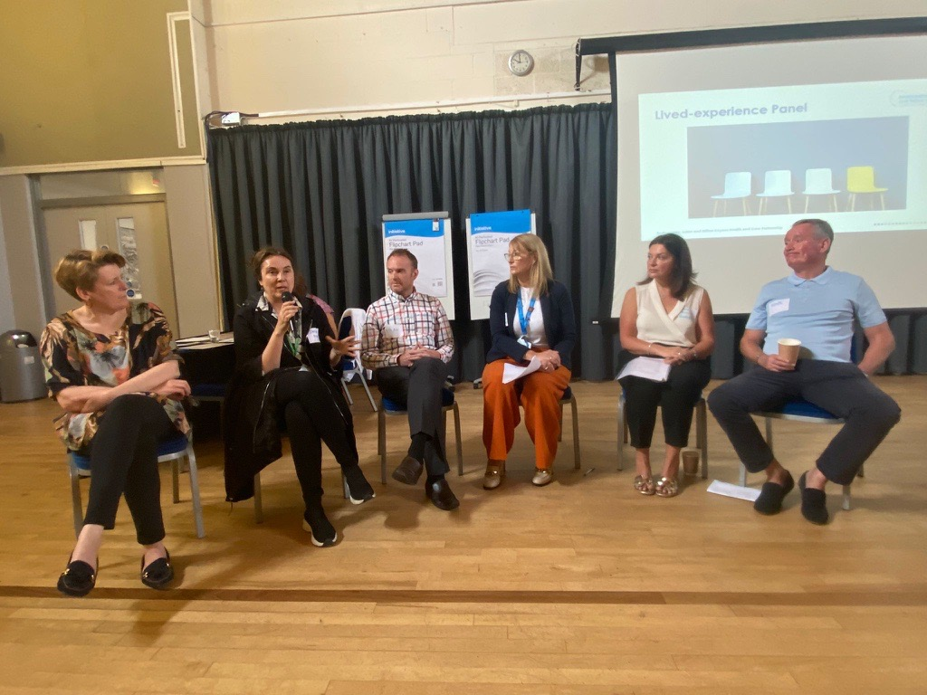
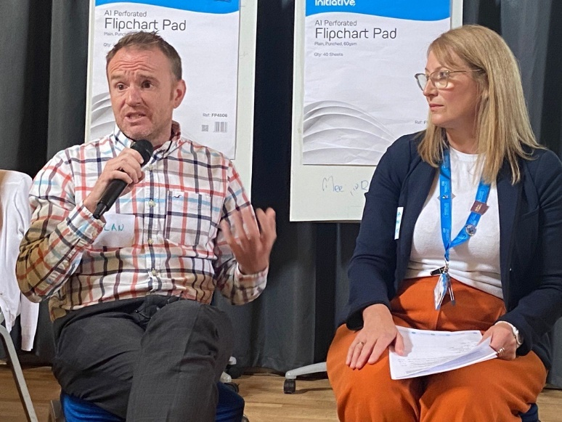
“Really excited to see so many people present today.
Today is about how do we help people get a job, stay in the job and be supported in the job.
Employment is usually a healthy experience for people. People in employment do enjoy higher levels of health than those not in employment.
This is a milestone in the strategy that will support our residents – today we aim to finish with action plans”
Rima Makarem, chair of the ICB, opened the session, welcoming delegates.
The seminar began with The Voice of the Resident, with videos from residents, and a panel of VCSE and lived-experience representatives.
This helped delegates understand what employment meant to them, and the challenges they have had to overcome with their health to gain and stay in employment.
All videos from the day are available here: https://youtube.com/playlist?list=PL1Fz3JZ33gXT5xvYxfyRLiKitKU1g0ZjQ
(The videos are accessible for those with the link)

Slide 5

We heard from our keynote speaker, Prof Donna Hall CBE, chair of the community-focused think tank New Local and an advisor on Integrated Care Boards to NHS England (and former chief executive at Wigan Council).
Professor Hall discussed the nature of the relationship between citizens and the services they receive from the state, a subject on which she has written extensively, and specifically the Wigan Deal, a joined-up approach to public service planning which succeeded in extending healthy life expectancy in Wigan by seven years.
Professor Hall said there were two critical elements to being successful with strategy: clarity of purpose; and constancy of purpose. For strategy to stick, it has to be about relationships and it has to be produced by people who live in that area.
“You’re quite unusual as an ICB to be doing this – it’s rare to get people talking about employment and health and doing it by listening to residents. Give yourselves a round of applause!”

Slide 6
Delegates used a data pack, create by Public Health colleagues, to help shape their conversations
Key: A lighter colour indicates better performance
Domain | Indicator | Bedford Borough | Central Beds | Luton | Milton Keynes | East of England | England
Overall employment | Employment rate | 74% | 81% | 70% | 82% |  | 75%
 | Economic inactivity rate | 24% | 18% | 26% | 17% |  | 21%
 | Unemployment rate | 5.5% | 3.1% | 7.6% | 5.0% |  | 5.0%
Employment inequalities (employment gap) | People with learning disabilities | 65% | 73% | 68% | 74% |  | 71%
 | People with long term conditions | -0.1% | 14.4% | 16.1% | 6.7% | 9.0% | 9.9%
 | People with mental health conditions | 75% | 65% | 62% | 72% | 62% | 66%
Ill health | % of Employment Support Allowance claimants where MSK was primary cause | 12.3% | 12.3% | 13.0% | 13.2% | 12.4% | 12.6%
 | % of employees with at least 1 day off in the previous week | 2.9% | 2.0% | 0.9% | 3.6% | 1.9% | 1.8%
 | % of working days lost to sickness absence | 1.4% | 0.6% | 2.2% | 0.6% | 1.1% | 1.0%
Younger and older people | % of 16-17 year olds who are NEET or whose activity is unknown | 4.6% | 3.6% | 3.1% | 3.7% | 3.9% | 4.7%
 | Gap in early years educational attainment between children with and without a special educational need | 21% | 26% | 9% | 19% | 21% | 20%
 | Employment rate in adults aged 50-64 years | 69% | 74% | 65% | 70% | 73% | 71%

Slide 7
table discussion points
(verbatim reproduction – work is already progressing to refine and further develop plans)
Activity 1: Topic-based table discussions

Slide 8
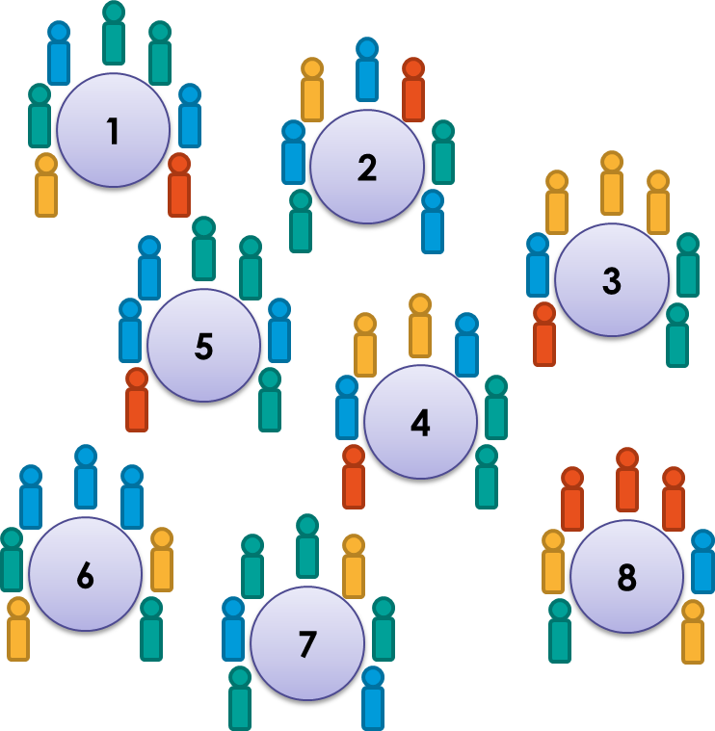
Activity 1 – What matters to me?
For eight different topics on tables, delegates discussed:
What matters to us?
What’s working well?
What’s not working so well?
This aim was for delegates to consider what to address during the afternoon session action planning, and to help people explore the key concerns and opportunities for people living in those situations.
Key points were fed back to the room, and all views from those in the room are captured on the following slides
Table 1 – Neurodiversity
Table 2 – Mental Health
Table 3 – Musculo-skeletal issues
Table 4 – Carers of adults
Table 5 – Homelessness and rough sleeping
Table 6 – Domestic Abuse
Table 7 – Addiction issues
Table 8 – Children and young people

Slide 9
1: Neurodiversity
What matters to us?
What is already working well?
What is not working so well?
Diagnosis may help direct into employment that suits characteristics
High functioning neurodiverse people recognised. Chris Packham
Voluntary sector are great at being inclusive
Beginning to educated the next generation over different platforms, raising awareness and making it more socially acceptable
Social awareness of neurodiversity
Fitting In!
Public sector needs to lead by example
Adult transition from CAMHS etc.
Covid social disadvantage
Delay in diagnosis Adults and Children
better reasonable adjustments
Fitting In!
Lack of services for adults
Not wanting to reveal "diagnosis" being "labelled"
Varying support needs from severe disability to high functioning
Services aren't joined up - duplication and gaps
Lack of funding
Understanding what to do with a "diagnosed" employee
Interview processes
Delay of diagnosis
Mentor with experience in the workplace
Supporting at work to be their best
Social change - how do we respond?
Neurodiversity seen for strengths they can bring
Individualised support
More opportunities for neurodiversity in the work place
Stigma and label vs benefit of diagnosis
Undiagnosed adults - difficulty getting assessment
Delays for children getting diagnosis to get support and intervention
Schools - method requires compliance with 'normal'
Lack of services for adults

Slide 10
2: Mental Health 1/2
What matters to us?
What is already working well?
Getting private sector on board with this agenda
Make everyone feel wanted as an applicant and potential member of staff
Staff morale, wellbeing and happiness
T-level scaling in different sectors
Feeling a valued part of the team and doing a good job
That people are given a chance
To reduce barriers to work - look at the VCSE to understand what we can do to be a solution
Joined up working instead of silo culture
The "system" funding initiatives that work for longer than 6 months - 1 year - we need 2/3 windows of funding
An approach that rewards aspiration
Fairness for all
Retention and wellbeing of staff
Wellbeing days being given which will reduce sick days
MHFA
BLMK Health and Wellbeing Accreditation - Bronze, Silver, Gold level. E.g. BedsRCC applying for Silver
BLMK Keeping Well Hub
More employers having MH first-aiders
NHS Employment Services - individualisaed support
MKUH: Lots of support to get people into work; dedicated advisor helping people into work; major benefits programme; assistance with recruitment
BedsRCC: H&WB group; Staff & CEO lead driver. 1 hour per month to engage in "Wellbeing Hour" led by a staff member
MH Support available / funded as organisation
MKUH: Support available during application process
BeActive Mental Health Champions: Training, network, free (ideal for SMEs)
BedsRCC: Annualised hours contracts. Fulfill hours across a week but not in set hours of a day
Transformation to a holistic approach to secondary MH services
Supporting people into work (though tends to be big organisations)

Slide 11
2: Mental Health 2/2
What is not working so well?
Quality right jobs
Open-mindedness; looking and using people's strengths
Fear of impact on benefits
Employment that rewards where management and value counts
Understanding individual needs in order to support
Employer understanding of mental health and health condition management
Employer / organisations support (reasonable adjustments)
Housing - those accessing through our housing offer; sofa surfing; temp accommodation
Communication avenues
Access to IT and online services; CV writing; UC journal; Job Applications
Lack of clear information on services available
Desire to join NHS as perceived more supportive but "falling"/"failing" in application process.
Wait times for Access to Work
Gaps in employment caused by periods of illnesss - deskilling; loss of confidence
Focus is on what is measured as that drives funding for future
106 Agreement planning
Transport links and lack of public transport - not reliable; frequency low in rural areas – needs to be accessible
Manual work force - Distribution centres located for major roads but not accessible to the workforce
Self-belief of our clients
Flexible work opportunities e.g. around childcare
£££ - to get there / suitable clothing / childcare
School not getting its children who are not going to be academic a rewarding career
Impact of MH support on rest of team - workload; perceived fairness
Interview support and practice – translation
Workplace culture
Lack of education

Slide 12
3: Musculo Skeletal (MSK) issues
What matters to us?
What is already working well?
What is not working so well?
People in employment going into zero pay due to length of absence - waiting for appointments - risk of leaving
Information available to public
People want instant fix or pill
Waiting times are managed on an NHS target not on risk - health inequalities vs economic / personal circumstances
WFH impact
System understanding of the resources available
SMEs have less support offer
Sharing good practice across BLMK on self-referrals; lack of awareness and criteria
Public expectations and contract
Waiting list in acutre hospitals
Long waiting list
Priorities
Clinical cancellations due to own MSK related issues / sickness
Digital poverty
Online self-assesments 'tick box' exercise
Making people well. We need close collaboration with primary, communtiy care and social care. The ICS is so important
Early access to rehab before its an issue
Getting the appointments from health services in a timely way to get back into work
streamline pathways to allow patients to access to correct service quickly
Public education and importance of physio
The message abuot self referral is important
Importance of encouraging active life
information to improve and while waiting
Psychological support from employers
Digital - opportunity to improve
More personal eligibility criteria
Having a conversation with employees wellbeing including reasonable adjustments. 'Can do'
ICS organisation employer role
Understand reasonable adjustments
Good services are available to people, but backlog is an issue
Luton: Good Business Charter
Self referral
Employment advisors support people
Self assessment tool
Physio self assessment
Some employers have good support offers

Slide 13
4: Carers of adults
What matters to us?
What is already working well?
What is not working so well?
Recognition of the role of caring in society as vitally important
Supporting carers as they want to be supported and tailoring messages accordingly
A workplace culture of care for employees
Employers talk to their employees openly about their needs as a carer in employment
Good identification of unpaid carers
Personalised and individualised approach - what works best for you?
Carers feeling well signposted to a carers support hub
Carers recognisiing themselves as such
Full use of Anchor institutions
Honesty from clinicians about the caring needs of a person to enable carers to make informed decisions and plan ahead re: employment
MKUH - Any Hours contract gives carers the flexibilty they need
The Carers Passport provides a flexible employment contract - needs to be more widely used
Covid has forced employers hands into new ways of working
Some employers are leadig the way - Timpsons is one, Sue Ryder another
Healthy Workplace Standards provides pockets of best practice and a ladder of progression for employers
The Carers Hub at Bedford Hospital is a valuable resource
Stigma attached to being a carer - only 30% are in employment
Legal Barriers to communication with carers
Financial disincentives - eg through the welfare system - to carers finding or increasing work
Disclosure of carers remains an issue
Limited respite for carers
Diificult to champion those small employers doing well in a coordinated way and spread best practice
Changing employment contracts to better accomodate caring can be very challenging
LAck of employer representation at Seminar
Carers do not feel available support is well joined up to meet their needs
Limited employment opportunities for carers that allow them to confidently balance caring and work
Carers register is weak - needs improvement
Better leveraging voicse of anchor institutions to act as examplars of best practice and to promote that in the area

Slide 14
5: Homelessness
Hidden Homeless – understanding
Current situation vs homelessness
Building evidence of the impact of measures that have been put in place
Define what we mean by terms
*Dedicated ‘wet’ rooms for social interaction / ability to drink alcohol rather than having to go out on the street
*Everyone is an individual – personalised plans together
Financial impacts – economy
Who is classed as homeless
Why are people homeless
Data to define and know numbers
*Understand people we are working with – one size doesn’t fit all
Consistency of purpose
*Open acceptance of needs based on each person
Greater issue as can’t access services
Services being available if you don’t have an address
England 3000 rough sleepers on any night
England 288,000 household = homeless
Know who they are and services needed
One size doesn’t fit all
What is already working well?
What matters to us?
What is not working so well?
International examples
My Job – 12 week stay – rouse
Flats that have built in Luton – use these
Housing first
Shipping containers projects i.e. Jimmy’s charity in Cambridge (learning new skills set)
Utah model – international models
House people first then look for work
Copenhagen approach to education
Homelessness Partnerships – health and local authority partnerships
International – buddy ideas, education and Mental Health and homelessness up
Partnership Working - Currently in small pockets but needs to go further and the need for investment
Learning from abroad
Housing: expensive; not enough social housing
Hostels: need to be on universal credit; if you get a job you can't stay; unaffordable if working
Benefit delays in moving to new home
Restrictions on what jobs you can do when you receive a visa to work
Lack of digital skills to enable people to access information
Safe housing needed before able to work
Dual diagnosis – enough understanding
Educating and changing people’s experience to overcome myths
Barriers in place
Universal credit - waiting periods to receive funds
Triple harm barriers
Rules increase harm

Slide 15
6: Domestic Abuse 1/2
What matters to us?
Impact on MH and networks
Confidentiality
Trust
Breaking down stigma
Helping men and women to speak up / disclose -> who to disclose to
Employer awareness and able ot be sensitive and responsive
Where to signpost / signs
If in emploment -> leave job or decreased productivity
Stigma in workplace -> how perceived; fear
Abuse can happen in many different ways
Disparity with women in workplace coupled with women in workplace experiencing DA
Men starting to come out as victims too -> taboo in some communities
Myths: affects all strata of society
Myth: will [always] see bruises
Hidden issue - how reflected in policy?
Housing; Income; Stability; Employment; Children
Recognising children in their own right
Fear of consequences of reporting e.g. what will happen to children
Physical and mental health needs
Taboo for men to come forward. Masculinitiy and cultural differences
£ trapped. Post pandemic cost of living support

Slide 16
6: Domestic Abuse 2/2
What is already working well?
What is not working so well?
Good provision from voluntary sector agencies
MK Act: training - PC sessions; Shelter - women and children; support for men; support for abusers
MK Primary care opportunity to have DA champions - general awareness and support
Luton: Employers against DA programme: policies; awareness; recognising; all staff; know who to go to; show loss of productivity; look at empl. Policies; train managers to spot DA
BDAP: cross-sector multi [agency] partnership
MK Together: cross-sector multi [agency] partnership
Luton: Blended approach across referrals
Women's Academy: £ stable; work towards work; building self esteem
Social media awareness (FB, TikTok etc)
"Tell Angela" type media campaigns
Create cultuer and environment
The right culture - flexibility; tailored provision -> employers
Variance across BLMK in support provision -> awareness by communities and community involvement
Diversity of community; and Diversity of organisations to be culturally aware
Employer awareness -> manager training, sensitivity, competence, effective available resources
Culturally appropriate information and accessibility (multi-lingual) - resource needs to be raised to meet need
Need to address issue / perpetrators earlier - behaviours, relationships, acceptability
More for CYP and to catch earlier
Service not equitable across 4 LAs
SARCs - forensic services for cases of suspected sexual abuse (esp. CYP)
Bedfordshire Perpetrators Hub - small success rates
How much data do we have? Rates? Convictions?
Services currently overwhelmed - resource not meeting demand
Low reporting; low speaking up
Addressing gaps re stigma, disclosure, cultureal approaches

Slide 17
7: Addiction 1/2
What matters to us?
What is already working well?
Move to proactive PC against current reactive - (impact negatively on PC currently incl. 111)
understanding cause and supporting to address these, not just symptoms
Breaking the cycle across generations
I am not judged / discriminated against by an employer because I have or have had an addiction (even sometimes NHS orgs)
Trauma - informed appraoch
The -ve impact that addcition has on family or friends - ie indirect stress and ?MH issue
Indentifying, supporting and signposting
Challenge our perceptions - "employed functioning alcoholics"; recreational drugs
How can employers support people they employ who have challenges with adiction? Stigma challenges
Person-centred approach
Grooming young people -> addiction
MH issues - drug and alcohol addiction
Fostering a culture that reduces stigma in the workplace -> Employer charter
Same / similar issues with housing, not just employment
Less stigma due to greater prevalence
Good examples of employers that support people experiencing addiction -> Primark; Timpsons; Iceland
EoE Problem Gambling service opening
Greater awareness
Peer support element in local recovery services
Social awareness to addiction has improved
More help available
Some larger employers who are prepared to take the risk
Good recovery college services in parts - working with communities and 3rd sector partners
Willingness of society to make change happen
Breaking down organisational barriers and sharing resources to focus on residents
Big companies starting to change employment patterns e.g. Timpsons; Primark
Implementing Combatting Drugs strategy locally. More "whole system" approach than before (maybe?!)
Lived experience and co-produced approach

Slide 18
7: Addiction 2/2
What is not working so well?
The £ flows in different ways through different agencies + sometimes ad hoc ways
Health are not the only sector to support addiction (e.g. education)
Tailor services to modern day needs
Not enough resources available
Resources available to provide services
Workforces challenges leaving services on the brink
More industry regulation to stop advertising that may encourage addiction
Criteria/elegibility-based approaches
Services are still siloed - more to do
Addressing poverty and inequalities
How can the public sectro learni from good practice and e.g. Timpsons / Iceland
Solution to increased use of ATRs DRRs to help people earlier in their journey of addiction
Not being person-centred with the support
Intergaces with criminal justice services challenging
Not enough early prvention DELETE criteria hindrance
Lack of awareness of what is available
Is enough done in schools + colleges?

Slide 19
8: Children and Young People
What matters to us?
What is already working well?
What is not working so well?
Looked after children
Missing careers advice in schools - is it relevant?
Raising CYP aspirations and ambitions
Experience aspiration for CYP with LD
Don't underestimate impact of Covid in CYP (all ages) -> transitions; on careers; lingering IPC
Absenteeism (lost CYP) and increase in ADHD post-covid
Oral health and dental
Support to staff working with CYP
Emotional resilience and wellbeing support
Don't blame our CYP for "behaviour"
Choose where to invest
Employer focused on employing LAC
Health ambassadors in schools
Virtual careers advice
Early investment in ASD / SLT and OT/audiology
Increase in employers supporting MH
Increase in apprenticeships for CYP
Employers getting more involved in schools
VCSE expertise in supportin emoptinoal resilience
Project Search is expanding
Loads of co-production with CYP and families
More flexibility for parents and carers at work
Communication (too much isolation)
Not enough support yet (flexible working) for carers to return to work
More family hubs (join up for whole family)
More support earlier for Cyp
No wrong ask for help and support
Not enough buddying to access and feel confident
Join it up more!!
Expelled CYP vulnerable joined up

Slide 20
Place-based Action Planning
These slides are a verbatim reproduction of all of the
ideas and suggestions made during the workshop discussions
and will need further development by places, including:
Review against current place plans to align with existing work
Refine, prioritise and further develop plans, considering existing capacity
Review and agree at place boards
Activities 2-5: Breakout discussions

Slide 21
Activities 3-5:
Breakout discussions formed the main part of the afternoon session. Groups were formed around local authority places.
The aim for the discussions was to create an action plan for the top 1-3 priority cohorts.
Participants were asked to discuss and agree:
Aim statements
A prioritised set of ideas, using a “PICK” (impact vs effort) chart
A detailed action plan, outlining the next steps
Main Hall
MKCC
BBC
Moorfield Room
Woodfield Room
LBC
CBC

Slide 22
Bedford Borough
These slides are a verbatim reproduction of all of the
ideas and suggestions made during the workshop discussions
and will need further development by places, including:
Review against current place plans to align with existing work
Refine, prioritise and further develop plans, considering existing capacity
Review and agree at place boards
Activities 2-5: Place-based group discussions

Slide 23
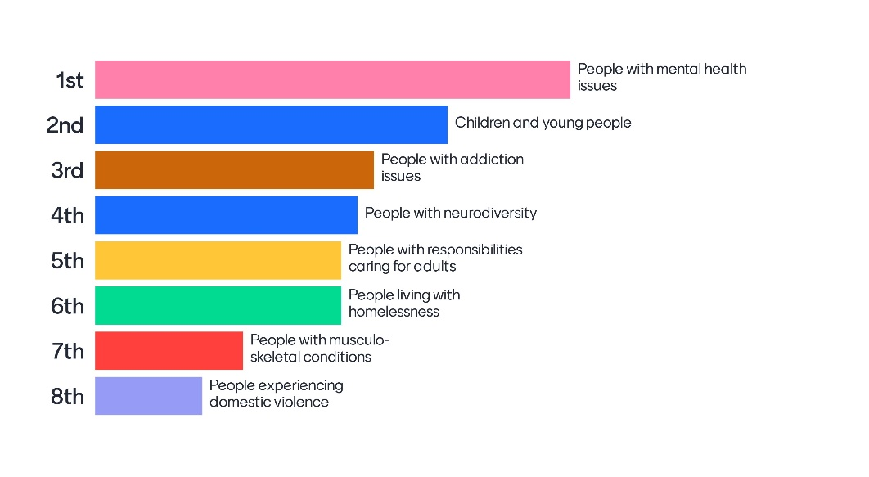
The partners of the BLMK ICS will work together within Bedford Borough to…
Bedford Borough
Aims
1
…ensure every vulnerable 16-25yo is targeted to give them a chance to know all the options available, and what support they would need to access it.
Bedford Borough prioritised Mental Health, Children and Young People, and people with addiction issues in the Mentimeter poll
2
…create more MH awareness in workplaces to help people gain and retain good employment for all adults with mental health difficulties
3
…increase the number of organisations signing up to Healthy Workplace Standards, specifically the one on substance misuse
These aim statements will be further refined in discussion with Place board and partners

Slide 24
The partners of the BLMK ICS will work together within Bedford Borough to ensure every vulnerable 16-25yo is targeted to give them a chance to know all the options available, and what support they would need to access it
Bedford Borough
Ideas
1
Relatively easy to do
POSSIBLE
Ambassadors to come "follow me"
Health and education - "no diagnosis" needed CYP
Social prescription Life Hack
Buddies and mentors (community wellbeing)
Targetted adverts
Advertise on TikTok etc.
Proactive adverts from NHS and others
Seeing 'vulnerable' CYP in school (not dealing to all)
IMPLEMENT
Specific pathways for specific CYP cohorts e.g. special educational needs
Private companies make friends
Probably
Low impact
Potentially High impact
KIBOSH
Stewby "film making" studio
Target certain schools
Incentives: electric cares, bike ?free
"De-NHS"
Parks - gardening / garden centres - "volunteers opportunities"
Constrcution rail jobs
Free transport whilst on apprenticeship
All employers apprenticeship (incl. universities)
Debenhams into an employment 'training hub'
CHALLENGE
Police "volunteers" opportunities
Resources ££££
Friends with Cranfield
Physical health focus 16-25yo
These ideas were developed by attendees at the workshop – other ideas may be added following further discussion with Place Board and partners
Likely difficult to do

Slide 25
The partners of the BLMK ICS will work together within Bedford Borough to create more MH awareness in workplaces to help people gain and retain good employment for all adults with mental health difficulties
Bedford Borough
Ideas
2
Relatively easy to do
POSSIBLE
Invest in people when well to prevent ill mental health
Break down stigma - Reduce fear - risks/assumptions
More creative recruitment systems
Campaign to employees on Healthy Workplace Standards (use Event 26 Sept)
Educating employment / employers
IMPLEMENT
Access to work - MH Job scheme (support to find employment)
Mental Health First Aid MHFA Trining / work champions
Employee Assistance programme - consider employee benefits (support in work)
Awareness - manager, peers, middle management
Reasonable adjustments - supporting employees whatever diagnosis - Retain
Behvaioural / cultural change - long term
Continued target for wellbeing supports - short term
Probably
Low impact
Potentially High impact
KIBOSH
Everyday work demands - pressures on others / duty of care - all
CHALLENGE
Recognising triggers / decline - person-centred
Masking
Stigma
Medication
Perception of risk to employers / employees
These ideas were developed by attendees at the workshop – other ideas may be added following further discussion with Place Board and partners
Likely difficult to do

Slide 26
The partners of the BLMK ICS will work together within Bedford Borough to increase the number of organisations signing up to Healthy Workplace Standards, specifically the one on substance misuse
Bedford Borough
Ideas
3
Relatively easy to do
POSSIBLE
Understand experience from those affected to inform approach
IMPLEMENT
Publicise and raise awareness - Engage business networks - federation of small business; Chamber of Commerce; Round Table; Rotary
HNA to identify high risk cohorts - geography
Work experience / liaise with schools
Case studients - resident experience; employer
Target and identify employers in BBC - anchor institutions
Target manual and routine workers / employers
Probably
Low impact
Potentially High impact
KIBOSH
CHALLENGE
Prevention. Schools. Employers should encourage more younger into work place
Promote no blame culture
Insurance company buy-in
Corporate social responsibility of orgs / employers
Engagement of employers of manual and routine workers
These ideas were developed by attendees at the workshop – other ideas may be added following further discussion with Place Board and partners
Likely difficult to do

Slide 27
The partners of the BLMK ICS will work together within Bedford Borough to …
Bedford Borough
Proposed Actions
Cohort | Idea | Action | Who will do it? | By when? | Measure of success
CYP 16-25yo |  | Get better data to understand which groups to target and what options are available.
CYP 16-25yo |  | Take to place board for discussion
CYP 16-25yo |  | Comms? HR? CYP employment plan
CYP 16-25yo |  | Determine how plan fits into [existing] BBC Place plans
Mental Health | To link the MH work pieces (ie collaborative and transformative) to place EDG | See PICK chart | Kate Walker and Alison Fuller through Richard Fradgley / Robin Porter | Aug-23 | More people access and remain in employment
Addiction | Raise awareness with employers about ROI on Healthy Workplace Standard | Comms and engagement via business networks | LA / ICB / parish and town councils / VCSEs / Schools |  | Number of orgs signing up for standards
Addiction | Raise awareness with employers about ROI on Healthy Workplace Standard | Comms and engagement via adult working population | LA / ICB / parish and town councils / VCSEs / Schools |  | Number of orgs signing up for standards
Addiction | Raise awareness of nature of problem and impact locally, individually, community and economy | Schools talks and newsletters | Local resilience forums
Addiction | Host a Healthy Workplace Standards Network |  | BLMK HCP
This action plan was developed by the attendees at the Health and Employment seminar – further engagement with Place Board and partners will occur to refine and agree the plan

Slide 28
Central Bedfordshire
These slides are a verbatim reproduction of all of the
ideas and suggestions made during the workshop discussions
and will need further development by places, including:
Review against current place plans to align with existing work
Refine, prioritise and further develop plans, considering existing capacity
Review and agree at place boards
Activities 2-5: Place-based group discussions

Slide 29
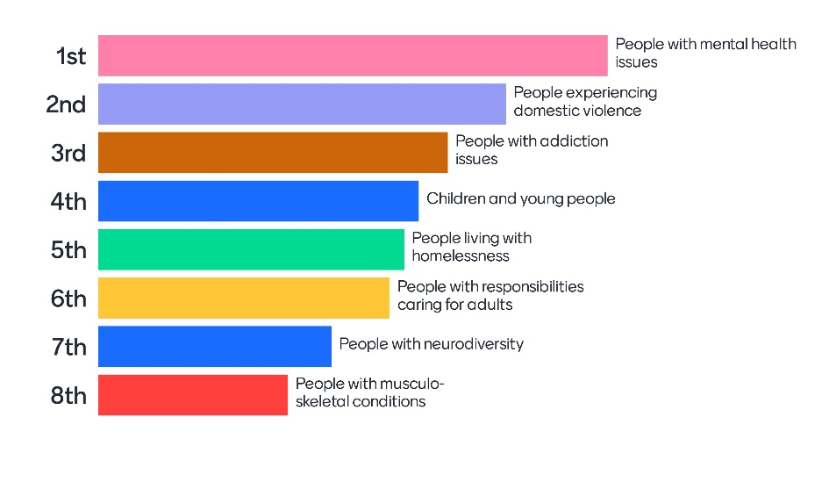
The partners of the BLMK ICS will work together within Central Bedfordshire to…
Central Bedfordshire
Aims
Central Bedfordshire prioritised Mental Health, domestic abuse, and people with addiction issues in the Mentimeter poll. As a group, they chose to focus on children and young people to support that group and also improve the situation for our future adults.
1
…improve support for CYP, neurodiverse and residents with MH conditions to increase employment of those groups
This aim statement will be further refined in discussion with Place board and partners

Slide 30
The partners of the BLMK ICS will work together within Central Bedfordshire to improve support for CYP, neurodiverse and residents with MH conditions to increase employment of those groups
Central Bedfordshire
Ideas
1
Relatively easy to do
POSSIBLE
First time give people a chance
Developing coordinated team - system leadership
Picking out companies - getting it right and promoting
Work with local CIPD branches
IMPLEMENT
Reasonable adjustments - supporting employers
Work experience and apprenticeships
Two people share one apprenticeship
Supported internships and employment - increase (system and employer)
Parents - taking careers advice for parents and kids
Better data intelligence analytics and sharing
Cut [?] letter
Better matching of CYP w/ employer
Action with workless households
Visit every secondary school
Careers Hub Development
Probably
Low impact
Potentially High impact
KIBOSH
Support people to work locally
CHALLENGE
Employers education e.g. neurodiverse
AI skills
Consistency of employer messaging -> coordinated
Make work more meaningful
SEND children smoother transition to employement -> excluded -> particular skills
Social experiment on meaningful employment
SEND: flexible working and adjustments for SEND children
Better and broader social value in contracts
[Use all] levy money -> inequalities
Digital access
Teachers -> attract; retain; recruit
These ideas were developed by attendees at the workshop – other ideas may be added following further discussion with Place Board and partners
Likely difficult to do

Slide 31
The partners of the BLMK ICS will work together within Central Bedfordshire to …
Central Bedfordshire
Proposed Actions
Idea | Action | Who will do it? | By when? | Measure of success
More Supported Employment | Map internal opportunities across the ICS and together develop a clear vision as CBC partners for supported employment | System and Employer Level | Next two years | Number of supported employment placements going to CYP
Improve Data Analytics | Establish clear benchmarks from which changes can be measured | System led | Next two years | Data reliability and accuracy
Developing a Careers Hub | “Us” as employers vising every secondary school in CBC to discuss careers, opportunities and skills, including CV writing workshops | System and Employer Level | Next 12 months | Number of children having contact with an anchor institution every 12 months
Improving Digital Skills, and AI awareness and access | Connecting with and funding VCSE and other organisations who can coach and train young people in digital skills | System led | Next two years | % of CYP reporting good digital access and skills
Action on workless householders | TBC | TBC | TBC | TBC
Promotion of those employers really getting it right | Use better, and more coordinated communication methods as a group to ensure honed and targeted employer messaging and promotion | System led | Next 12 months | Proportion of Central Beds employers receiving central communciatons
Closer working with local CIPD branches | Work with local CIPD branches to support the delivery of CV workshops, including those led by local employers | System and Employer Level | Next 12 months | % of CB CYP attending a CV or similar workshop each year
Focus on the attraction, retention and recruitment of teachers | Work with Local Authority and Education Sector colleagues to do all we can as an ICS to support teacher recruitment and retention | System led | Next three years | % of good and outstanding schools in CB, and vacancy rate for teachers
Better use of social value in contracts | More public sector contracts to include social value requirement | System led | Next three years | % public sector contracts making use of SV
Pushing more flexible working and adjustments for SEND children | Co-design activity with parents | System led | Next 12 months | % of SEND CYP in employment, and % SEND CYP reporting successful adjustment
Widen use of work experience and apprenticeships (using Levy) | As per suggestion made in seminar, we should make full use of local apprenticeship level funds to support more apprenticeships for CYP, and use our analytical capacity to match roles to CYP | Employer Led | Next two years | % of CYP reporting access to work experience pre 18, and % usage of the apprenticeship levy
This action plan was developed by the attendees at the Health and Employment seminar – further engagement with Place Board and partners will occur to refine and agree the plan

Slide 32
Milton Keynes
These slides are a verbatim reproduction of all of the
ideas and suggestions made during the workshop discussions
and will need further development by places, including:
Review against current place plans to align with existing work
Refine, prioritise and further develop plans, considering existing capacity
Review and agree at place boards
Activities 2-5: Place-based group discussions

Slide 33
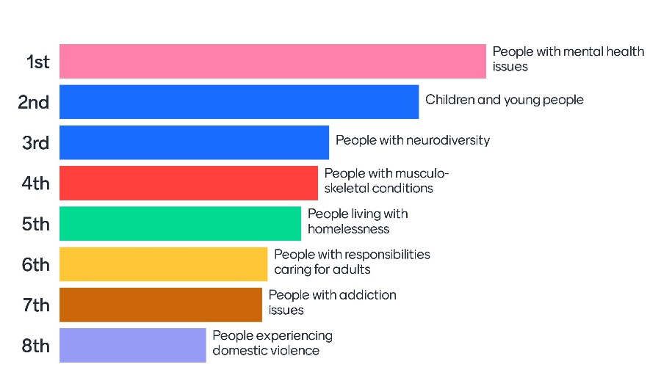
The partners of the BLMK ICS will work together within Milton Keynes to…
Milton Keynes
Aims
1
…improve and create meaningful and sustainable employment for people with neurodiversity
Milton Keynes prioritised Mental Health, Children and Young People, and people with neurodiversity in the Mentimeter poll
…support 15-18 yos not in education, training or employment into stable employment or further training in order to reduce the proportion of young people not in education, employment or training by 2026
2
3
…reduce the employment gap for people with mental health challenges
These aim statements will be further refined in discussion with Place board and partners

Slide 34
The partners of the BLMK ICS will work together within Milton Keynes to improve and create meaningful and sustainable employment for people with neurodiversity
Milton Keynes
Ideas
1
Relatively easy to do
POSSIBLE
Apprenticeships with additional support for people with Neurodiversity
Training for organisation on Neurodiversity
On the job support and application support for people with neurodiversity
How do we identify where people can excel – what careers can we match them to?
Use of local authority knowledge and schemes
Discourse of what’s already happening
IMPLEMENT
Is there an employers forum?
Disability passports across NHS/ICB
Probably
Low impact
Potentially High impact
KIBOSH
CHALLENGE
Engaging with volume of employers
Education on range and understanding of neurodiversity
More sophisticated approaches to employment entry? Currently schemes don’t quite work
Target SME?
Help people understand needs
These ideas were developed by attendees at the workshop – other ideas may be added following further discussion with Place Board and partners
Likely difficult to do

Slide 35
The partners of the BLMK ICS will work together within Milton Keynes to support 15-18 yos not in education, training or employment into stable employment or further training in order to reduce the proportion of young people not in education, employment or training by 2026
Milton Keynes
Ideas
2
Relatively easy to do
POSSIBLE
‘passporting’ between local partners including 1° care= 1 ‘no wrong door’
More apprenticeship programmes
Be prepared to be radical
System supporting targeted careers fairs
Schools and colleges (place – system)
Identify population of C&YP in 3.7%
Bring together funding programmes
IMPLEMENT
Joined up approach across partners to more work experience / placements (place vs system?)
Youth opportunities board eg, Barts
CYP in other strategies eg key worker housing
Making health careers attractive for young people
Flexible apprenticeships eg for those with caring responsibilities
Early in reach into secondary schools
Locally focussed recruitment campaigns
Apprenticeship brokerage
Probably
Low impact
Potentially High impact
KIBOSH
Everyday work demands - pressures on others / duty of care - all
CHALLENGE
Create University
One in pipeline
Single joined up approach across partners for apprenticeships
Clear entry pathways
NHS Brand and EVP for young people
These ideas were developed by attendees at the workshop – other ideas may be added following further discussion with Place Board and partners
Likely difficult to do

Slide 36
The partners of the BLMK ICS will work together within Milton Keynes to reduce the employment gap for people with mental health challenges
Milton Keynes
Ideas
3
Relatively easy to do
POSSIBLE
break down stigma and reduce inequalities
Supporting people and retain employment during mental health challenges
Making conversations about mental health part of employment practice
ICS guaranteed interviews for people with MH
Self esteem building before work
Return to work support after long absence
Creative employment models
Support emotional recovery
Targeted career development for people with Mental health challenges
YMCA example
VCSE sense of achievement
More flexible working
Alternative employment offers that adjust to meet needs
Reasonable adjustments
IMPLEMENT
Wellbeing support
Support for line managers in employer: understanding; solutions; … for employees
Recognise the value mental health experience brings to work
Establish peer support networks
Understand employees experience
Flexibility essential to employ people with mental health issues – contract = 2 way
Working from home – an opportunity to move jobs better for people with mental health issues
Generate team of advocates with lived experience and network within employers
Recruitment evening targeted at VCSE/groups supply people with mental health challenges ICS wide / MK wide
ICS Employers identify jobs with more flexibility: How we advertise; job descriptions - barriers of qualifications; have to start somewhere
Talk to people with mental health issues who have struggled with employment and learn from experience i.e. MH Alliance MANCAVE
Make case for change to employers – positive stories, honest conversations
Use Social media to get engagement and share information
Mental health tick – promote in MK – equality act
Women and work /Works for us – support people with mental health issues
Mentor model / advocacy
Build aspiration mentors etc
Ongoing continued support worker model
Probably
Low impact
Potentially High impact
KIBOSH
CHALLENGE
Resource challenge - Get private employers more included.
Invite employers to come and meet people with MH challenges – YMCA example
Healthy workplace standards – increase funding for team?
These ideas were developed by attendees at the workshop – other ideas may be added following further discussion with Place Board and partners
Likely difficult to do

Slide 37
The partners of the BLMK ICS will work together within Milton Keynes to … (1/2)
Milton Keynes
Proposed Actions
Cohort | Idea | Action | Who will do it? | By when? | Measure of success
All | n/a | Review action plan and present to MK Place Board | Maria Wogan, Ross Graves, Vicky H | September 2023
Neurodiversity | MKC employers forum | Check re: existing provision with MKCC and discuss forum | Maria
Neurodiversity | Share MKUHFT job support Programme | MKUHFT to share job support Programme | Danielle Petch
Neurodiversity |  | Disability passport roll out | Martha and MK disability lead
Neurodiversity |  | Identify schemes already happening in MK | Ross
Neurodiversity |  | Publish help into work schemes to employers | Comms
Neurodiversity |  | Education on range of Neurodiversity and opportunity | Comms
Neurodiversity |  | Lobbying DWP for more sophisticated schemes | Felicity Cox / Comms
Neurodiversity |  | Earlier diagnosis | Ross & CNWL & ED ?
CYP | CYP 15-18 | 1. Identify outcomes and inequalities data 2. Targeted careers fairs | ICS Anchors (NHS, LA) |  | %↓ Also reduction in inequalities across
CYP | Potential in reach into secondary schools | 1. Locally focussed recruitment programmes 2. Apprenticeships eg nursing assistants/associates 3. early in reach into schools and colleges re: careers 4. all the above but working across public and private sector | ICS Anchors (broader for fourth action)
This action plan was developed by the attendees at the Health and Employment seminar – further engagement with Place Board and partners will occur to refine and agree the plan

Slide 38
The partners of the BLMK ICS will work together within Milton Keynes to … (2/2)
Milton Keynes
Proposed Actions
Cohort | Idea | Action | Who will do it? | By when? | Measure of success
Mental Health | Coproduce solutions with people with mental health challenges with colleges, schools, employers, VCSE, Mancave and works for us | • Use social media and engage and share • Create a team of advocates to engage employers and residents • understand what do we already | VCSE; MH Alliance MANCAVE? Men in sheds; Women’s Network; Simon YMCA | 3 months | No of people and employers engaged with and ideas generated
Mental Health | Support recovery into employment | • YMCA example – emotional model • Relationship building • How we recruit – volunteering | Baseline ICS; DWP CNWL; VCSE | 12 months | Numbers of employment achieved
Mental Health | More flexible employment offers | • Role flexibility • Share mental health stories • Open events targeted • Flexible working offers | MK; ICS Employers MKCC; MKUH; ICB; CNWL; Plus anchors and SMEs Network | 12-24 months | Feedback from employers, jobs offered and accepted, feedback from residents
Mental Health | Support people in work and line managers | • Mentors • Networks • MH Tick across MK • Targeted career day • Healthy workplace Standards++ | MK; ICS Employers MKCC; MKUH; ICB; CNWL; Plus anchors and SMEs Network | 12-24 months | Feedback from employers, jobs offered and accepted, feedback from residents
Mental Health | Engage private sector employers | • Invest in Public Health team resource • Events for employers and residents • Job Centre offers ++ | MK Business Leaders – Simon YMCA | 12 months | Feedback from employers, jobs offered and accepted, feedback from residents
Mental Health | Ensure delivery | Report on next steps to MK HCP 21/9 Share information from all groups Revisit to check progress Read across cohorts | Maria, Vicky, Ross | Sept 23 | Report and agreed next steps
This action plan was developed by the attendees at the Health and Employment seminar – further engagement with Place Board and partners will occur to refine and agree the plan

Slide 39
Luton
These slides are a verbatim reproduction of all of the
ideas and suggestions made during the workshop discussions
and will need further development by places, including:
Review against current place plans to align with existing work
Refine, prioritise and further develop plans, considering existing capacity
Review and agree at place boards
Activities 2-5: Place-based group discussions

Slide 40
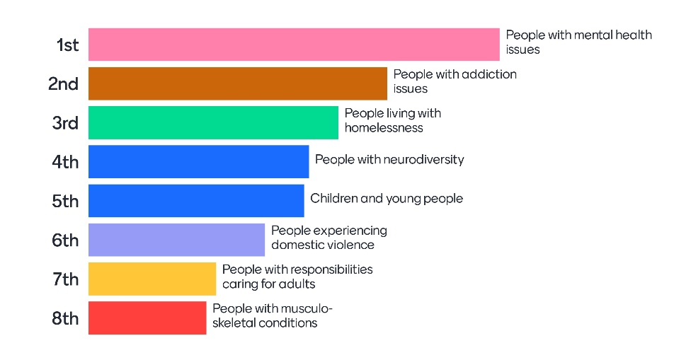
The partners of the BLMK ICS will work together within Luton to…
Luton
Aims
Luton prioritised mental health, addiction and homelessness in the Mentimeter poll – there was recognition from the group that many people may be included in all three cohorts, and that the approach to supporting residents in any of them would be similar.
1
…support adults living with homelessness and/or with addiction and/or mental health difficulties to access and retain employment
This aim statement will be further refined in discussion with Place board and partners

Slide 41
Luton partners drafted a driver diagram
Luton
Ideas
Map employers: 1) those who have potential for supporting people with MH/D&A/homelessness; 2) those that can share successes with other civic responsibilities
Employers to recruit those with MH/D&A/Homeless with mentor
Care Coordinator link to Employment support / volunteering
Drug culture
Groundwork with (small) employers to create opportunities - best done by industry e.g. hospitality
Identify who doesn't meet service criteria - those who don't access services go under the radar - how do we support them?
Training for staff to accept people with these issues
Family social breakdown
Embed volunteering / offer knowledge into services
Support adults living with homelessness and/or with addiction and/or mental health difficulties to access and retain employment
Coordinate Anchor-employer inclusive employment policies, and disseminate to other large employers
Work with employers - health adjustment passport
Mentors
Access
Primary drivers
Change ideas
Learn from work, pilots, studies - implement work we've already done, not commission new work
Map what we're already doing
One trusted adult / support worker / befriender who stays with a person for a year, to help them access all services
Better Coordination across services - SPOC; homelessness/D&A/MH
Trauma
Be innovative - run two or three pilots where we really focus on pre-employment (barriers), employment support and staying in employment
One collator for data from all organisations within Luton in order to drive change through data
Establish virtual team for personalisation one stop shop
Social Housing
Key worker hubs that enable people to access the most pressing public service for their situation
All services in one place - triage
Resources
One-Stop-Shop approach - triage; steered by support / community workers / lead practitioner
Specific zero drugs policies
One stop shop (joined up services in one location) with lead practitioner
This draft driver diagram was developed by attendees at the workshop – it will be reviewed and adapted with Place Board and partners

Slide 42
The partners of the BLMK ICS will work together within Luton to …
Luton
Proposed Actions
Cohort | Idea | Action | Who will do it? | By when? | Measure of success
MH / Addiction / Homelessness | Awareness raising | Share outputs from Employment and Health seminar with Luton Place Board | Nicky Poulain | 8 August 2023
MH / Addiction / Homelessness | Driver diagram | Complete driver diagram, mapping against secondary drivers and prioritise ideas; add measures | Sally Cartwright / Nicky Poulain | Within one month
MH / Addiction / Homelessness | Understand the system | Map seminar outputs against Luton 2040 vision and strategy and Marmot Town work to align to these and ensure coordination | Sally Cartwright / Sinead McNamara | Within 3 months
MH / Addiction / Homelessness | Lived Experience pathways to employment, (including children in care) | Develop lived experience pathways into employment, for example through: i) 2-Year multi-organisational OT preceptorships ii) Paramedic recruitment iii) 111 as an employer | Bethan Billington | Commence development within 3 months
MH / Addiction / Homelessness | WorkWell Partnership programme | Develop joint ICB/LA/DWP bid for funding to develop pathways for pathways to employment for those in economically inactive groups | Tim Simmance / Bethan Billington / Sonia Aziz | Autumn 2023
This action plan was developed by the attendees at the Health and Employment seminar – further engagement with Place Board and partners will occur to refine and agree the plan

Slide 43
ICB Next Steps
BLMK ICB Actions

Slide 44

BLMK ICB will continue to support at system- and place-level
ICB actions to include:
Disseminate outputs from topic-based table discussions to appropriate groups within ICB, NHA, LA and VCSE sectors to help shape thinking.
BLMK ICB-led activities – led by Bethan Billington and Tim Simmance
  Convene Anchor Apprenticeship Levy working group to look to maximise use of the levy across the system
  Continue work on developing employment support pathways for social housing residents
  Create more-detailed social value frameworks, working with LA colleagues, to ensure health and care services and suppliers they commission are contributing to skills and employment development at a local level, aligned to Place priorities
  Support uptake of employer programmes across Anchors, including Healthy Workplace Standards, Good Business Charter, Disability Confident
  Connect Anchor recruitment pipelines to pre-employment support offers from LA and VCSEs
  Explore opportunities to introduce good practice outlined in seminar pre-reading pack
Support Link Directors to report on progress to ICB Board.

Slide 45
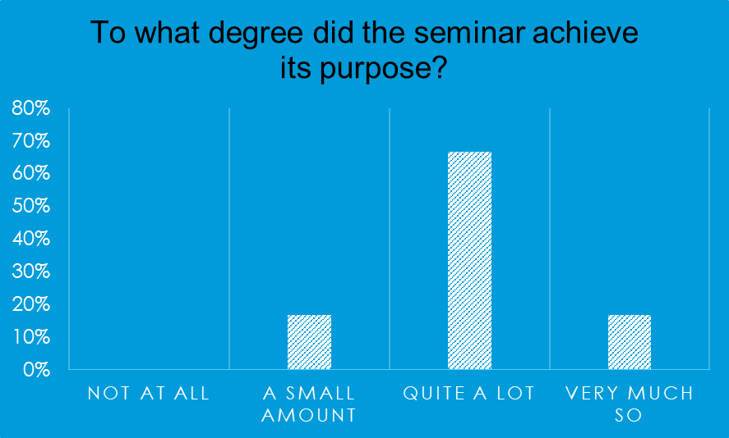
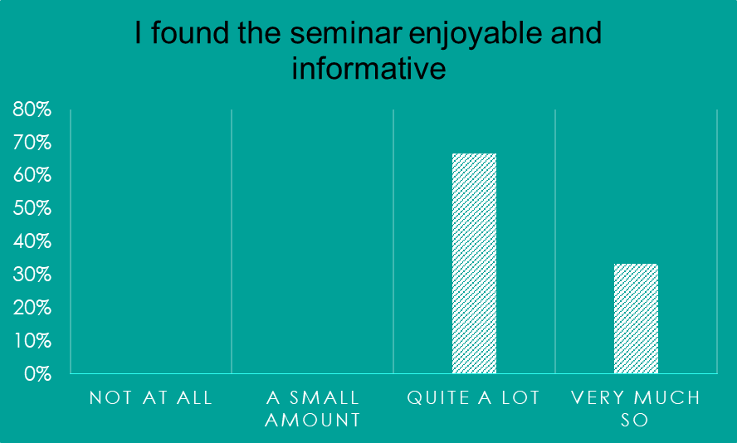
Feedback received to date
The main speaker on the video, Donna Hall, was fantastic - very inspirational.
4 August 2023
I thought the structure, and the way the Seminar was run, including materials was good.
What did you learn?
"Got new ideas about where we can link to with our soon to be started employability project. Found out about apprenticeships donations of funds.”
How you can create the right environment for carers and people recovering into work.
What could have been better?
Briefing those who are running the small group sessions so that there is consistency in activity and output may be helpful.
Clearer about the aims of the day
My only concern was that there was not a consolidated action plan to take forward from the co-ordinators of the seminar, the onus was put on the groups
What else could we change for the next event?
The question of how ICB activities/strategies will sit with local authority and other statutory bodies ones seems like a big challenge. How will the discussions happen to unpick these challenges?
The place based exercise was tricky, as so much is already going on at place, so needing to link with existing activity/strategies, not often about creating new ones.

