Slide 1




BLMK ICS Digitising Social Care (DiSC) Programme
Catalogue of products
Email the team: blmkicb.digital.socialcare@nhs.net
Visit our webpages: https://blmkhealthandcarepartnership.org/our-priorities/
data-and-digital/digitising-social-care-disc-programme/

Slide 2
Digitising Social Care programme
Our team members support a wide range of high-profile projects, programmes, and transformation initiatives with most of our work delivering against national health and care priorities.
The BLMK Digitising Social Care (DiSC) programme aims to transform social care delivery across Bedfordshire, Luton and Milton Keynes through the strategic implementation of digital technologies.
By leveraging digital tools and systems, the programme aims to:
Support care planning and delivery:
Use digital tools
to support personalised
care planning
and delivery
Enhance
service user experience:
Improve overall experience of receiving social
care services through digital solutions
Improve efficiency:
Streamline administrative
tasks, allowing
care providers to spend more time with service users
Enhance communication:
Facilitate better communication between care providers, service users, and other stakeholders
Improve data management:
Collect, analyse, and utilise
data to inform
decision-making and service improvement

Slide 3


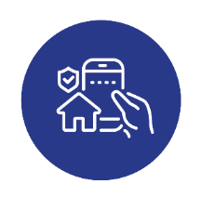
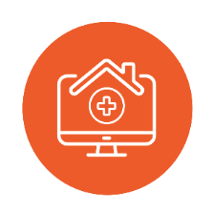
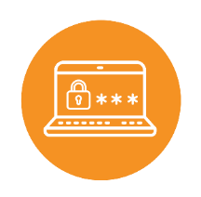
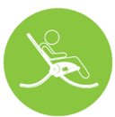


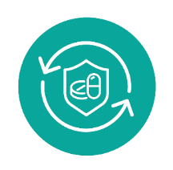


Our digital offer
The multi-agency Digitising Social Care programme is driving digital transformation in social care.
By fostering strong partnerships and implementing robust governance, the programme is enabling a more integrated, efficient, and person-centred care system.
A dedicated team serves as the primary digital liaison for each local authority’s social care sector, fostering strong partnerships with care providers. By working collaboratively, we are able to co-create innovative digital solutions that address local challenges and promote cross-sector collaboration within place-based and system-wide partnerships.
Our digital offer includes:
Enhancing patient access through remote monitoring: Whzan
Improving communication and workflow: NHSMail/secure mail, Proxy Access
Supporting independent living: MiiCare
Digital records: Digital Social Care Records
Preventing falls and promoting independence: Raizer Chair, GaitSmart, Acoustic Monitoring
Strengthening data security: Data Security and Protection Toolkit
Enhancing wellbeing: RoboPets
Pain management: PainChek

Slide 4
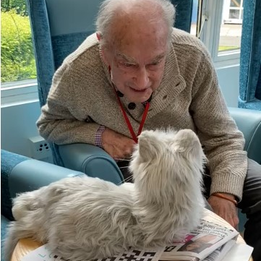


RoboPets
Robotic cats, dogs and birds which use artificial intelligence to respond to voice commands, and interact through realistic movements. A unique and beneficial approach to companionship and therapy, especially for individuals with specific needs.
BLMK pilot underway to issue around 1,300 RoboPets to local residents
Ideal companions for the elderly, people living on their own, or anyone who is unable to have a pet of their own
Provides a calming influence to reduce anxiety and agitation
Improves mental health and wellbeing, and quality of life
Gives people greater independence and confidence
Provides comfort to reduce feelings of isolation and loneliness
Aids communication between the cared-for person and their carer.
Visit our webpage to read more about this pilot
and complete an
Expression of Interest form
To get involved or find out more, contact blmkicb.digital.socialcare@nhs.net

Slide 5
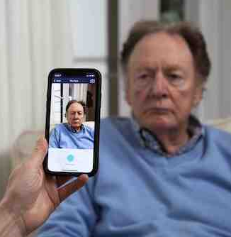

PainChek
Video:
How PainChek works
Innovative pain management technology to improve the care of residents, especially those with communication difficulties or learning disabilities. PainChek uses artificial intelligence to measure small changes in facial expressions and voice to quantify a pain score – guiding carers to provide the right support.
BLMK pilot underway to enable around 1,000 residents to benefit from PainChek
Reliably detects pain in those who may be unable to verbalise it, such as those living with dementia or other cognitive impairment
Reduces levels of pain, insomnia, stress, distress and mobility
Ensures medications are used appropriately
Reduces hospital admissions and falls
Encourages greater independence through activity
and exercising new skills in a supportive environment
Improves self-confidence of staff in managing pain.
“PainChek supports the gathering of information to better support our residents.
The information is easy to access and track… It’s a good tool to work alongside the GP
for pain management.”
Louise Norris, Deputy Home Manager,
Oak Manor Care Home
To get involved or find out more, contact blmkicb.digital.socialcare@nhs.net

Slide 6
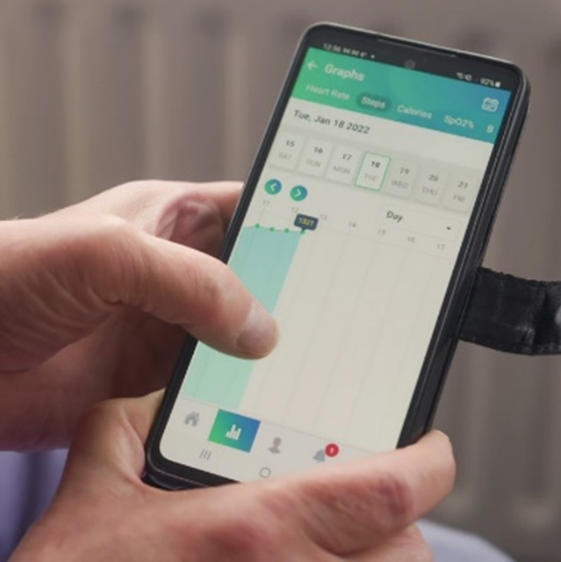
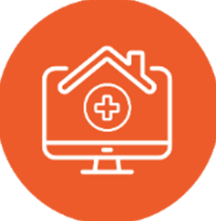
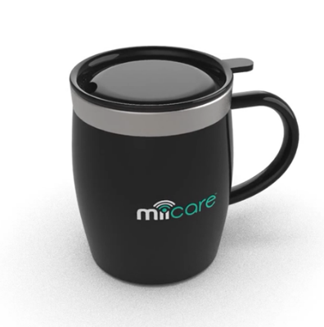
MiiCare
25% reduction in routine site contacts
An assistive technology platform supporting vulnerable adults to live independently at home. A ‘virtual assistant’ called Monica checks on wellbeing and daily routines to help users to stay safe and well at home.
MiiCare is suitable for people who are at risk of falls or urinary tract infections, or who have recently left stroke or neurological units.
39 residents supported through 39 installations
Helps people stay in their own home, safely and for longer​
A central MiiCare hub is connected to a set of devices and sensors around the home – such as door sensors, mugs and watches
Helps reduce hospital admissions​
Prompts actions important for wellbeing​ – such as
reminders to take medication and have a drink
Gives reassurance to family members and alerts them
in case of emergency.​
“Thanks to the MiiCare app I have assurance at my fingertips! This little box has taken away some of the worry, without removing my mother’s sense of self or independence.”
‘Karen’ (not her real name),
whose mother uses MiiCare
To get involved or find out more, contact blmkicb.digital.socialcare@nhs.net

Slide 7
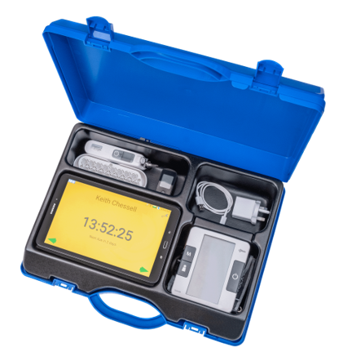


Whzan Blue Box
Video: Local care
home staff and a GP
talk about Whzan
A user-friendly, digital health platform enabling remote patient monitoring.
Collects vital signs data and calculates early warning scores to help
healthcare professionals to identify patients at risk of deterioration.
Whzan is now supporting Discharge to Assess (D2A) beds and expanding to
home-based monitoring with domiciliary care providers. Integration with SystmOne is underway to enhance communication between care settings and primary care – enabling real-time information sharing for personalised care.
3,079
residents
supported across 90 homes
Staff can understand results easily and work more effectively
Detects health changes and deterioration earlier to reduce ambulance call-outs and hospital stays
Measures pulse, blood glucose, oxygen levels, blood pressure, respiratory rate and body temperature
​Authorised carers and GPs can access the ​latest readings through a secure portal – speeding up diagnosis and care.​
“Whzan speaks for residents who can’t talk. It’s a really useful tool for any care home to have and gives us the help we need for our residents much more quickly.”
Sylvester Mulenga, Senior Carer, Oasis House Residential Home
To get involved or find out more, contact blmkicb.digital.socialcare@nhs.net

Slide 8
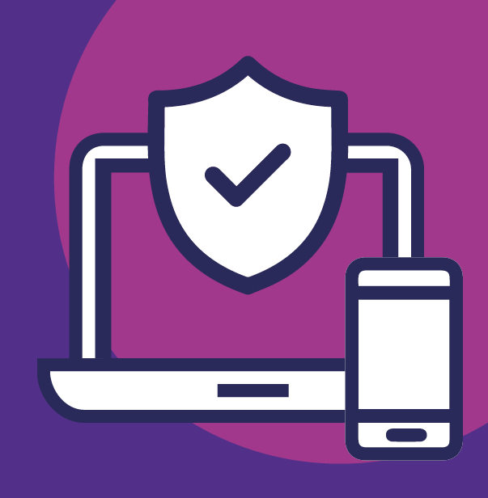
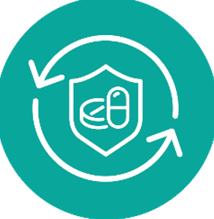
Data Security and Protection Toolkit (DSPT)
Continued support is provided to CQC-registered care providers in completing this annual self-assessment to understand how they can keep their residents’ data safe.
This involves assisting providers in assessing their adherence to the National Data Guardian’s 10 data security standards and fostering a strong data protection culture within their organisations.
80% completion by BLMK care homes
Helps ensure providers store and use people’s data securely​
Shows them how to keep people’s information safe
and protect their organisation from risk​
Completion of the toolkit enables access to other
digital solutions such as NHSmail and Proxy Access.
“Now we have the DSPT, we have been able to demonstrate to the CQC that we can securely store and protect patient data. This has helped us to strengthen our IT system and begin our digitalisation journey.”
Anda Marin, General Manager,
Burlington Hall Care Home
Visit the Bedfordshire Care Group DSPT
webpage to find out more
To get involved or find out more, contact blmkicb.digital.socialcare@nhs.net

Slide 9
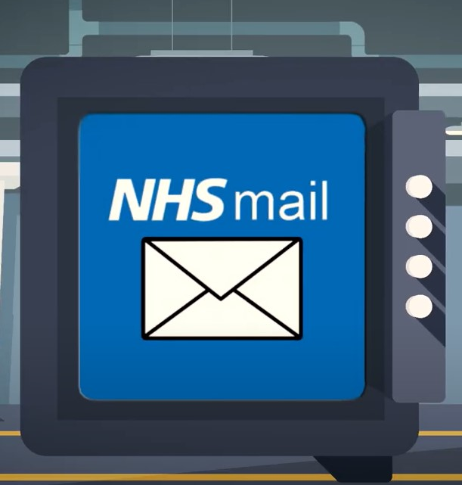

NHSmail
Video: Why care homes
should use NHSmail and
how to get started
Wide-scale adoption of NHS.net mail accounts fosters smoother and more secure communication across the healthcare network. This is the preferred system for Proxy Access and for hospitals to safely share patient information with social care.​
123 active accounts in BLMK care homes
Ensures residents’ information is sent safely and securely​
Is required for funding to support a Digital Social Care Record
Enables access to Proxy Access​
Available to all CQC-registered care providers who
have achieved ‘Approaching Standards’ on the
Data Security and Protection Toolkit.​
“Before NHSmail, my staff would have
been required to visit practices to access resident information – taking valuable
time away from care provision.”
Anda Marin, General Manager,
Burlington Hall Care Home
To get involved or find out more, contact blmkicb.digital.socialcare@nhs.net

Slide 10
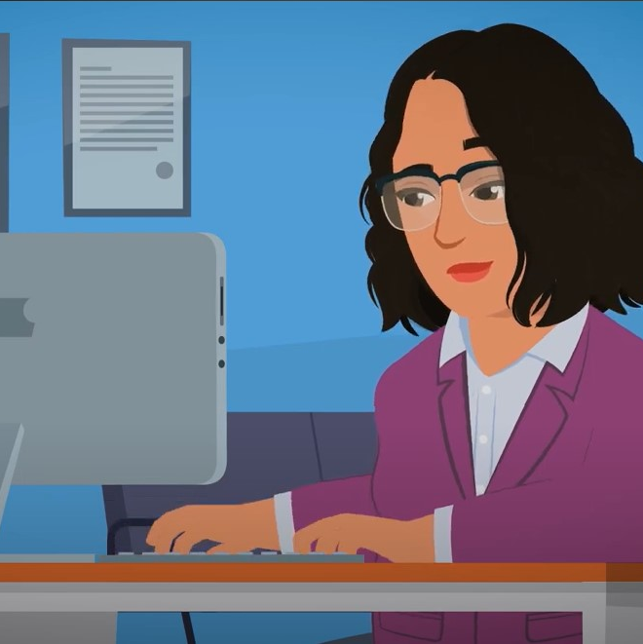
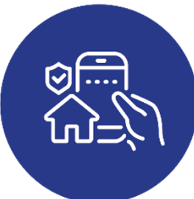
Proxy access
Video: Local care
home staff talk
about Proxy Access
Video: Local GP
practice staff talk
about Proxy Access
A safer, easier and quicker way of ordering repeat prescriptions
online on behalf of care home residents.​ Enhances collaboration between care homes and GP practices by enabling real-time information sharing – including access to complete care records, streamlined medication ordering, and efficient appointment booking.
34% of homes have full access (against 20% target)
1,034 days of staff time saved during 2023/24
Allows medication ordering 24 hours a day​
Fewer emails and calls between care homes and GPs
Frees-up staff time to focus on delivering care​
Communication about repeat medications
between GP and care home is safer, more
efficient and cost-effective​
Improves accuracy of medication ordering
Improves audit trails and reporting.
“It’s increased productivity and made things much easier for everybody. It’s increased communication and relationships with the GP surgery, and it reduces time wastage, medication errors and staff stress levels.”
Claire Croucher, Registered Manager, Precious Homes
To get involved or find out more, contact blmkicb.digital.socialcare@nhs.net

Slide 11
Appendix
Previous projects

Slide 12
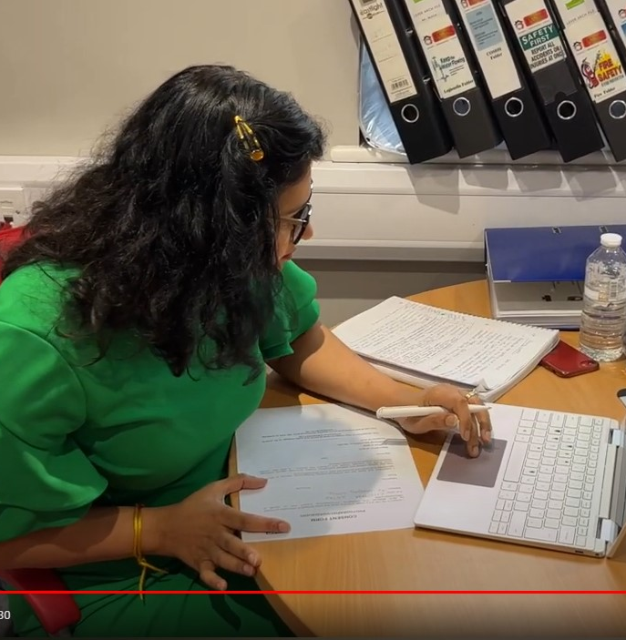
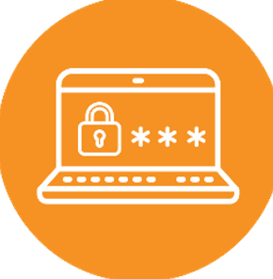
Digital social care record (DSCR)
Video: Local
care home staff
talk about DSCR
Supporting CQC-registered care providers in the transition to digital care planning. This enhances efficiency, improves care quality, and facilitates seamless information sharing within integrated care records.
Used by 80% of care homes
Improves care outcomes, care quality and the safety of care for residents​
Allows easy recording and updating of residents’ health and care records​
Saves care homes time and money
Frees-up staff time to focus on delivering care​ and have better quality time with their residents
Enables managers to spot trends and carry out lessons learnt reviews
Improves audit trails and reporting.​
“The care system flows a lot better because of the digital notes. The person-centred system allows for a more rounded picture of care, which supports with the day-to-day running of the nursing home. I can’t imagine going back to a paper system.”
Heidi Perret, Deputy Manager, Peter’s Place
We are no longer accepting new applications

Slide 13
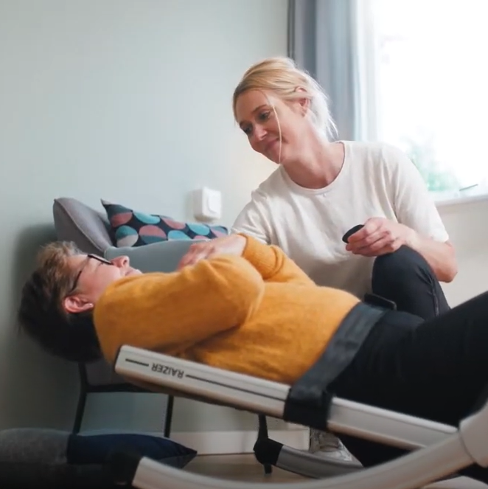
Raizer II chairs
Video: How the Raizer Chair
is improving falls outcomes
in local care homes
A chair that can be built around a person to lift them from the floor after a fall where there’s no injury – reducing the time spent on the floor to minimise discomfort and the need for ambulance assistance.
It is improving post-fall care in care homes by enabling quicker and safer recovery for residents. The scheme has been extended to domiciliary care providers to explore how it can enhance post-fall care.
175 chairs installed across 145 care locations
A single member of staff can lift quickly and safely
– optimising care staff time
Reduces reliance on the ambulance​ service
Improves resident safety, care​ and experience
Improves outcomes and quality of life​
Residents less likely to have health issues from the fall​ or to need a hospital stay.​
“Raizer is easy to use and kind to the person
who is being assisted by it. It’s possibly the
best piece of equipment to come into
the care sector for years.”
Dawn McGuire, Registered Manager,
Chase House Residential Nursing Care Home
We are not currently accepting new applications for this pilot

Slide 14
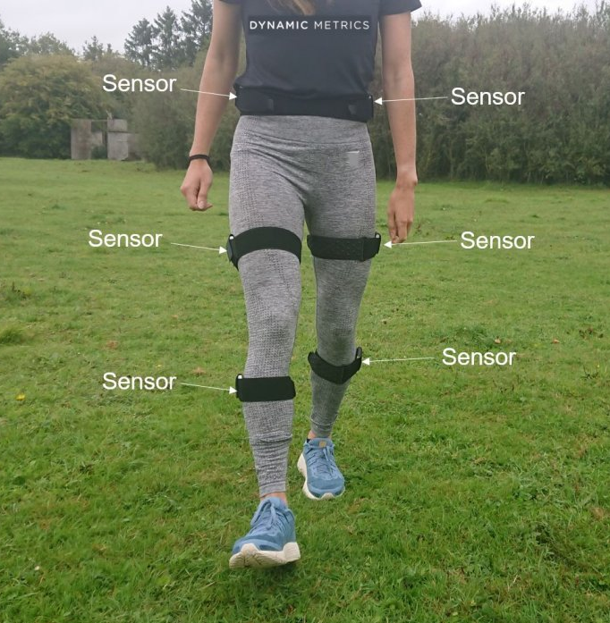
GaitSmart
Takes rapid, individual assessments of gait in patients at high risk of falls. After automatically comparing the results to ‘healthy’ gait profiles, GaitSmart generates a personalised exercise plan to improve gait, balance, and confidence.
By integrating this tool into care pathways, the aim is to reduce fall rates and enhance overall patient outcomes.
Quick and easy for trained staff to use in a range of settings
Records an individual’s movements over 10 to 15 steps using wireless sensors
The personalised report suggests exercises that can address strength, stability or balance issues
The test takes 10 minutes, can be carried out virtually anywhere, and is suitable for people using walking aids
Repeating the tests over a period of time can monitor changes in gait and effectiveness of treatment.
We are not currently accepting new applications for this pilot

Slide 15
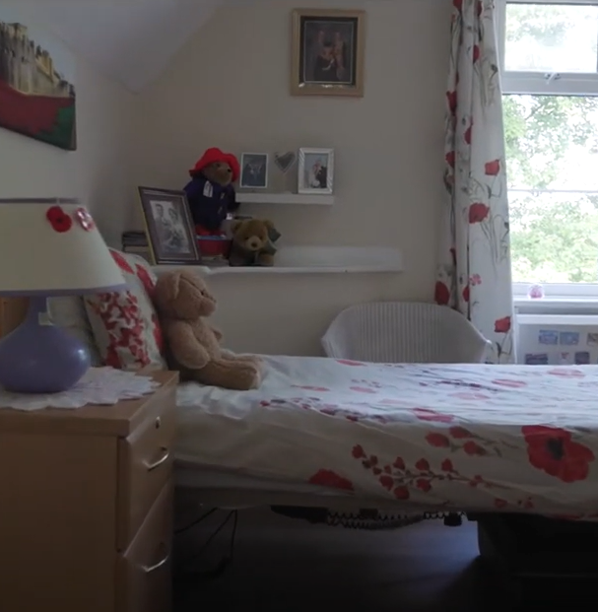
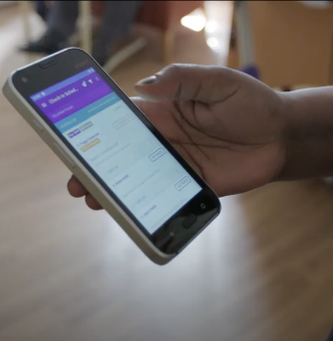

Acoustic Monitoring
Video: Elcombe House
Care Home’s story of
using Acoustic Monitoring
Acoustic monitoring is being piloted in BLMK care homes to enhance night-time care. By detecting potential falls and reducing disturbances, the technology aims to improve sleep quality for residents and optimise staff time. The device, which works by using Wi-Fi, can recognise sounds such as the person waking up, crying out, calling for help or being restless.
343 residents supported across 12 care homes
Staff don’t need to check on people as often, resulting in residents having fewer disturbances
and a better night’s sleep
The always-on device can alert staff to possible problems at any time, meaning a resident who needs help doesn’t have to wait until the next planned visit and is also less likely to have a fall
Provides extra reassurance for family and friends.
“Acoustic monitoring has been a great help
in ensuring the safety of the residents without disrupting their usual sleeping patterns.
It is easy to use and reduces the likelihood
of resident falls during the night.”
MK, Night Manager, Burlington Hall Care Home
We are not currently accepting new applications for this pilot

