Slide 1




BLMK ICS Digitising Social Care (DiSC) Programme
Whzan self-help guide
Email the team: blmkicb.digital.socialcare@nhs.net
Visit our DiSC webpages: https://blmkhealthandcarepartnership.org/our-priorities/
data-and-digital/digitising-social-care-disc-programme/

Slide 2
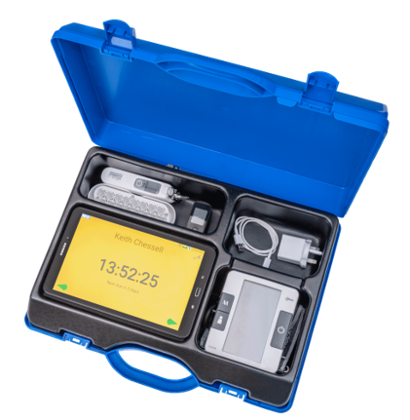

Whzan Blue Box
A user-friendly, digital health platform enabling remote patient monitoring.
Collects vital signs data and calculates early warning scores to help
healthcare professionals to identify patients at risk of deterioration.
Whzan is now supporting Discharge to Assess (D2A) beds and expanding to
home-based monitoring with domiciliary care providers. Integration with SystmOne is underway to enhance communication between care settings and primary care – enabling real-time information sharing for personalised care.
3,079
residents
supported across 90 homes
Staff can understand results easily and work more effectively
Detects health changes and deterioration earlier to reduce ambulance call-outs and hospital stays
Measures pulse, blood glucose, oxygen levels, blood pressure, respiratory rate and body temperature
​Authorised carers and GPs can access the ​latest readings through a secure portal – speeding up diagnosis and care.​
“Whzan speaks for residents who can’t talk. It’s a really useful tool for any care home to have and gives us the help we need for our residents much more quickly.”
Sylvester Mulenga, Senior Carer, Oasis House Residential Home

Slide 3
Getting set up
How do I get a Whzan blue box?
Please contact the team at blmkicb.digital.socialcare@nhs.net
Who supports with training?
Face-to-face training is given by a member of the BLMK DiSC team on-site, which usually takes around 3-4 hours. We will arrange a training date with the care provider.
Online training can be carried out afterwards, and resources are also available on the Whzan website: www.whzan.uk/media-centre/categories/videos
Note: Training from BLMK ICS does not include clinical training. Care providers should follow their own escalation procedure if a resident is unwell following results from the Whzan kit.
Do I need WiFi?
No. Some of our kits have a sim included within the kit, however others will require a sim card which can be purchased from any local supermarket.

Slide 4
Further questions
What happens if equipment within my kit is no longer working?
In the first instance, please contact the team at blmkicb.digital.socialcare@nhs.net
How do I renew my licence? Will there be a cost?
Please contact the team at blmkicb.digital.socialcare@nhs.net
Currently there is no charge to renew the licence. However, depending on future funding, this would usually cost £400 for 12 months.
What if I no longer want my Whzan blue box?
Please contact the team at blmkicb.digital.socialcare@nhs.net who will reply to arrange collection of the Whzan kit.
How do I get re-training?
Support including videos of troubleshooting can be found on Whzan’s website: www.whzan.uk/media-centre/categories/videos

Slide 5
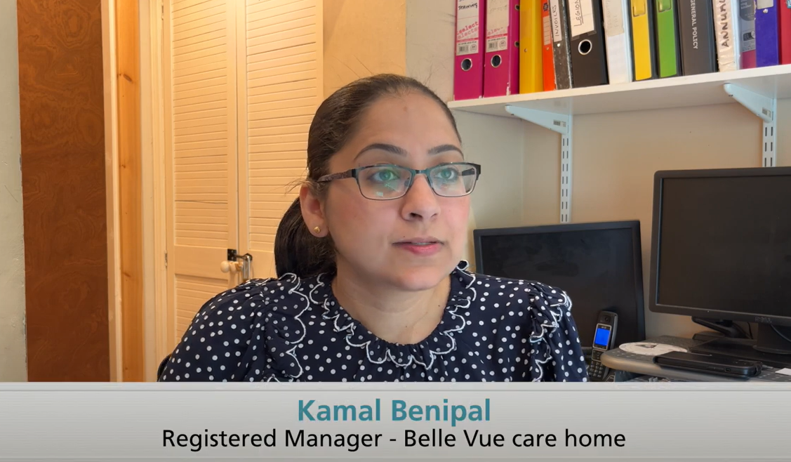
Find out more
Visit Whzan’s website: www.whzan.com
View a local case study: www.blmkhealthandcarepartnership.org/90-local-care-homes-are-using-remote-monitoring-toolkits-to-reduce-hospital-admissions
Watch a video of local care home staff and a GP who use Whzan: http://youtu.be/A2TumjdVYNE

