Slide 1




BLMK ICS Digitising Social Care (DiSC) Programme
PainChek self-help guide
Email the team: blmkicb.digital.socialcare@nhs.net
Visit our DiSC webpages: https://blmkhealthandcarepartnership.org/our-priorities/
data-and-digital/digitising-social-care-disc-programme/

Slide 2
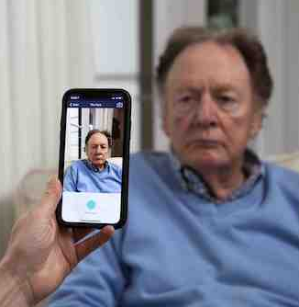

PainChek
Innovative pain management technology to improve the care of residents, especially those with communication difficulties or learning disabilities. PainChek uses artificial intelligence to measure small changes in facial expressions and voice to quantify a pain score – guiding carers to provide the right support.
BLMK pilot underway to enable around 1,000 residents to benefit from PainChek
Reliably detects pain in those who may be unable to verbalise it, such as those living with dementia or other cognitive impairment
Reduces levels of pain, insomnia, stress, distress and mobility
Ensures medications are used appropriately
Reduces hospital admissions and falls
Encourages greater independence through activity
and exercising new skills in a supportive environment
Improves self-confidence of staff in managing pain.
“PainChek supports the gathering of information to better support our residents.
The information is easy to access and track… It’s a good tool to work alongside the GP
for pain management.”
Louise Norris, Deputy Home Manager,
Oak Manor Care Home

Slide 3
Getting started
What device do I use the PainChek app on?
The PainChek app can only be used on hand-held devices purchased through your workplace. It cannot be used on personal devices.
How much will it cost?
Costs are covered for the duration of the project.
Please contact blmkicb.digital.socialcare@nhs.net for information about ongoing costs.
What initial support is given?
Face-to-face training is given during the first installation.
Online training can also be offered after the initial face-to-face training – see the next page.

Slide 4
Training and support
How do I update my PainChek profile?
You can view and update information including your name, phone number, job title and profile picture in the profile settings screen. For step-by-step guidance on this, please visit https://support.painchek.com/hc/en-us/articles/8001632525711-Updating-your-PainChek-Profile
What happens if the app stops working?
For support and troubleshooting, please contact PainChek through their online enquiry form https://www.painchek.com/uk/contact-us
Can I access online learning?
Please visit the PainChek Academy at https://painchek.learnworlds.com
How do I get training for a new member of staff?
Contact the team at blmkicb.digital.socialcare@nhs.net to arrange this.

Slide 5
Further questions
How does my Digital Social Care Record (DSCR) integrate with PainChek?
For an overview of the PainChek/AutumnCare Integration, visit https://support.painchek.com/hc/en-us/articles/6249360678927-PainChek-AutumnCare-Integration-Overview
How do I renew my licence?
Please contact the team at blmkicb.digital.socialcare@nhs.net
What if I no longer want PainChek?
Please contact the team at blmkicb.digital.socialcare@nhs.net who will reply to discuss.

Slide 6
Find out more
Visit PainChek’s website: www.painchek.co.uk
Read a good news story from local care homes already using PainChek: www.blmkhealthandcarepartnership.org/facial-recognition-technology-improves-pain-management-in-local-care-homes/

