Slide 1




BLMK ICS Digitising Social Care (DiSC) Programme
RoboPets self-help guide
Email the team: blmkicb.digital.socialcare@nhs.net
Visit our DiSC webpages: https://blmkhealthandcarepartnership.org/our-priorities/
data-and-digital/digitising-social-care-disc-programme/
Version 1.1 Date 31/01/25

Slide 2
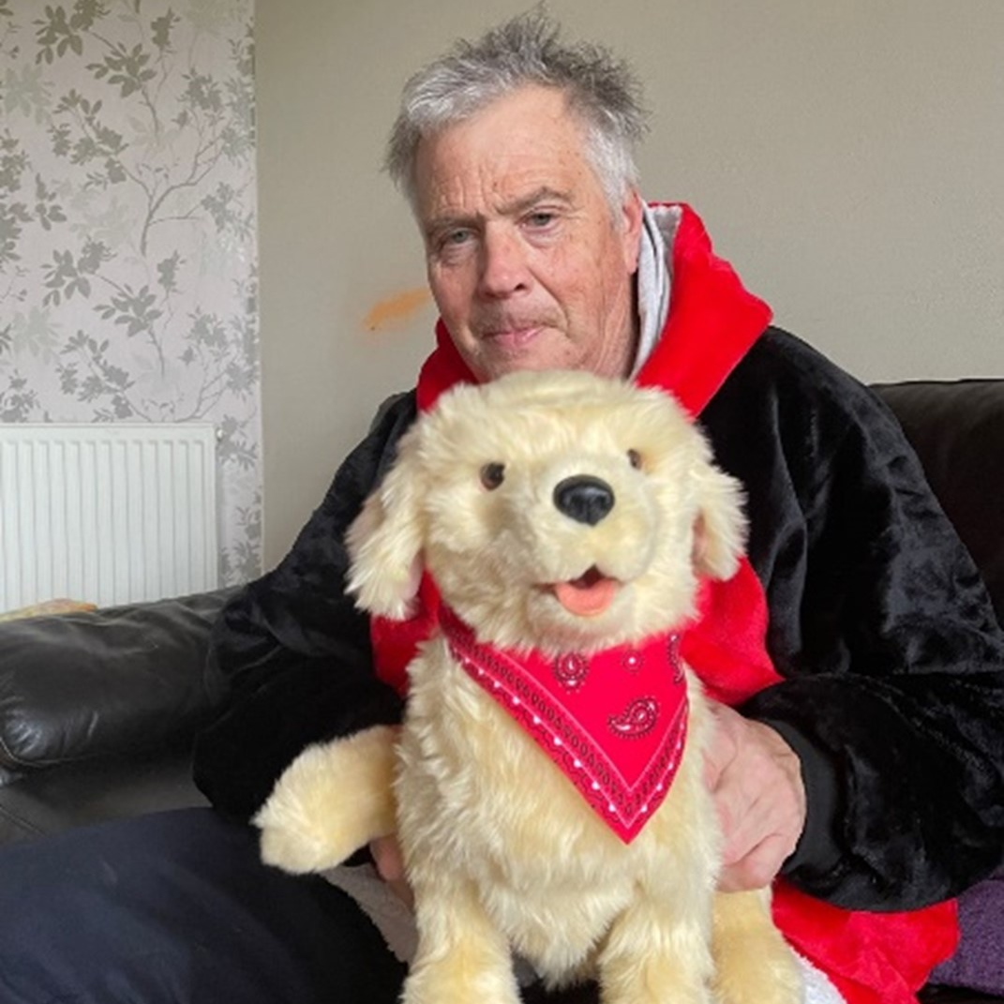


RoboPets
Robotic cats, dogs and birds which use technology to respond to sound and touch, and interact through realistic movements. A unique and beneficial approach to companionship and therapy, especially for individuals with specific needs.
As of February 2025, 484 devices have been delivered to 56 different care locations
Provides a calming influence to reduce anxiety and agitation
Improves mental health and wellbeing, and quality of life
Gives people greater independence and confidence
Provides comfort to reduce feelings of isolation and loneliness
Aids communication between the cared-for person and their carer.
Aimed at adults living independently (with support of informal carers) in receipt of domiciliary care or those within care homes who will be selected based on the following characteristics: living with / experiencing behaviour that challenges, cognitive impairment, communication difficulty, dementia, and low mood / anxiety.
Visit our webpage to read more about this pilot
and complete an
Expression of Interest form

Slide 3
About this project
Who is funding the project and why?
The project is funded by NHS England through their Adult Social Care Technology Fund.
The aim is to understand the acceptability, usability, cost-effectiveness and impacts as the technologies are implemented and adopted – to inform the development of an evidence-based plan for scale and spread across Bedfordshire, Luton and Milton Keynes.
Who is delivering this project?
Bedfordshire, Luton and Milton Keynes Integrated Care System’s (BLMK ICS) Digitising Social Care (DiSC) programme in partnership with the University of Hertfordshire and Health Innovation East.
Researchers from the University of Hertfordshire will evaluate the impact of introducing RoboPets in different adult social care settings to support older people, including those living with dementia, and their carers – including informal carers (i.e. families and friends in unpaid caring roles.
The study will run from April 2025 to March 2026.

Slide 4
How the project will work
What does participation in the project involve?
The management of the care setting will be offered a range of RoboPet models (i.e. cats, dogs and birds) in a variety of colours, so will need to specify the number, type and colours of the devices that will meet the needs of the adults in their care. The project seeks to evaluate the impact of a RoboPet upon the care of the individual to who the device is allocated; ‘communal/shared’ use of a pet is not within the scope of the study. Therefore, in a residential care setting each RoboPet will need to remain in the cared-for person’s room.
Care settings will also be offered the option of a ‘demo’ RoboPet. This device would not be allocated to a specific adult, but can instead be used on a trial basis by staff to help determine if a cared for person will benefit from a RoboPet ‘of their own’.
Participating care settings will be invited to give feedback to the project team on the impact that the devices have on delivery of care.
The implementation of RoboPets will be monitored for a year. At the end of the year, the RoboPets do not need to be returned and can stay with the care setting – although maintenance will be the responsibility of the care provider.

Slide 5
Responsibilities of participants
Pre-deployment
Collaboration: Work with the Project Manager to assess resident/service user needs and preferences to determine suitability for RoboPets.
Resident/service user selection: Participate in selecting residents/service users who might benefit most from RoboPet companionship, considering factors like emotional wellbeing, social isolation, and cognitive abilities.
Informed consent: Obtain informed consent from residents/service users and/or their families before introducing RoboPets.
Training: Access training materials provided by the Project Manager to learn about RoboPet functionalities, proper use, care, troubleshooting, and safety protocols.

Slide 6
Responsibilities of participants
Deployment
Setup and integration: Assist with the initial setup of RoboPets with the resident/service user and help personalise the device according to their user preferences.
Guidance and support: Provide guidance and support to the user as they interact with the RoboPet. This may include showing basic functions and addressing any anxieties they might encounter.
Monitoring and observation: Monitor the individual’s interactions with their RoboPet and observe their emotional / behavioural responses. Report any concerns or potential issues to the Project Manager.
Ongoing support: Support individuals to use their RoboPets and address any questions or difficulties they might have.
Reallocation: The Project Manager must be advised if a RoboPet is allocated to a different person from the one who the device was originally assigned to, as this will impact the evaluation data. This may be necessary in the event of rejection by the original individual, or if they move to a new setting or pass away. Before a RoboPet is reallocated, it must be properly cleaned and disinfected.
Resident/service user advocacy: Advocate for individuals who may not be comfortable or benefit from RoboPets.

Slide 7
Responsibilities of participants
Maintenance
Change batteries: The RoboPets are powered by disposable batteries (4 x Type ‘C’ for cats and dogs, and 3 x Type ‘AAA’ for birds). The cost and time necessary to replace the batteries is the responsibility of the care setting.
Infection control: Ensure proper cleaning and disinfection according to established protocols. To clean the fur, use a damp cloth or sanitizer wipes and a spray. Do not get the devices soaking wet due to the inner workings. Using a real cat brush with metal teeth will bring the fur back up fluffy.
Safety supervision: Supervise the individual’s interactions with their RoboPet to prevent any potential safety hazards (e.g. tripping hazards, malfunctioning equipment).
Data collection and feedback
Participate in data collection efforts by recording observations on engagement and wellbeing changes potentially linked to RoboPet use. Where asked to do so, participate in the collection of Adult Social Care Outcome Tool (ASCOT) data. Participate in the evaluation process.
Provide regular feedback to the Project Manager on the effectiveness of the RoboPet project, including user experiences and suggestions for improvement.

Slide 8
Training and support
What training and support will care staff receive on the use of these devices?
We have produced an instructional introductory video giving an overview of the different RoboPet models and their features, maintenance, cleaning and advice on usage.
Other support materials are available on the Enhanced Wellbeing through Digital webpage
on the BLMK website.
General enquiries should be sent to blmkicb.digital.socialcare@nhs.net.
How are RoboPets powered?
The RoboPets are powered by disposable batteries which come installed in each device.
These batteries are either of the ‘C’ or ‘AAA’ type, depending upon the model of RoboPet.
Once these batteries are depleted, it will be the responsibility of the care setting to replace these.
The battery compartment for each device is accessed by removing a small Phillips screw in the base of the device.

Slide 9
Project evaluation
How will success be measured and what will success look like?
The University of Hertfordshire will evaluate the impact of introducing RoboPets in different adult social care settings. They will adopt a mixed methods study comprising rapid evidence and document reviews, stakeholder workshops, qualitative research, and quantitative and cost consequence analysis. One key data collection method will be a survey called Adult Social Care Outcome Tool (ASCOT) to assess the quality of life of service users who are in receipt of the technology.
The evaluation will explore outcomes including: increase in effective prescribing, improvements in service user experience and quality of life, variation in hospital admission and safeguarding incidents, acceptability and useability of technology, improvement in staff experience, and reduction in carer burden. Please note this is not a clinical trial.
How will the outcomes of the project be communicated?
Final reports of the evaluation findings will be made available to all project participants.
Workshops to share findings and discuss potential recommendations will also be held for key stakeholders in March 2025 and January 2026.

Slide 10
Further questions
Can I request an additional or different RoboPet after the project starts?
In principle yes, provided that the project team have surplus available. Please contact the Digitising Social Care (DiSC) programme team on blmkicb.digital.socialcare@nhs.net
Do RoboPets use Artificial intelligence (AI) technology?
No, the devices do not capture, process or share data.
What happens to the RoboPet at the end of the project?
The RoboPets are provided free of charge to the care setting for the duration of the study.
Once the study has completed, the care home may either retain the RoboPets for continued use or may choose to dispose of the devices.

Slide 11

Find out more
We have produced an instructional introductory video giving an overview of the different RoboPet models and their features, maintenance, cleaning and advice on usage.
Other support materials are available on the Enhanced Wellbeing through Digital webpage on the BLMK website – scroll down to the RoboPets section.
General enquiries should be sent to blmkicb.digital.socialcare@nhs.net.

